Slide 1


Study on the cumulative economic impact of trade agreements on EU agriculture
- 2021 update
Presentation to EP’s Agriculture Committee
Videoconference - 26 January 2021

Slide 2

Content of the presentation
What is the study about?
  Methodology
  Trade Scenarios
  Main assumptions & caveats
Results
Conclusions

Slide 3

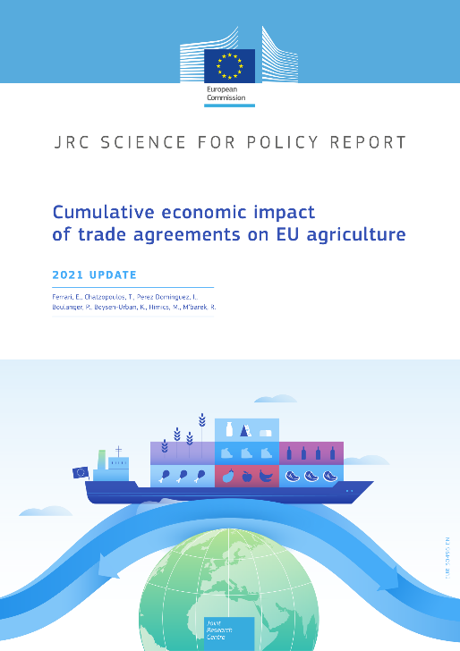
What is the study about?

Slide 4
What is the study about?
Analysis of economic effects on EU-27 agriculture of most significant free trade agreements:
recently concluded or entered into force: Canada, Japan, Vietnam, Mexico, Mercosur
under negotiation or possibly envisaged: Australia, New Zealand, Thailand, Philippines, Indonesia, Malaysia, Chile
Compare prospects for 2030 with cumulative free trade agreements and without agreements (= baseline)
Similar assumptions and methodology compared to the 2016 study with some significant changes

Slide 5

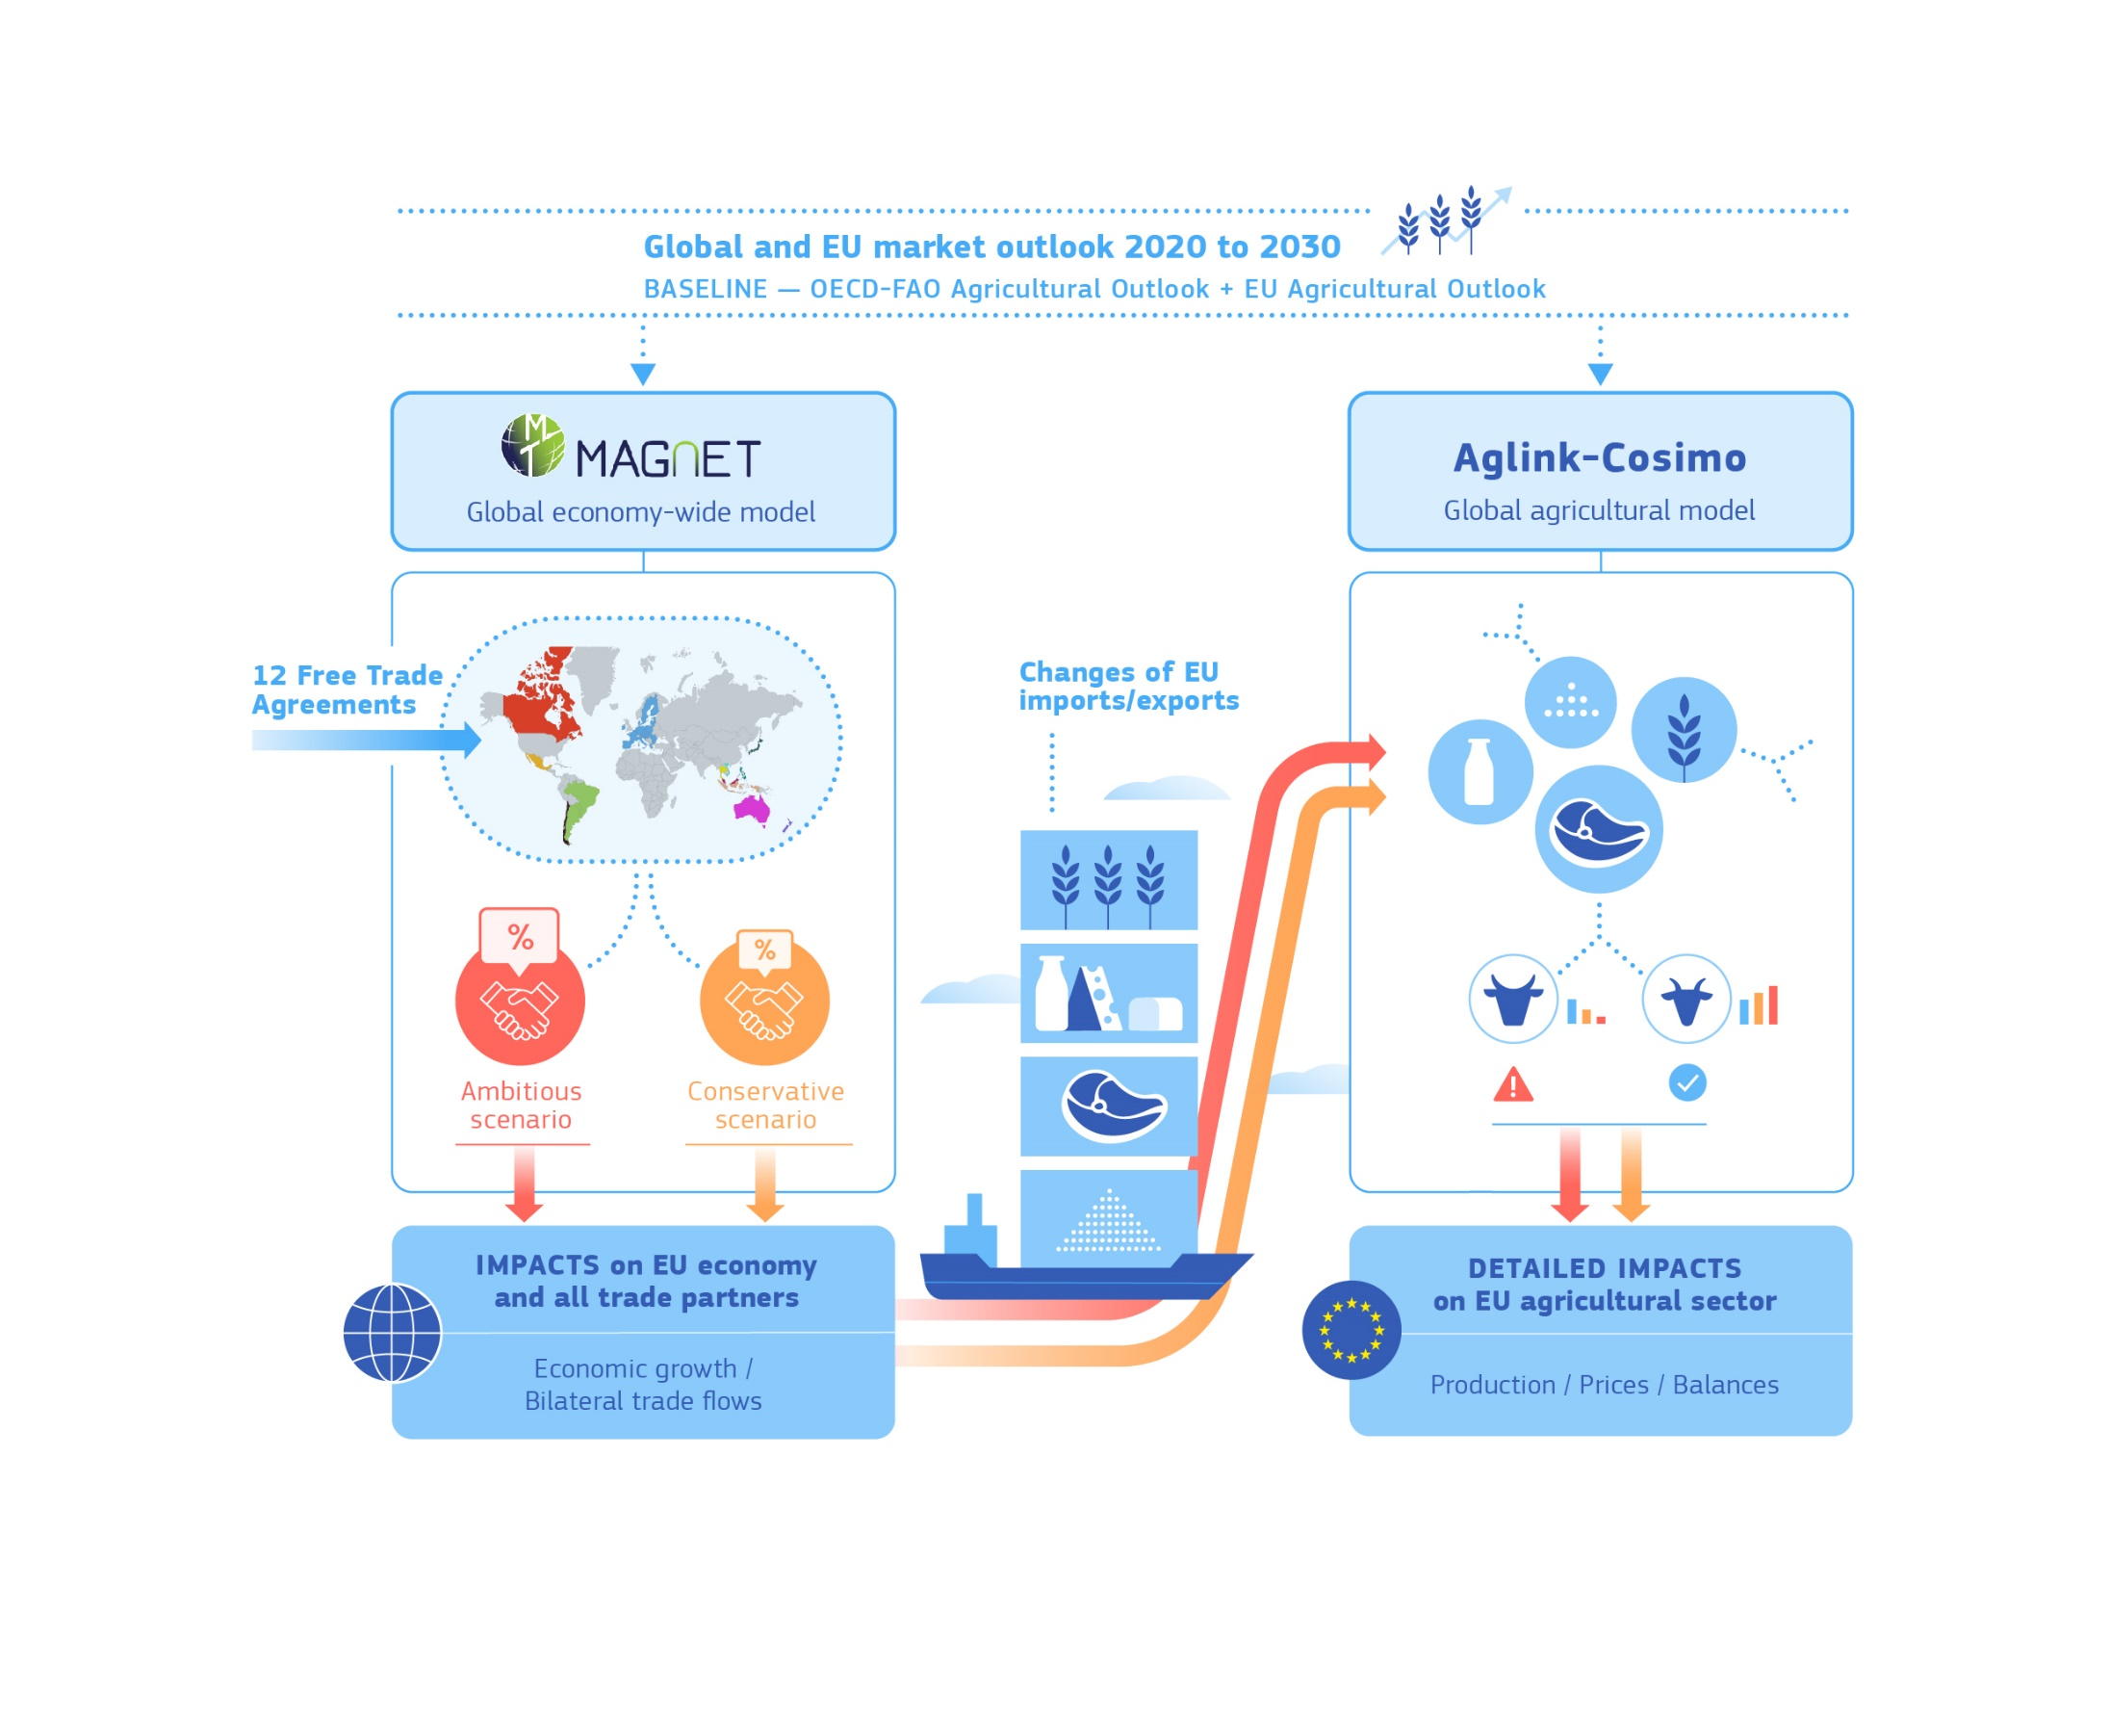

Methodology
1.
2.

Slide 6
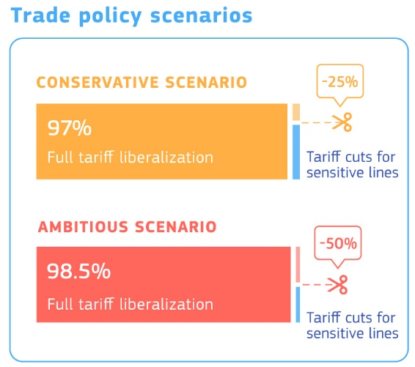
Trade scenarios
Conservative:
  Concluded agreements: as per negotiated outcome (tariff cuts + TRQs)
  Other agreements: 97% of tariff lines fully liberalised; other (sensitive) lines get a 25% tariff cut
Ambitious:
  Concluded agreements: same as for conservative
  Other agreements: 98.5% of tariff lines fully liberalised; other (sensitive) lines get a 50% tariff cut

Slide 7
Main assumptions and caveats
Future EU-UK relationship:
  Duty Free / Quota Free trade assumption after 2020 (friction not modelled)
  Apportioned WTO TRQs
  UK with same level of MFN tariffs + rolling over “old” EU FTAs
COVID-19 not considered; Green Deal / Farm to Fork not implemented
No analysis of non-tariff barriers (e.g. SPS) nor impact of protecting GIs
EU-27 aggregated results, no national or regional disaggregation
Detailed impact for only the main agricultural sectors

Slide 8

Results

Slide 9
Overall trade impacts
+5 465 [+3.3%]
+4 688 [+2.8%]
+777 [+1.4%]
+1 006 [+1.8%]
+3 682 [+3.3%]
+4 688 [+4.2%]

Slide 10
Overall results by sector

Slide 11
Detailed results by sectors: EU exports

Slide 12
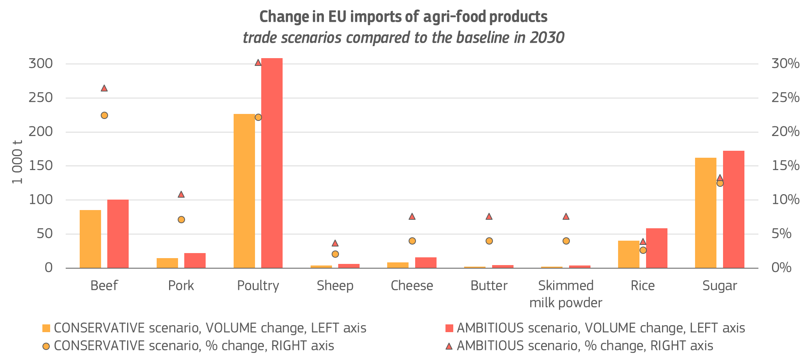
Detailed results by sectors: EU imports

Slide 13
Detailed results by sectors: prices and production

Slide 14

Conclusion

Slide 15
Conclusions
The study confirms that the EU agricultural sector can benefit from the EU trade agenda.
It justifies the existing approach taken by the Commission for the agricultural chapters in trade negotiations (incl. keeping a firm line and balance when it comes to market access for sensitive products).
TRQs are an appropriate tool to balance market access for sensitive products while limiting negative impacts on the sector concerned.
An ambitious future CAP, supporting innovation & competitiveness of the EU farming sector, plus better GIs protection and tackling of SPS barriers can also limit negative impacts while reinforcing the positive ones.

