Slide 1

Maryland Revenue Estimates
Board of Revenue Estimates
March 2021
Andrew Schaufele
Executive Secretary
Board of Revenue Estimates

Slide 2
High Level Comparison (Mar21 to Dec20)
March Estimates Versus December Estimates
Tax Type | Fiscal Year 2021 | Fiscal Year 2022
Personal Income Tax | $225.6 | $346.9
Corporate Income Tax | 73.6 | 62.5
Sales Tax | 75.1 | 62.7
Lottery | 23.6 | 1.1
Other | 26.1 | 0.0
Subtotal: Ongoing Revenues | 424.0 | 473.3
2021 Session Impacts | (424.8) | (174.7)
Total: Net General Fund | (0.8) | 298.6
Notes: dollars in millions; amounts may not sum from rounding

Slide 3
High Level Comparison (Mar21 to Mar20)
Estimates Versus Last Pre-Covid Estimate
Tax Type | Fiscal Year 2021 | Fiscal Year 2022
Personal Income Tax | $38.7 | $233.0
Corporate Income Tax | 41.5 | 56.1
Sales Tax | (265.4) | (153.1)
Lottery | 65.5 | 17.1
Other | (65.1) | 7.9
Subtotal: Ongoing Revenues | (184.8) | 161.1
2021 Session Impacts | (424.8) | (174.7)
Total: Net General Fund | (609.6) | (13.6)
Notes: dollars in millions; amounts may not sum from rounding; Mar20 estimate adj for 2020 Session

Slide 4
What Has Changed Since December?
Consolidated Appropriations Act – 12/27/2020; significant measures:
  $600 stimulus checks; estimated $2.5 billion to 75% of all MD households
  Extended federal UI benefits; estimated $2.2 billion to MD residents (expire 3/14)
  Expanded & altered PPP
  EITC lookback provision & multiple other tax provisions
American Rescue Plan Act of 2021 – under consideration; significant measures:
  $1,400 stimulus checks; estimated $5.7 billion to 75% of all MD households
  Extended federal UI benefits; estimated up to $3.9 billion to MD residents
  Many tax changes, incl child tax credit and EIC (impact not yet determined, but potentially significant)
  Major state and local government funding; estimated up to $8 billion for Maryland governments
  Expansion and targeting of PPP program to smaller employers

Slide 5
What Has Changed Since December? (continued)
Increased confidence in vaccine efficacy and timeframe
Late-fall/winter COVID case rates abating
Tax collections “survived” winter at approximate expectations
Certain tax collections from non-corporate businesses increase confidence in aggregate profitability

Slide 6
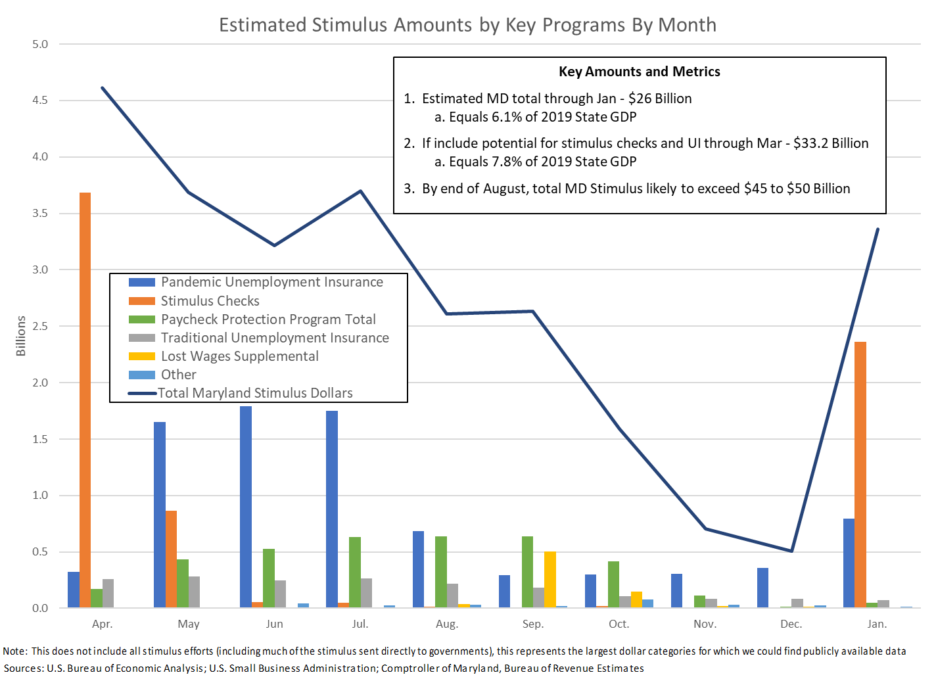

Slide 7
Changes to Economic Assumptions Since December
Extraordinary increase in government assistance from multiple stimulus programs
Moderate acceleration of employment and wage base recovery
Significant revision to proprietor’s income (proxy for non-corporate business income)
  Tax Year 2020 growth: from -1.5% to +4.0%
  Tax Year 2021 growth: from +5.0% to +7.1%

Slide 8
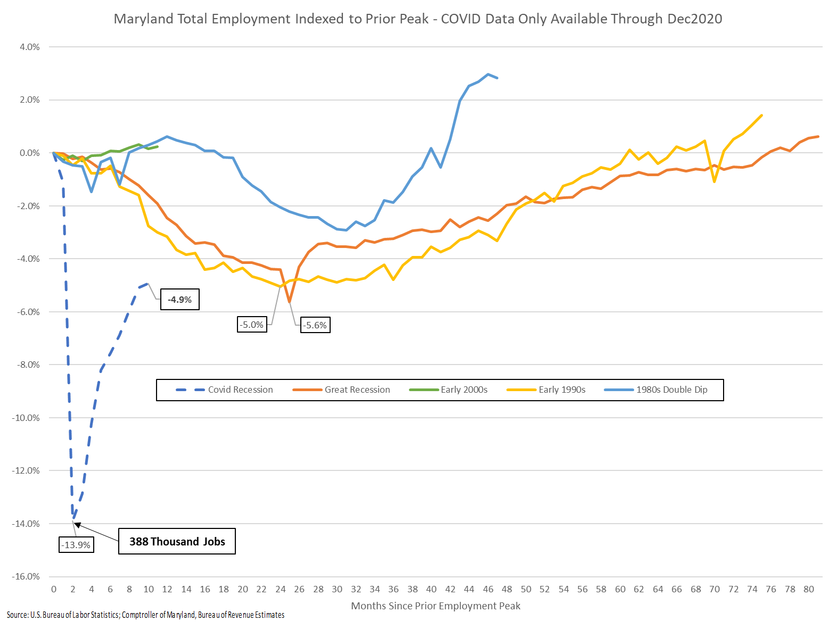

Slide 9
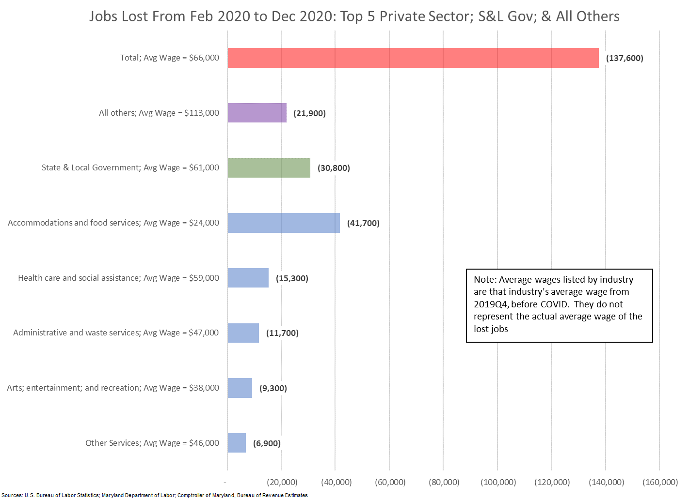

Slide 10
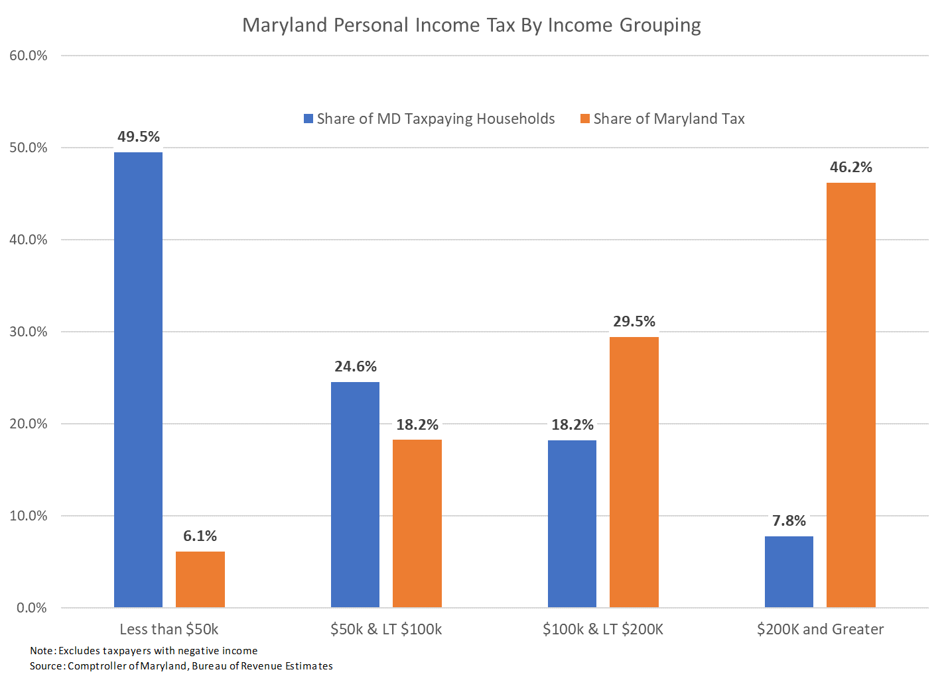
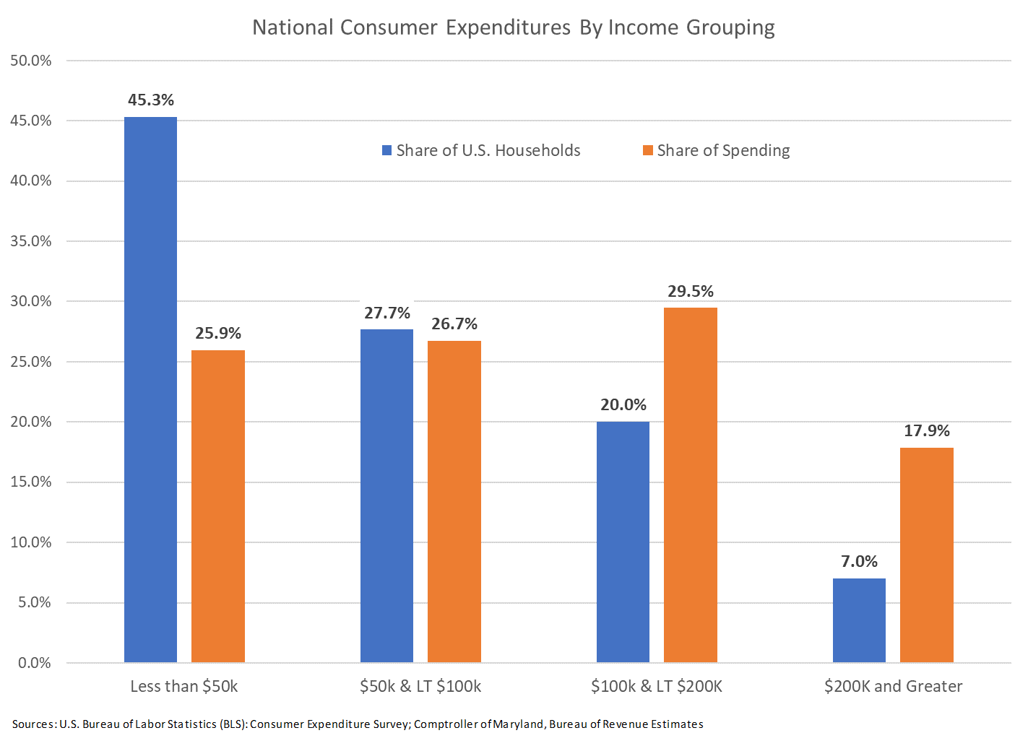
Tax Base Structure Limits COVID Revenue Impact
Income Tax is 50% of all general fund revenues
Sales Tax is 25% of all general fund revenues
  Further mitigated by expenditure mix – lower income households spend larger shares of their incomes on items not taxable in Maryland

Slide 11
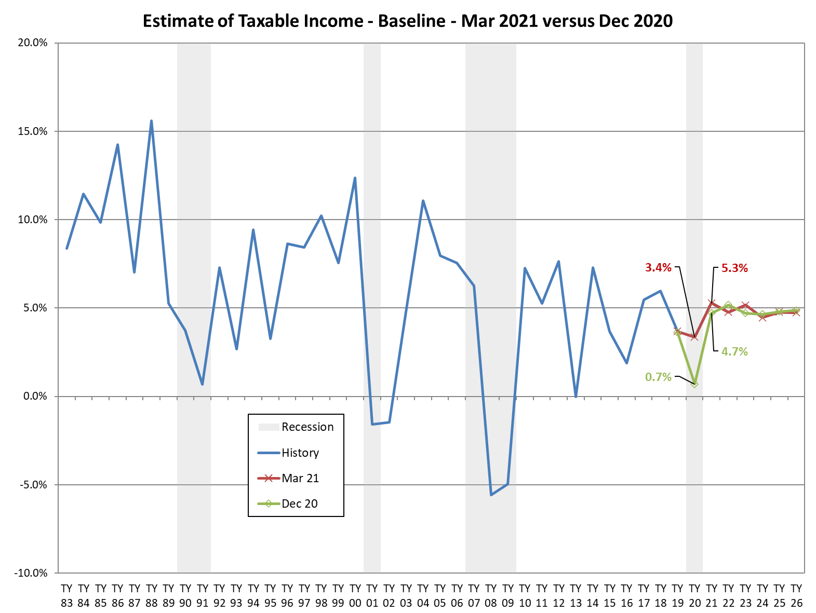
Income Tax Estimate By Tax Year (excl rate and law changes)

Slide 12
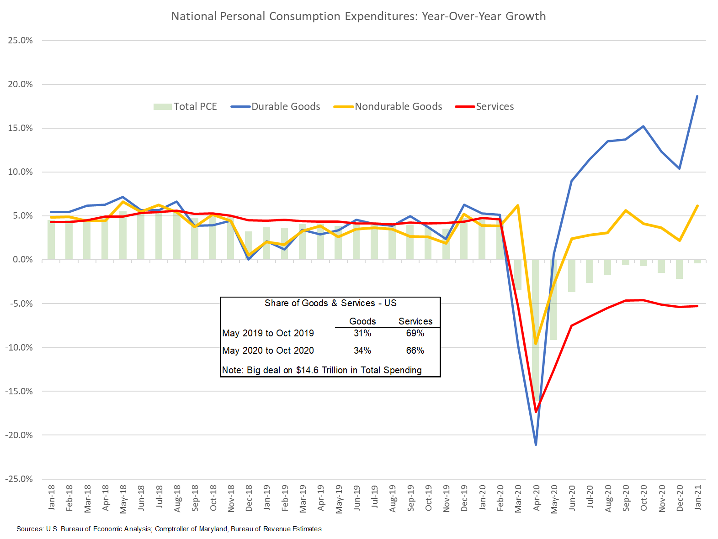
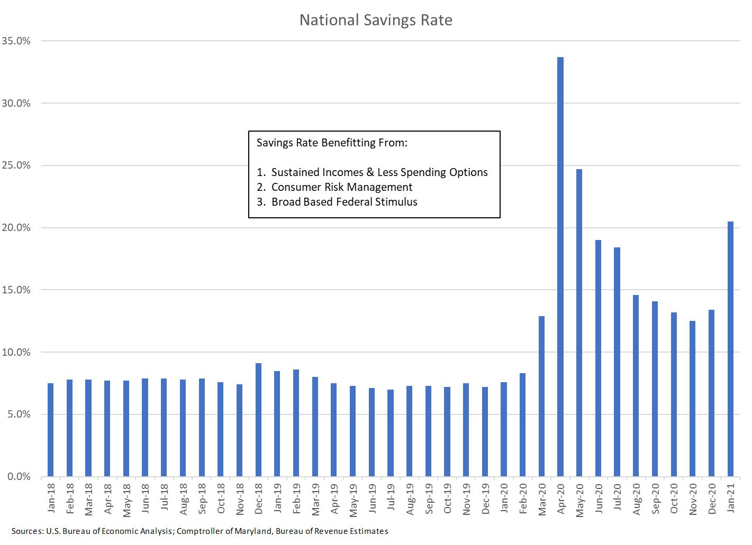
Sales Tax – Near Term Impacts & Uncertainties
Near term sales tax is benefitting from composition of expenditures
General fund benefits for short period as brick-&-mortar share semi-recovers
Timing of brick-&-mortar semi-recovery is uncertain
What happens to extraordinary savings after widespread vaccination?

Slide 13
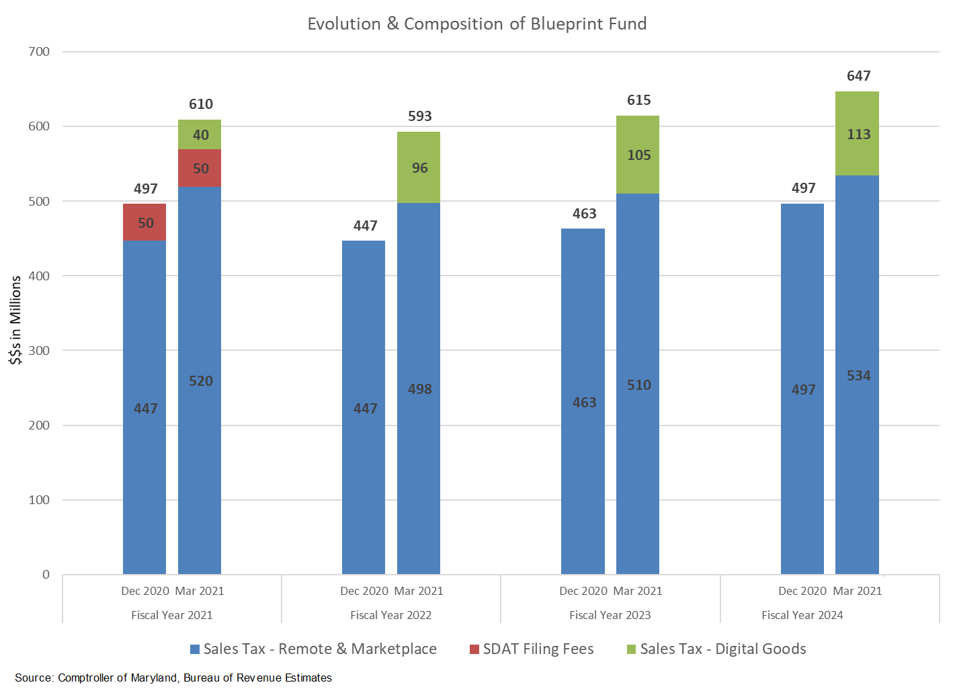
Sales Tax: Blueprint Continues to Surge

Slide 14
Discussion of Risk in the Outlook
STATEMENT: Highly confident in current year and budget year, but risks seem more elevated than usual in the six-year forecast window
Markets and Financial Risk
This level of stimulus is unprecedented
Economists and financiers are currently debating the prospects of short-term inflation, long-term inflation, and regular inflation
The stock and bond markets are clearly uncertain regarding the outlook
Could have impacts on growth potential as well as capital gains
Virus Risk
Proper to assume virus levels abating but premature to declare absolute victory
Some seem unwilling to get vaccinated – size of this population is uncertain
Variants already exist and there has not been enough time to study related vaccine impacts and whether they enable reinfection
Partial population vaccination could result in further mutations

Slide 15
Thank You
Andrew Schaufele
Comptroller of Maryland
Director, Bureau of Revenue Estimates
aschaufele@comp.state.md.us

