Slide 1
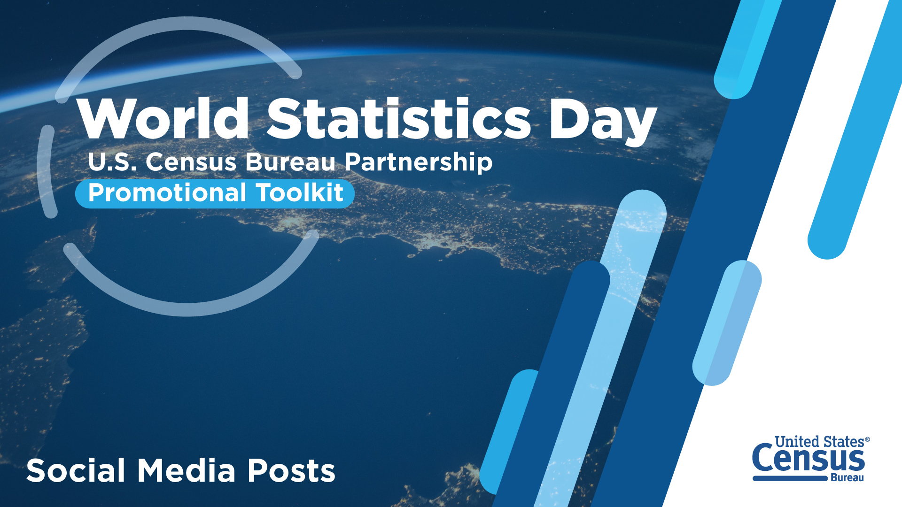

Slide 2

Purpose
The U.S. Census Bureau is celebrating World Statistics Day 2020 by highlighting the data innovations that empower the world.
This toolkit includes promotional materials for partners to utilize on their social media channels to further promote the World Statistics Day 2020 campaign.
We look forward to celebrating this monumental day together.

Slide 3
Social Media Post Sample Messages
October 20, 2020 is #WorldStatisticsDay. Celebrate the impactful stats and innovative data solutions that drive decision-making with the @USCensusBureau. Explore #DataTools on the #WorldStatsDay page: census.gov/WSD2020 #StatsDay2020
Every 5 years, #WorldStatisticsDay is celebrated around the world to recognize the value of statistical systems.
Head to census.gov/WSD2020 to learn about how the @USCensusBureau is celebrating #StatsDay2020.
Innovation fuels data solutions at the @USCensusBureau. Celebrate #WorldStatsDay by exploring all the innovative data resources that drive decision-making every day: census.gov/WSD2020 #StatsDay2020
As the world evolves, so does its data needs. This #WorldStatisticsDay, explore the innovative data solutions the @USCensusBureau has developed to continue crafting our society’s story. Explore #DataTools on the #WorldStatsDay page: census.gov/WSD2020 #StatsDay2020
NOTE: The WSD web page (census.gov/WSD2020) is scheduled to launch on Friday, Oct. 16th. Promotion of the page should not begin before this date.

Slide 4
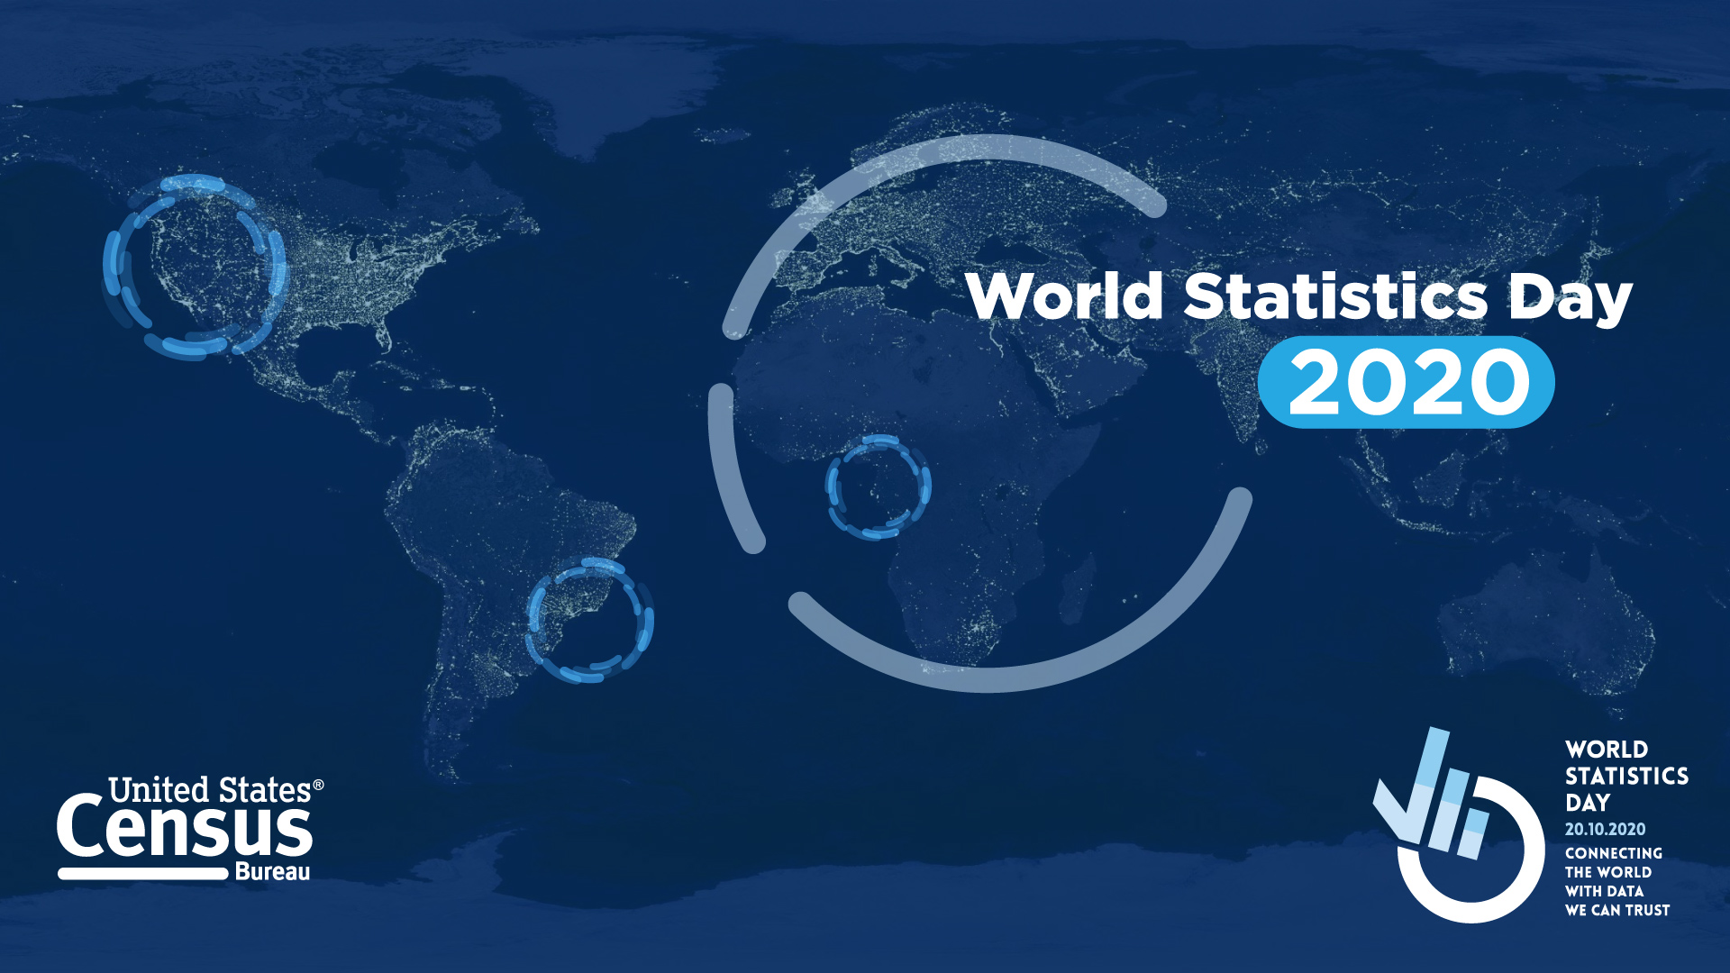
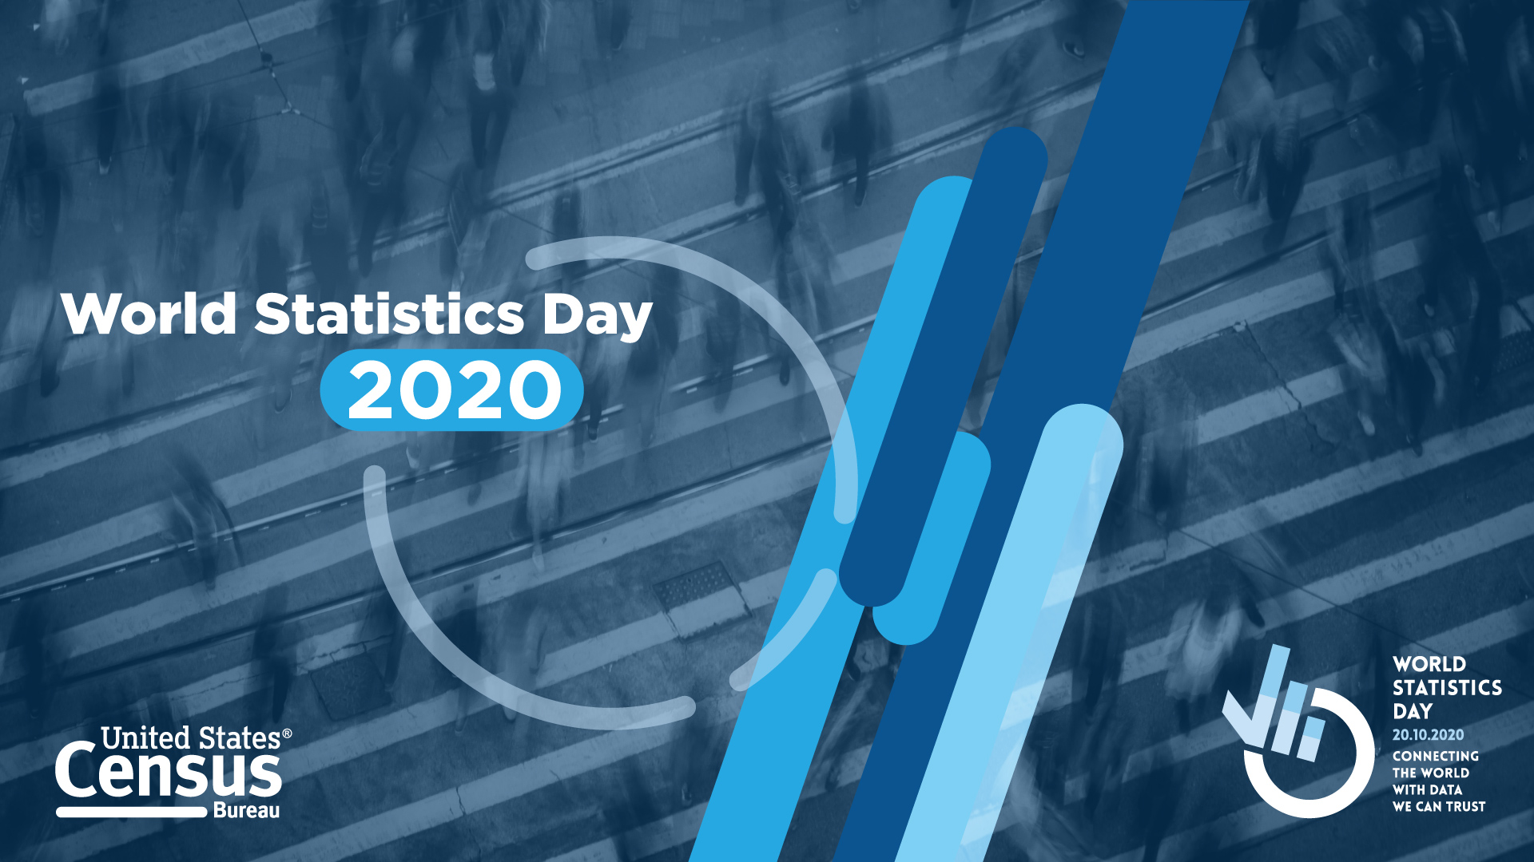
Social Media Post Sample Graphics
Graphic 1
Graphic 2

