Slide 1
Revenue ESTIMATES And ECONOMIC OUTLOOK
September 29, 2022
Robert J. Rehrmann
Chief
Board of Revenue Estimates

Slide 2
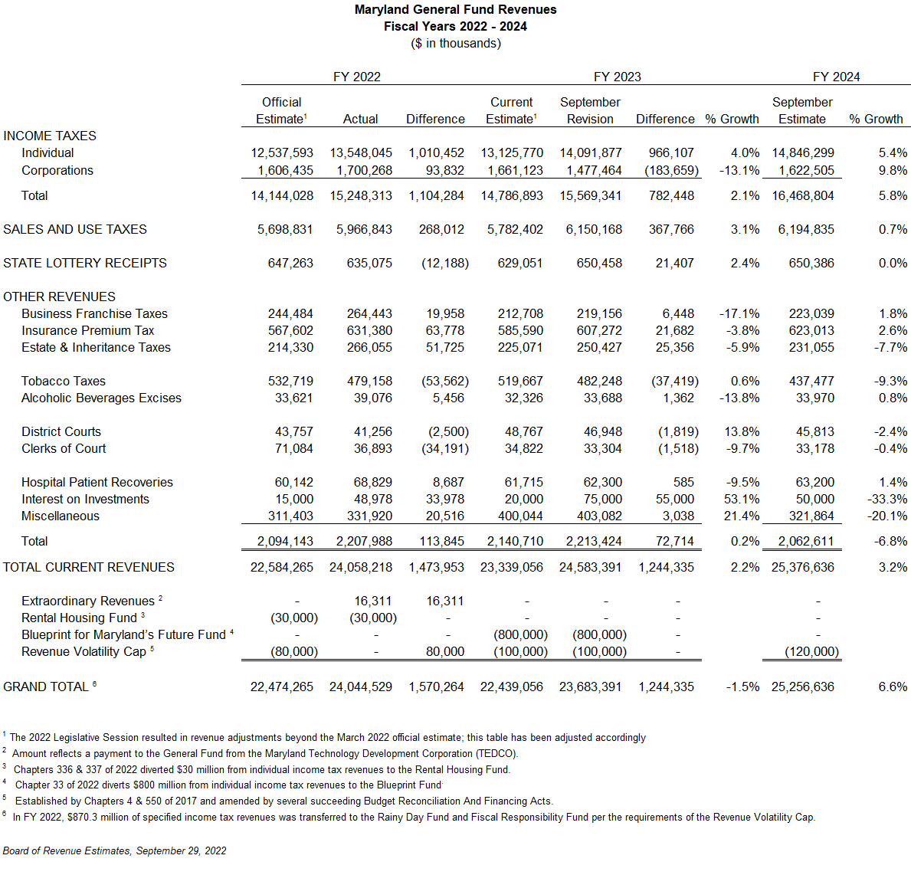

Slide 3
Summary of September Changes
 |  | Fiscal Year 2022 | Fiscal Year 2022 |  | Fiscal Year 2023 |  |  | Fiscal Year 2024
 |  | $ Change From Est | % Growth From Prior Year |  | $ Change From Est | % Growth From Prior Year |  | $ Change From Est | % Growth From Prior Year
Personal Income Tax |  | $1,010 | 15.7% |  | $966 | 4.0% |  | $837 | 5.4%
Corporate Income Tax |  | $94 | 16.3% |  | ($184) | -13.1% |  | ($41) | 9.8%
Sales Tax |  | $268 | 19.6% |  | $368 | 3.1% |  | $380 | 0.7%
Other |  | $198 | 5.7% |  | $94 | -30.6% |  | $30 | 32.0%
Total |  | $1,570 | 15.4% |  | $1,244 | -1.5% |  | $1,205 | 6.6%
Notes: dollars in millions; amounts may not sum from rounding; Mar22 estimate adj for 2022 Session

Slide 4
Revenue Growth is Expected to Moderate

Slide 5
Distribution of Sales Tax Revenues

Slide 6
Forecast Assumptions and Risks
Recent above average revenue growth mainly reflected the impact of federal stimulus and is not expected to continue
Forecast is largely consistent with March forecast, but slower economic growth primarily in fiscal 2023
Federal Reserve reduces inflation without causing a recession
Volatile income sources that have recently increased may work against us if economic conditions deteriorate

Slide 7
Federal Economic Policy Has Recently Shifted
Federal Reserve has shifted its focus from supporting the economy to reducing inflation
Benchmark interest rate has increased five times since March 2022 and are increases are expected to continue
Goal is to engineer a “soft landing” – reducing inflation without causing substantial harm to the economy and labor market
Federal Reserve stated its strong commitment to bringing inflation down to 2% and doing so will likely require a period of below-trend economic growth
We are too early in this process to know if the Federal Reserve can reduce inflation without causing a recession.

Slide 8
Impact of Fiscal Stimulus is Fading

Slide 10
State Revenues and Labor Market Growth is Moderating but not Declining
Consumer spending has held up while the labor market continues to add jobs and is returning to pre-pandemic levels
BRE is carefully monitoring economic data revenues sources for signs of weakening
Uncertainty over the economic outlook has increased but economic data and State revenue data do not at present indicate a broad-based slowdown

Slide 11
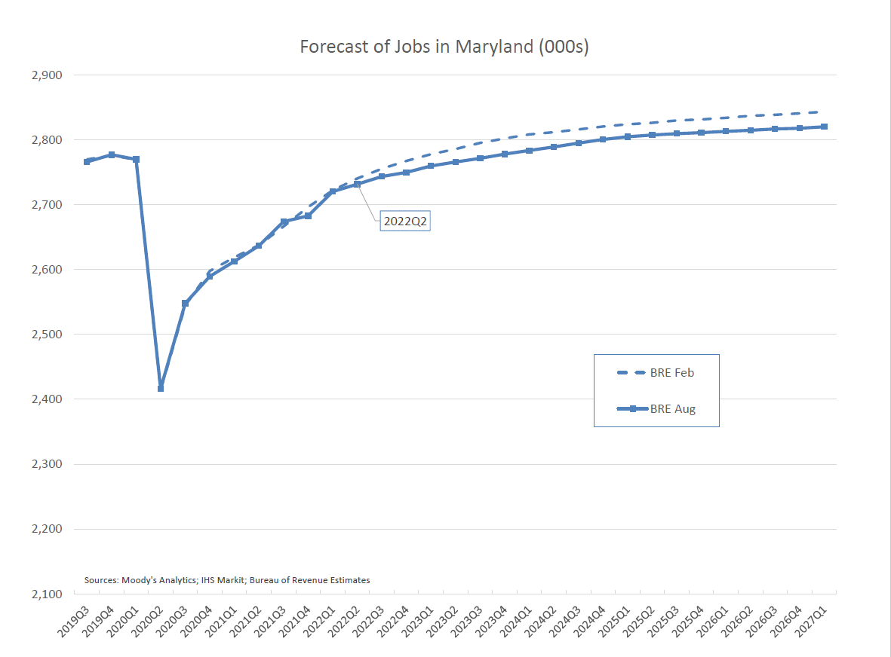

Slide 12
Volatile Revenue Sources Are an Increasing Share of the General Fund
Wages do not typically decline without significant job losses
Non-wage income is not as stable and can decline precipitously in a short span of time
Non-wage income data is harder to monitor
Our largest tax source has shifted from being overwhelmingly wage based to more non-wage based income

Slide 13
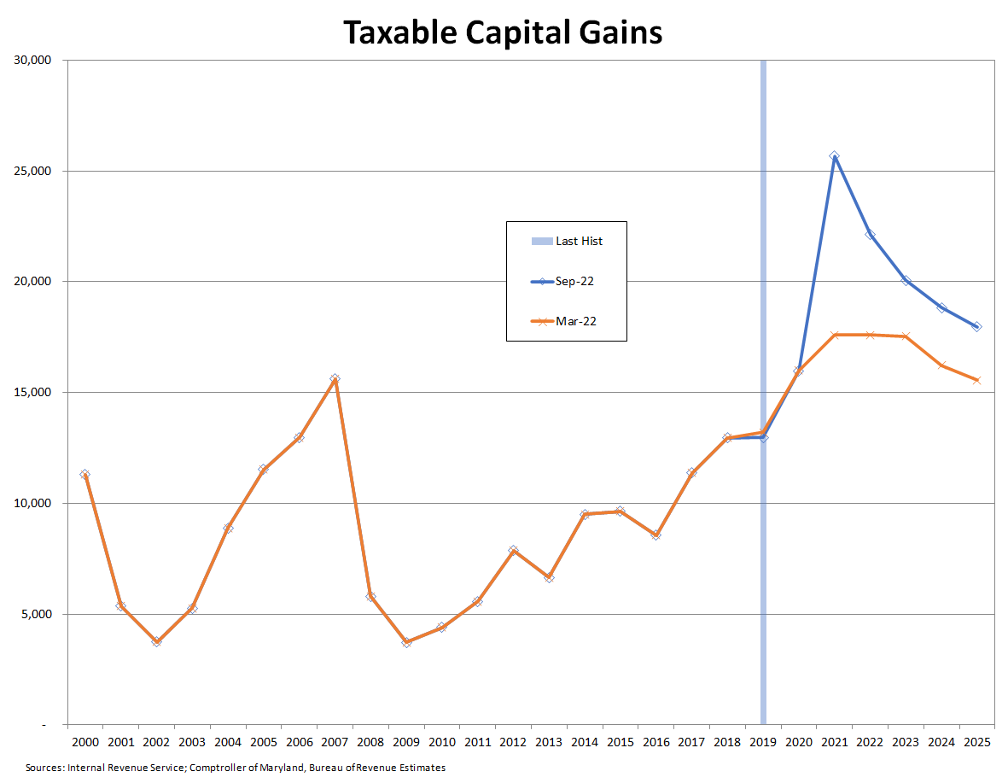
Source: Bureau of Revenue Estimates

Slide 14
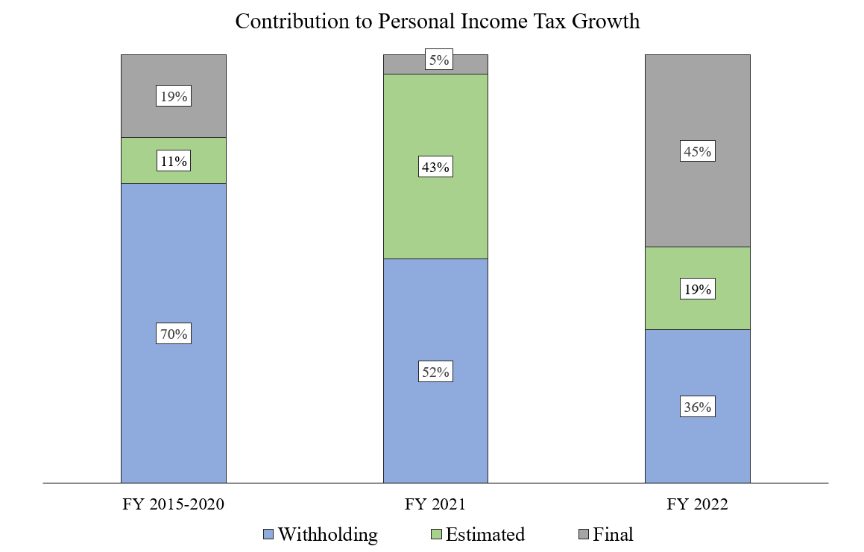
Estimated and Final Payments are Driving Recent Individual Income Tax Revenues

Slide 15
State Revenue Sources are Now More Volatile

Slide 16
Thank You
Robert J. Rehrmann
Comptroller of Maryland
Chief, Bureau of Revenue Estimates
rrehrmann@marylandtaxes.gov

