Slide 1
SELF CONFIDENCE & YOU
DELIVERED BY CLARE GILKES
DWP - Mercia ScHOOL ADVISER
Notes:
Welcome to our Self Confidence and you session. My name is Clare Gilkes and I am a School Adviser who works for the Jobcentre. I will be spending the next 20 minutes talking to you about self confidence. I hope you enjoy the session. Please play this session in slide show mode so you can access the video on slide 6.

Slide 2
WHAT DOES SELF-CONFIDENCE MEAN?
Lets break this down:-
Confidence means to have a feeling of trust in someone or something.
Self means the set of someone's characteristics, such as personality and ability, that are not physical and make that person different from other people.
Bringing this altogether:-
SELF-CONFIDENCE is a feeling of trust in one's abilities, qualities, and judgement.
Notes:
Are we born with Self Confidence? The good news is NO! Confidence is influenced by factors like upbringing, work environment and experiences
Who do you think is the best judge of your own ability? You
What are the advantages of self-confidence? Confidence can help you to take on the world with more energy and determination, resulting in better relationships, quality work and a feeling of being connected with your surroundings. Self-confident people usually can influence others more easily, as well as control their own emotions and behaviours more responsibly.
What can improve our Self Confidence?…overcoming barriers/problems but I like to call them challenges!!

Slide 3
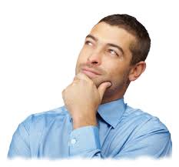
WHY OVERCOMING CHALLENGES ARE GOOD FOR US!
What emotions would someone might feel when experiencing a problem or challenge?
impossible
Notes:
Discuss first question with students? Panic, Fear, sweating, heart racing, wanting to run away, these are all quiet normal feelings but they are only temporary. Showing different feelings.
What about how you felt when you had a problem or a challenge, and you managed to find a solution and overcame the problem.
This could be when they have had to start at a new school, learn a new skill that they
found particularly difficult, or do a physical challenge, such as abseiling or diving.
Discuss how successfully solving a problem or meeting a challenge can make us feel.
Rewarded, stretched, proud of ourselves and more confident in what we can do. It can also
make us feel that we’ve learnt something new: it allows us to grow and develop
• Share your own story of a challenge you took on, the fears you had to overcome and the
emotions you experienced. Examples might include starting or changing jobs, managing
a team of people, becoming a parent, public speaking, visiting a country you hadn’t
been to before, moving home. Older or more able groups may want to consider some
different examples of challenges and these could be seen as an opportunity and/or way to
overcome a fear. Can they think of examples within different settings, e.g. in the workplace,
at school, or in the community? What action plans might they devise to tackle this
challenge and turn it into a positive experience that helps their own personal development
• Ask students what feelings they can remember having before tackling the challenge: did they
feel nervous or scared? Help them to identify that challenges often seem frightening at first

Slide 4
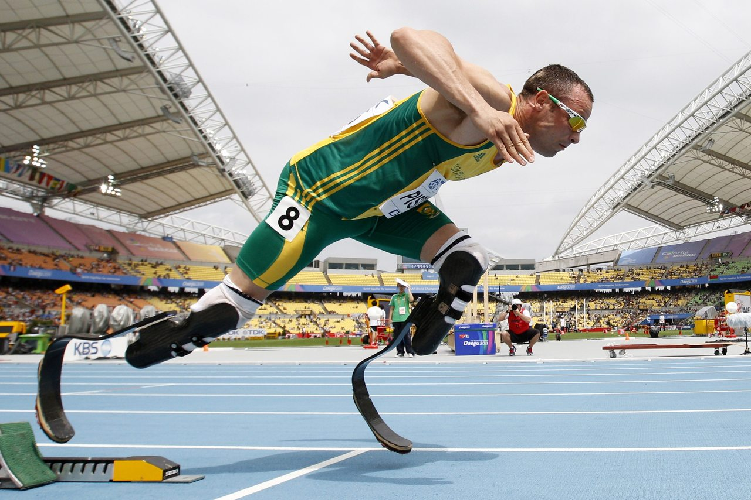
PEOPLE WHO HAVE OVERCOME CHALLENGES
Have you ever experienced the feeling of overcoming a challenge?
J.K. Rowling is well-known for writing the bestselling Harry Potter stories, but she began writing the books in challenging circumstances. Whilst a single mother and studying full-time for a teaching degree, J K Rowling had an idea for a children’s story about a boy wizard. She wrote in the evenings, often sitting in local cafes having walked her baby daughter to sleep in her pushchair.
Jonnie Peacock won Gold in the men’s T44 100m at the 2012 and 2016 Paralympics. In1999, aged just six, he had to have part of one leg amputated after a bout of meningitis in which he nearly died.
This Photo by Unknown Author is licensed under CC BY
Notes:
What do you think we can learn from these people? Discuss with student.
Explain that they show we can all overcome big and also small challenges and use them to help ourselves
or others to grow. Sometimes FEAR can stop us from overcoming these challenges……So which fear will you choose.. are you going to Forget Everything And Run or are you going to Face Everything and Rise ?
Think about a time when you had a problem or challenge in front of you and overcame it? How did it make you feel when overcame it?
Jonnie Peacock said I’ve gone past my expectation every single year… I’ve done things that other people
couldn’t dream of.
J.K. Rowling said
Had I really succeeded at anything else, I might never have found the determination to
succeed in the one area where I truly belonged. I was set free, because my greatest fear
had been realised, and I was still alive, and I still had a daughter whom I adored, and I
had an old typewriter, and a big idea.
Do you see a challenge as an opportunity (being positive or a problem -being negative). When you see them as challenges you will feel more able to overcome them.

