Slide 1
COVID-19 Employee Training
March 2024
All photos from Adobe Stock unless otherwise indicated.
Notes:
[This presentation can be used to train employees about COVID-19. Tailor the presentations content to ensure it fits the work being done at your business. Check state and local regulations for the most up to date requirements. Educate your workers in a language they understand best.]
COVID-19 continues to be a workplace hazard in Washington.

Slide 2
This training will cover:
How to protect yourself from getting COVID-19
Our COVID-19 policies and procedures
What to do if you get sick
Notes:
By the end of this training, you should know what policies and procedures we have that protect you from getting COVID-19, where to find those policies and procedures, and what to do if you get sick.

Slide 3
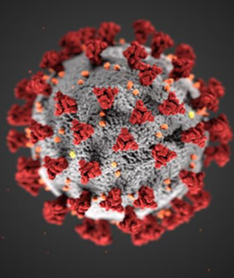
COVID-19 remains a workplace hazard
Symptoms vary between people:
Mild symptoms similar to common colds or allergies to no symptoms (asymptomatic)
In other people, it can cause a very serious health effects or death.
Note: The virus continues to change new variants still emerging. It’s possible to have COVID-19 multiple times.
Graphic from the CDC
Notes:
Most of you by now know a lot about COVID-19. The virus continues to evolve into new variants. These new variants can increase the risk of reinfection.

Slide 4
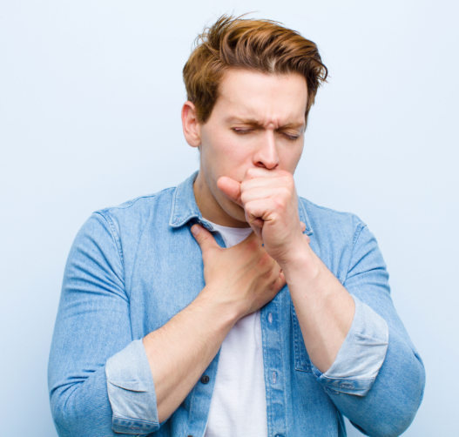
Watch out for these symptoms
Fever or chills
Sore throat
Headache
Congestion
Nausea
Muscle aches
New loss of taste or smell
Fatigue
Cough
Diarrhea
Runny nose
Vomiting
Body aches
Notes:
You may have COVID-19 if you come down with any of these symptoms. COVID-19 symptoms can be mild and may look like other illnesses, like the cold or like allergies. Symptoms may appear 2-14 days after exposure to the virus, however some people have no symptoms at all called asymptomatic. You can spread COVID-19 to other people without having symptoms. Testing is the best way to see if you have COVID-19 or not.
[Check the Center for Disease Control website for up to date information about COVID-19.]

Slide 5
You have a higher risk for serious illness if you are:
An older adult
Pregnant or recently pregnant
Immunocompromised
Have certain health conditions
Notes:
You, or someone you know may be at risk for serious illness. Serious or severe illness means that a person with COVID-19 may need hospitalization, intensive care, or they may even die. Pregnancy weakens your immune system and pregnant women have died of COVID-19.

Slide 6
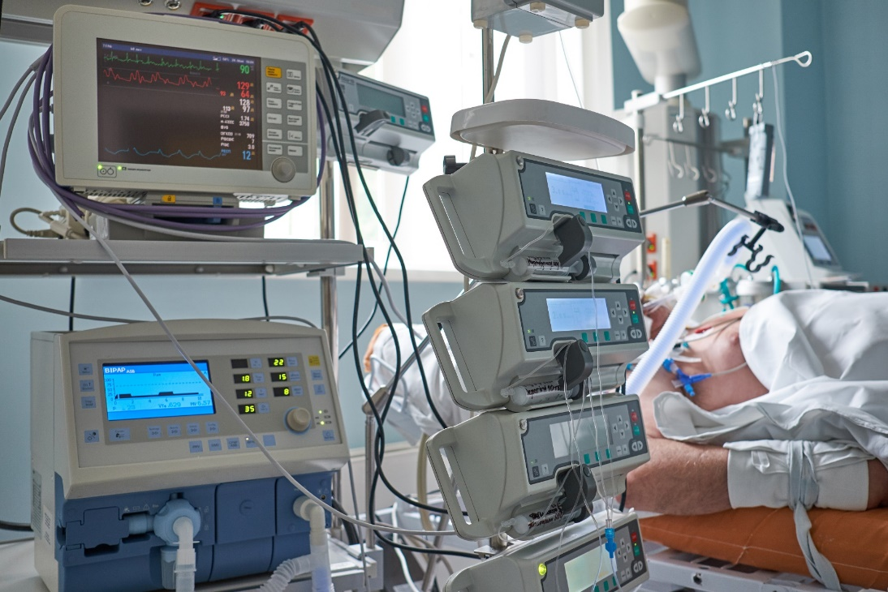
Common Health Conditions with Higher Risks of Serious Illness
Asthma
Overweight
Diabetes, Type 1 or 2
Smoker – current or former
Alcohol or drug abuse
Chronic lung, heart, liver or kidney disease
Notes:
There are many medical conditions that can lead to serious illness. The ones listed here are some of the more common ones. Check the Center for Disease Control website for additional medical conditions that could lead to serious illness.

Slide 7
Emergency Warning Signs
Labored breathing
Pain or pressure in the chest
Sudden confusion
Not waking up or able to stay awake. Lethargy or drowsiness
Pale, gray, or blue-colored skin, lips, or nail beds (depending on skin tone)
Notes:
Call 911 or seek emergency medical care immediately if you or someone you know has these symptoms, or any other symptoms that are concerning to you.

Slide 8
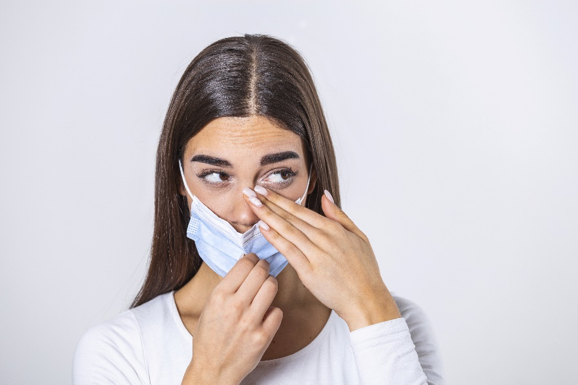
How does Covid-19 spread?
Notes:
Our goal is that you not get COVID-19. People who have COVID-19 breath out viruses, especially when coughing or sneezing. You can get COVID-19 by breathing in air from an infected person. The virus can land on your eyes, nose, or mouth, which can lead to an infection. Or you can touch your eyes, nose or mouth with hands that have the virus on them.

Slide 9
Is it allergies or is it COVID-19? From one illness to an outbreak
Graphic from the CDC/ Photo from L&I
Notes:
An unvaccinated teacher in California in May, 2021 came to work thinking she had allergies. She was congested and tired. She occasionally read aloud to her students without a mask on. She developed a cough, fever, and a headache while working over the course of 2 days. She ended up testing positive for COVID-19. All of her students in her class were below the vaccination age limit. This led to an outbreak of 26 students and family members contracting the COVID-19 delta variant. In this picture, the students in pink are the ones in the classroom who got COVID-19. Staying home when sick, COVID-19 testing, and vaccinations are key parts to preventing the spread of COVID-19. [Reference: Outbreak Associated with SARS-CoV-2 B.1.617.2 (Delta) Variant in an Elementary School — Marin County, California, May–June 2021; https://www.cdc.gov/mmwr/volumes/70/wr/mm7035e2.htm)]

Slide 10
Germs can spread when you:
Are close to a sick person especially if they are coughing or sneezing.
Touch your eyes, nose, and mouth with unwashed hands
Prepare or eat food and drinks with unwashed hands
Touch dirty surfaces
Notes:
These are some of the main ways COVID-19 spreads between people.

Slide 11
Wash Your Hands Often
Photo from the CDC
Notes:
Washing hands can keep you healthy and prevent the spread of COVID-19.
[Employer: Insert your hand washing and hand sanitizer policies here.]

Slide 12
COVID-19 Vaccines and Boosters
COVID-19 vaccines and boosters can help protect you from serious health effects and long term illness caused by COVID-19.
Photo from the CDC
Notes:
Being up-to-date on your vaccines is the best way to prevent serious illness from COVID-19.
[Employers: Insert your workplace-specific policies and procedures for COVID-19 vaccinations and how you are supporting employees getting vaccinated.]

Slide 13
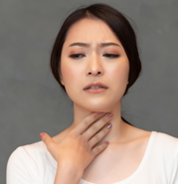
What to do if you feel sick
If you believe you may have COVID-19, stay home!
Tell your supervisor, if you get sick.
Notes:
It is best to stay home if you are sick no matter what the sickness is. If you think you have COVID-19, get tested. One of the best ways to stop the spread of COVID-19 is to stay home and if possible contact those people with which you had contact.
[Employer: Insert your policy on what your employees should do should they get COVID-19. Describe how employees will be notified if they are exposed to COVID-19 in the workplace.]

Slide 14
Our Cleaning Practices
[Insert and describe your specific cleaning practices here (Use Text Box)]
:
Notes:
It is important to regularly clean commonly touched items, like door handles or shared equipment. Regular cleaning helps prevent the spread of COVID-19 and other diseases.
[Employer: Insert your workplace-specific policies and procedures on cleaning, including common-touch surfaces. Note: When chemicals are used in the workplace, the Chemical Hazard Communication Standard applies (Chapter 296-901 WAC). Read more here: https://lni.wa.gov/safety-health/preventing-injuries-illnesses/get-started-with-safety-health/chemical-safety-basics . ]

Slide 15
Our COVID-19 Spread Prevention Strategies
^{Facemasks & Respirators}
^{Physical Distancing}
^{Cleaning & Disinfecting}
^{Health Screening}
^{Barriers & Ventilation}
^{Vaccines}
Notes:
We have changed many work practices to prevent the spread of COVID-19 at work.

Slide 16
Our Requirements & Procedures
[ Insert your workplace specific policies from your Accident Prevention Program that related to limiting the spread of COVID-19.]
Notes:
[Employers: Insert your workplace-specific policies related to limiting the spread of COVID-19. Examples can include having people work from home, changing start times and break schedules, changing customer flow, or others.]

Slide 17
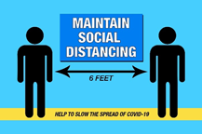
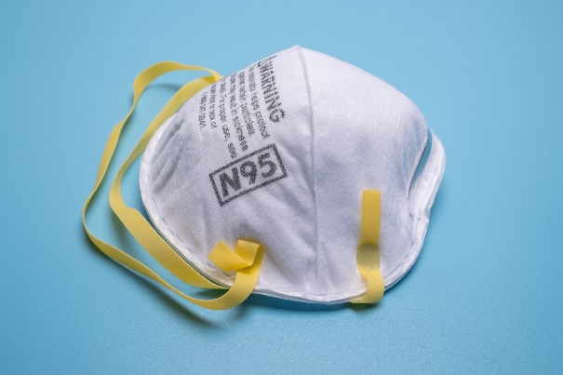
Ways to Protect Yourself
Keep vaccines updated
Wear a respirator
Practice 6 feet social distancing
Wash your hands often with soap for 20 seconds
Keep surfaces and tools clean
Stay home if you are sick
Notes:
We have many layers in place to protect you from COVID-19. This list has some of the main ways you can protect yourself from getting COVID-19.

Slide 18
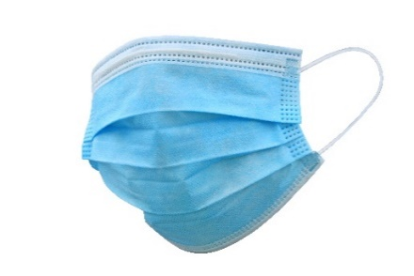
Facemasks versus Respirators
Surgical Mask
Respirator
Notes:
Facemask and respirators offer different levels of protection to the wearer. Respirators filter out particles in the air and are more protective than facemasks. Surgical masks can protect you from droplets or splashes that could contain germs. Face masks, like the surgical mask shown on the slide, can prevent some level of germs from spreading from the wearer to others.

Slide 19
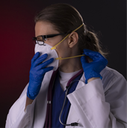
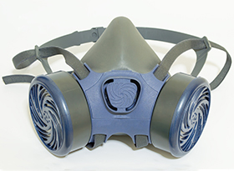
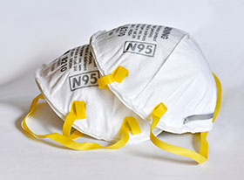
Respirators
Respirators have a certification process via NIOSH to ensure their performance and quality.
Respirators have two straps that go around the head and neck to keep the masks in place.
NIOSH evaluates performance of respirators in the US.
Each approved respirator has a NIOSH approval number on the mask.
Notes:
Respirators can protect you from COVID-19 when worn correctly. Respirators are more protective than face masks. A common respirator is called an N95. Respirators come in different sizes to fit different sized faces. A test can be done to make sure respirators fit correctly.
[Note: Additional regulations and employee trainings apply when respirators are worn in the workplace. Read more on the L&I respirators webpage at www.lni.wa.gov/safety-health/safety-topics/topics/respirators.]

Slide 20
Our Respirator Policies and Procedures
Describe here:
The types of respirators selected/used
Where you require the use of respirators
Your voluntary use of respirators (if applicable).
Notes:
[Note: Employee masking may not be barred by employers unless there is a reasonable concern for safety or security. Allow employees to voluntarily wear filtering facepiece respirators so long as it doesn’t create a safety or security issue.]

Slide 21
Respiratory Protection Training
[Complete Respiratory Protection Training Module(s) for the respirators worn in your workplace.
See Training Kits (wa.gov) scroll down to Respiratory protection and select the corresponding module.]
Notes:
[Note: Employee masking may not be barred by employers unless there is a reasonable concern for safety or security. Allow employees to voluntarily wear filtering facepiece respirators so long as it doesn’t create a safety or security issue.]

Slide 22
Questions?
Photo from CDC
Photo from OSHA
Notes:
Does anyone have any questions?

