Slide 1
Office of Early Childhood Cups and Conversations
Re-opening and Operating ECCE Programs During COVID-19, Part III
July 29, 2020
C7: Coordinated Enrollment Efforts in the Roanoke Preschool Development Grant Pilot Community

Slide 2
Good morning- thanks for joining Cups and Conversations!
A few reminders:
•This is a judgement free zone
•Sharing of local perspective, not DOE recommendations
•You are free to unmute your line at anytime to share your thoughts and ask questions
–*Please help us minimize background noise by staying muted if you are not speaking
•This meeting will be recorded and shared with participants
Optional: Please add your name and affiliation in the chat box

Slide 3
Today’s Special Guests
Vivien McMahan
Vice President, United Way of Roanoke Valley
vivien@uwrv.org
Karen Turner – Botetourt
Dana Kreklow – Roanoke County
Brenda McGrath – Franklin County

Slide 4
Overview of PDG B-5
Virginia’s Preschool Development Grant Birth to Five (PDG B-5) is all about building strong systems at the community level.
In 2019 Virginia was awarded the initial, one year PDG B-5 grant that was used to support three key activities.
Refine and implement a vision for a unified system
Key work: Need assessment and strategic plan
Expand community pilots to statewide capacity
Key work: Support community pilots to create a unified structure for their region that measures and supports quality and increased access.
Improve state infrastructure
Key work: LinkB5 data system, standards, and better understand key factors related to teacher workforce and pay (teacher incentive program)
The audience for PDG B5 is every publicly-funded B-5 early childhood provider (child care, schools, family day home, Head Start) in VA.
VDOE is the grantee, but works very closely with VECF and UVA as subrecipients.
The vast majority of funds are spent on supporting community pilots to accomplish goals related to measuring and supporting quality and recognizing early childhood teachers.

Slide 5
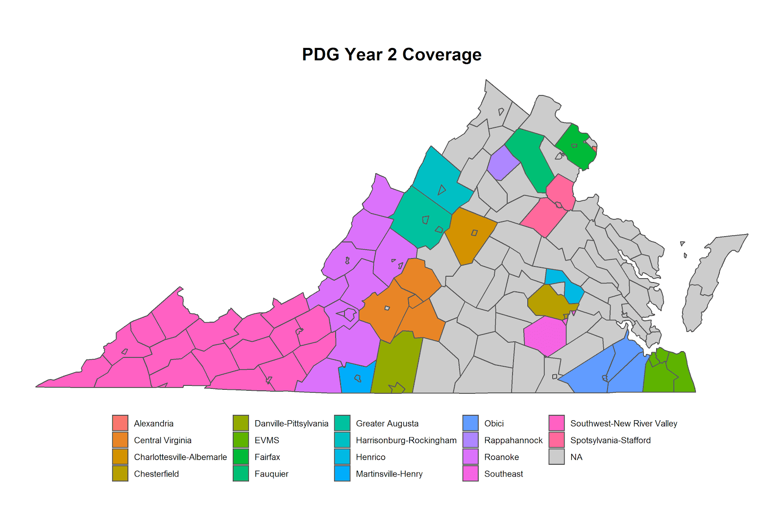
PDG B-5 Renewal Updates
PDG B-5 has been renewed and is now a three year grant (~11 million each year). It will run from January 2020-December 2022.
Now inclusive of 8 new pilot communities (10 pilot communities made up Cohort 1).
Notes:
Community Pilots (CP) are coalitions of all the publicly-funded EC programs within a region. With Cohort 2 being added, there are now 18 in VA. Each pilot has a lead organization that receives funding to:
Build relationships across programs (routine meetings and info sharing)
Increase access for families and children (coordinated enrollment and linkB5)
Strengthen quality of programs (CLASS observations, PD planning, teacher incentive)
Support family engagement (pilot approaches to engage families)
Why do they matter? Pilots are the foundation of the unified EC system in VA, eventually they will reach statewide. Locally conducted CLASS observations and systems of coordinated enrollment will be critical levers in a unified system.
Nearly 68% of the state has the opportunity to be a part of a PDG pilot community.

Slide 6
Q1: Could you tell us about the Roanoke PDG Pilot community?
Please share details about:
The Roanoke PDG Pilot community footprint;
Your role as lead organization

Slide 7
Q2: How did Roanoke engage in Coordinated Enrollment (CE) work?
What is the purpose coordinated enrollment?
What are some the logistical details that entail the CE process and how did the Roanoke community engage in this PDG activity (pre-and post-COVID)?
What challenges did you face? What were your “Wins”?
Coordinated Enrollment agenda
Please feel free to enter your thoughts and questions in the chat box or chime in when the floor is reopened!

Slide 8
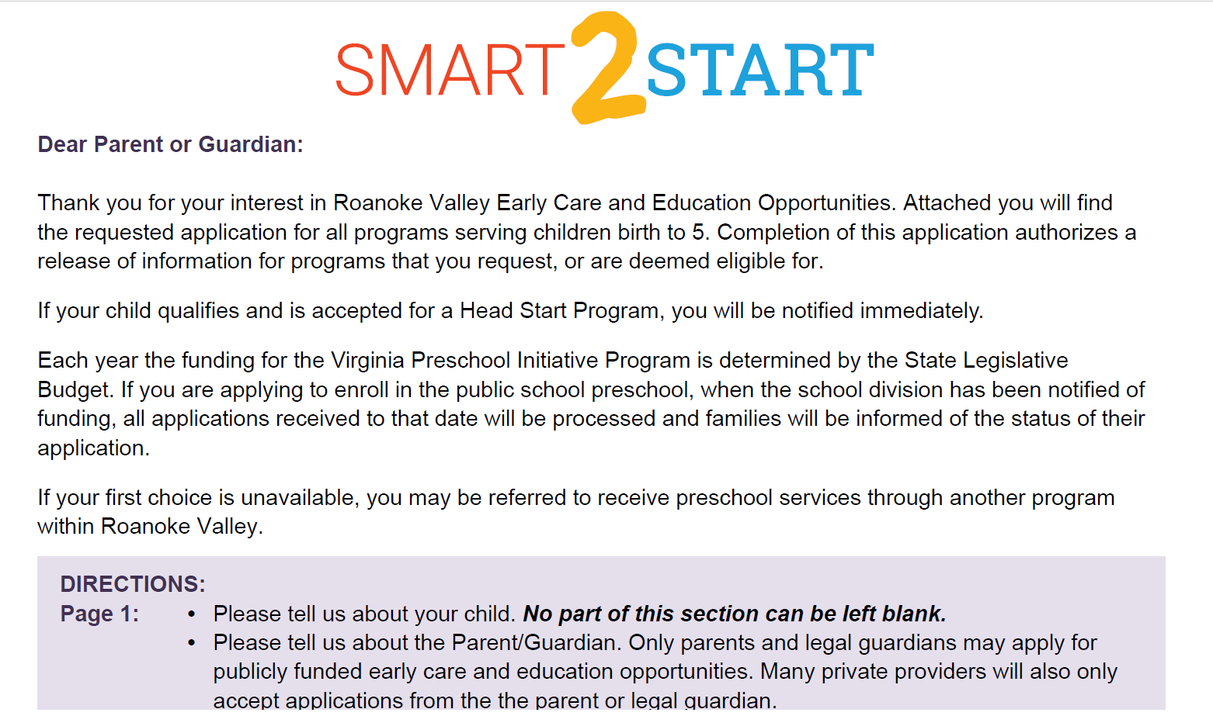
Coordinated Enrollment in Roanoke Valley
Roanoke Valley Smart 2 Start Application

Slide 9
We know now Coordinated Enrollment as...
Notes:
All this work led us to what we now know as Smart2Start!
We really wanted to be mindful in the design of this website and not have it a place where parents get lost. There are just a couple of simple links to access here. There is of course a phone number or email for questions or support, as well as a link that takes you to a page to where parents can learn about different providers.
Here, parents can access VA Quality and Child Care VA. We felt it was necessary to have both of these available to parents because Virginia Quality only provides information about programs participating in Virginia Quality. As it currently stands, Virginia Quality is voluntary, so not all providers can be captured here. Similarly, Child Care VA, does not provide any information about the options that are available within the school systems, like the Virginia Preschool Initiative. As the Commonwealth is moving towards a unified measurement and improvement system, perhaps this is something that can be addressed. To empower parents as consumers, we wanted to provide information that would help inform them of what programs would be a good fit for their families.
Our group wanted this to be an educational opportunity for parents and even the general public. An early decision made by the group, was that we would help parents navigate this system based on needs for their family, not to recommend any one program over another based on quality.
And then, of course, on the home page, there is an “Apply Now” button that will take you to the online version of the application! You can also download a paper version of the application in English or in Spanish. For online translations, parents can use “Google Translations”
If parents choose a paper application, they have multiple options as to where they can return them. They can take them to any public school in our region, head start program, or private site that has adopted the application, or they can bring it to one of our United Way offices in in Roanoke City or Franklin County.

Slide 10
Online Applications
Number of Parents/Guardians
Primary Language at Home
Number in Household
Number in Family
Gross Annual Income
TANF/SSI/WIC?
Notes:
Here we have a screenshot of part of that online application. There are 2 parts to the application. This part is where we are able to capture information about our families that really start the process to support them and help identify what programs they may be eligible for.
It is quite simple to fill out, as we have many drop down boxes for them to select responses for, and blank fields to capture specific information.
All of the information entered into this part of the application is automatically sent to the software system we are using to help us determine eligibility.
A recurring question I receive when I talk with people about this work is “What is the software you are using”. We are using ChildPlus. This is a software system that was really designed for use of Head Start Programs. This is NOT the only program out there that can do these things. There are others. We chose this one simply because we are partnered with 2 Head Start Programs and 1 School System that were already using this software, so it just made sense.

Slide 11
How about Consent?
About Consent
Notes:
I have had the chance to chat about some of this with some of you and a recurring question that has come up is “How do you get parents to consent?”
In the cover letter for the application, I have highlighted the answer for you. Our schools and Head Start programs have adopted this application, as well as a number of private providers. With all of our school systems, Head Starts, and a number of private providers who have adopted this application, most are referred to the website to enter in the information. By filling out this application parents are authorizing this information to be shared with the program of their choice if they specify a program.

Slide 12
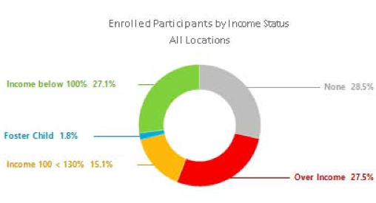
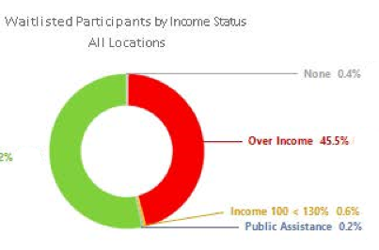
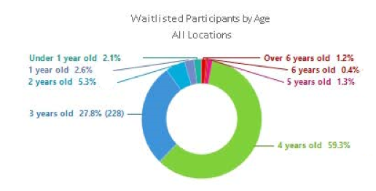
Data Snapshots

Slide 13
Q3: What are some of the major pivots you have made (or plan to make) in light of our prevailing circumstances?
Regarding:
Family engagement
Expanding child care and education to school age children
Leveraging Mixed-Delivery
Establishing relationships/systems building
Please feel free to enter your thoughts and questions in the chat box or chime in when the floor is reopened!

Slide 14
Q4: What do you know about fall reopening plans in the Roanoke region?
How have you and community partners been involved in informing considerations that relate specifically to Early Childhood programs?
The chat box is always open, and we welcome your thoughts and questions upon prompting!

Slide 15
Q5: What are your biggest lessons learned from this very unique planning process and administrative experience?
What top pieces of advice would you offer to divisions and programs about recruitment and (coordinated) enrollment and reopening this fall?
Do you have recommendations for helpful resources outside of VDOE publications (Recover, Redesign, Restart 2020, FAQs)?

Slide 16
Additional Resources
VDOE Recover, Redesign Restart 2020: A Comprehensive Plan that Moves Virginia Learners and Educators Forward
VDOE COVID 19 Website
–VDOE COVID 19 FAQs, Office of Early Childhood FAQ , and Transition from Part C to Part B FAQ
–Virginia Learns Anywhere (C4L) and #GoOpenVA
Other:
–Child Care Guidance for COVID 19 and Child Care Licensing FAQs, Child Care Resources COVID 19 website
–The Virginia Early Childhood Foundation (VECF) materials, including a guide for child care and a series of webinars

Slide 17
Closing Notes
Next Conversation, August 12
ECSE Eligibility Screenings
Forthcoming (via email or Readiness Connection newsletter)
Link to this recording
Invitation to complete short survey about your ideas for future conversation topics (we are always looking for volunteer facilitators)
Referenced materials
Notes:
Divisions "nominate" awesome videos or examples of actual preK content that can "inspire" others

Slide 18
Cups and Conversations Contact Information
Dawn Hendricks- Early Childhood Special Education Coordinator, VDOE
dawn.hendricks@doe.virginia.gov
Tamilah Richardson- Associate Director, Early Childhood Learning, VDOE tamilah.richardson@doe.virginia.gov

