Slide 1
Office of Justice Programs
How to Review a Proposal
October 2023

Slide 2
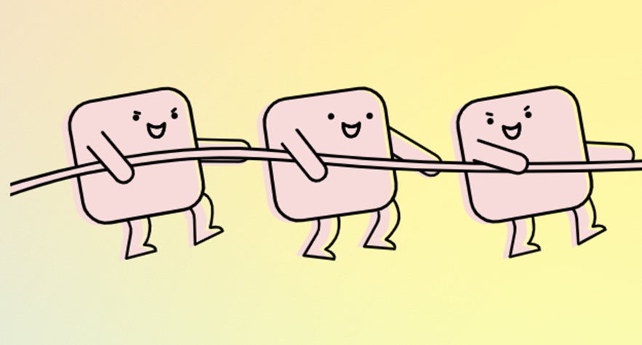
Why use Volunteer Reviewers?
To include a wide variety of perspectives and experiences that can inform the grant making process.
Make the granting process more inclusive, transparent, fair, and as free from influence and bias as possible.
&

Slide 3
Who are the Reviewers?
Community Members
Subject Matter Experts
Teachers/Educators
State & Local Government
Crime Victim Advocates
Youth Workers
Law Enforcement

Slide 4
Benefits of Reviewing
Being a proposal reviewer is one of the best ways to learn how to write a good proposal!
1. Learn more about the grant making process
2. Gain a better understanding of OJP
3. Have a voice in the process
4. Learn about YIP & CCIP programs across the state

Slide 5
Overall Expectation of Grant Reviewers
Keep proposals and scores confidential – this is not public information UNTIL the grants are awarded.
Review the required elements in the Request for Proposal (RFP) for the following sections: Narrative, Work Plan & Budget. Your scores reflect how well the proposal addresses those requirements.
Immediately report any conflict of interest to OJP and do not score proposals for which you have a conflict.

Slide 6
Review the RFP
Become familiar with:
The requirements of the proposals
The scoring criteria and point allocation
Read and understand the rating form
Reviewing Proposals: Step 1
Set aside enough time to review each proposal thoroughly; this is not a quick process.

Slide 7
Reviewing Proposals:
Step 2
We recommend you do a first reading of each proposal without scoring, to get a sense of what they are proposing and where to find details important for scoring.
Re-read each proposal and score them.
Use the info on the rating form to guide your scoring.
It is critical that you note strengths and weaknesses to support your scores.

Slide 8
Virtual Grant Review Meeting
Join on time, ready to discuss the proposals.
All rating forms must already be completed.
Submit your completed conflict of interest form.
Participate in the discussion of strengths & weaknesses.
Reviewers may change their scores based on discussion.
Reviewers will see an overall scoring for all proposals at the end of the meeting.

Slide 9
Range of Scores
Scores of a perfect 100 should be very rare as this means there were no weaknesses in the proposal.
Name Surname
Just as rare is a score of 0 as this means there are no strengths in the proposal.
If you do feel like a score of 100 or 0 are warranted, please document your reasoning completely.

Slide 10
Scoring Guidance
Everyone scores differently – that’s okay. Just be consistent in your scoring.
Only score a proposal based on the information provided – don’t assume anything or include outside knowledge.
Score proposals against the criteria in the RFP– not against other proposals.
No fractions or decimals – whole number scores only!

Slide 11
Review Guidance
Proposals should show a compelling need, provide strong services, and have a solid understanding of youth programs and/or community crime intervention programs.
Proposal activities should be clear and understandable.
Score each section of the Rating Form using the key at the beginning. Scores should vary based on the completeness of the answers.
You may deduct points for a disorganized proposal, but your score should be based on the quality of the responses.
Just having an answer to each question in the RFP does not justify a high score.

Slide 12
Thank You
For more information or questions please contact the Minnesota Department of Public Safety, Office of Justice Programs:
Greg Herzog (YIP Grants)
greg.herzog@state.mn.us
Mike Hreha (CCIP Grants)
michael.Hreha@state.mn.us

