Slide 1
RAIN Presents
Pride 2021

Slide 2
Pride Month, formally recognized every year in June, has expanded to many months over the year as so many cities and organizations want to celebrate the LGBTQ+ Community and there are just not enough days in June to do so!
Pride Parades and Festivals are generally known as a time of joy where people can openly express themselves, dance, party and have fun. The more color and sparkles, the better!
While all of this is true, Pride comes from a place of frustration, pain and struggle. Pride is representative of the VICTORIES of the Queer community, even while still fighting battles of equality, safety and acceptance.

Slide 3
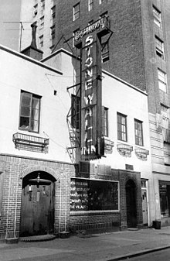
How much do YOU know about PRIDE?
Q1. What was the location where the 1969 riots were started?
(Business Name, City)
A1. Stonewall Inn,
New York City
Bonus Question!!!
Who OWNED the Stonewall Inn?
The MAFIA!

Slide 4
Stonewall History
Tired of being harassed by civilians and law enforcement alike, the patrons of the Stonewall Inn (then considered a semi-safe space for the LGBTQ Community) stood up to a police raid and started what eventually became a 3-day riot.

Slide 5
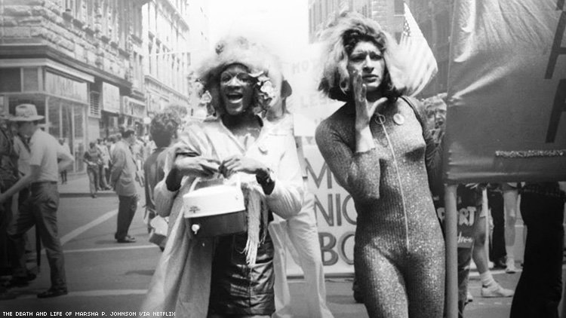
Q2. What year was the FIRST Pride parade held?
A2. 1970
The first PRIDE Parade,
also in New York,
began as a commemoration of the Stonewall Riots.
Marsha P. Johnson & Sylvia Rivera
Transwomen; LGBTQ+ History

Slide 6
Q3. When did the American Psychiatric Association declassify homosexuality as a mental disorder?
A3. 1973
(That was only 47 years ago y’all!)

Slide 7
Q4. Who was the first openly gay man elected to a political office in California?
Harvey Milk
1977 – Elected to the Board of Supervisors
Milk, only “out” and active in his 40’s, became an activist and eventually decided to run for office, open about his sexuality as san Francisco has become a hub for the gay community in the US at the time. He felt that local government needed representational leadership.
November 11, 1978 a colleague on the Board of Supervisors, Dan White, shot and killed Milk and then-Mayor George Moscone.
White said he was extremely depressed, causing him to eat too much junk-food and that the excess sugar cause “diminished capacity”. This became knows as the “Twinkie Defense”. He eventually only served 5 years for manslaughter (not murder!) and a two years after his release from jail, committed suicide.

Slide 8
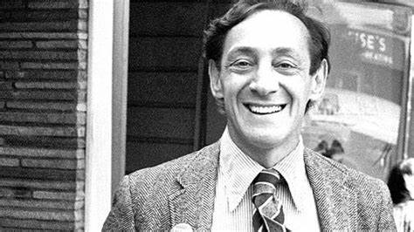
One of Harvey Milks’ Famous quotes?
“If a bullet should enter my brain, let that bullet destroy every closet door.”
(Let that sink in…)

Slide 9
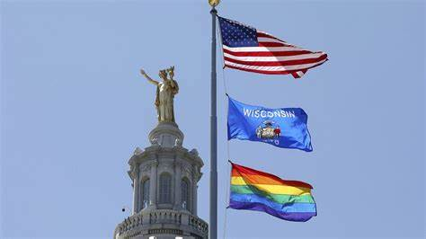
Q5. What State became the first to outlaw discrimination based on sexual orientation?
A5. Wisconsin!
March 2, 1982 Wisconsin passed a law outlawing discrimination of people based on their sexual orientation in employment, housing and public accommodations.
(Again---only 38 years ago!)

Slide 10
Q6. Whose administration repealed the “Don’t Ask, Don’t Tell” policy in the U.S. Military?
A6. Barack Obama – 2011
During WWII, there was a ban on homosexuals in the military.
Seeing it as a solution to the ban, “Don’t Ask, Don’t Tell” was signed by Bill Clinton in 1993, allowing homosexual people to enlist, as long as they didn’t identify themselves as gay and their fellow service people should not ask about their sexual identity.
This inevitably increased discrimination and hate crimes within the military and was ended by Obama, allowing LGBT service members to live out and free while serving our country.

Slide 11
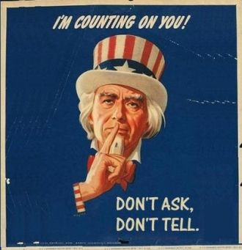
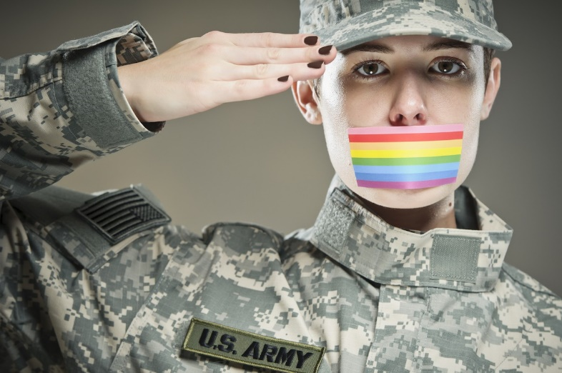

Slide 12
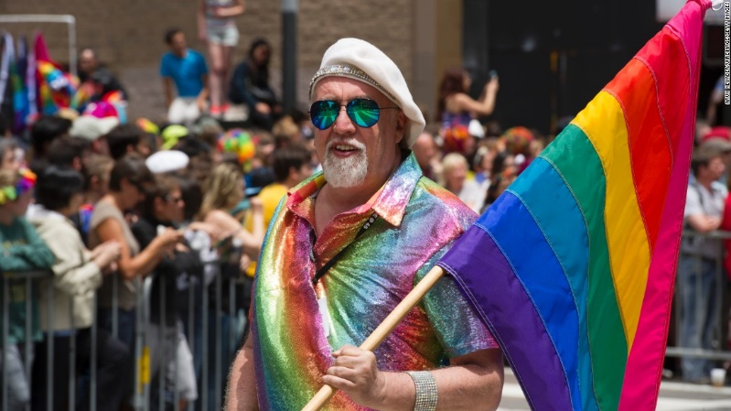
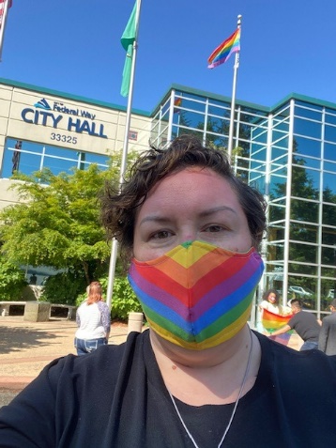
Q7. When did the first RAINBOW flag appear in a PRIDE parade and in what city?
A7. 1978; San Francisco
The Flag was designed by Gilbert Baker;
American Artist and Gay Rights Activist
Speaking of PRIDE Flags, I have worked hard for my community and we raised Pride Flag in Federal Way for the first time EVER…yesterday. (6.1.2020)

Slide 13
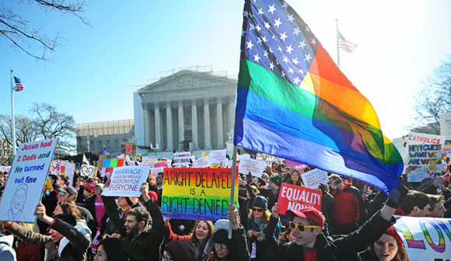
Q8. When did the U.S. Supreme Court lift the nationwide ban on same-sex marriage?
A8. 2015
BONUS: When did WA State allow same-sex marriages?
2012!!!

Slide 14
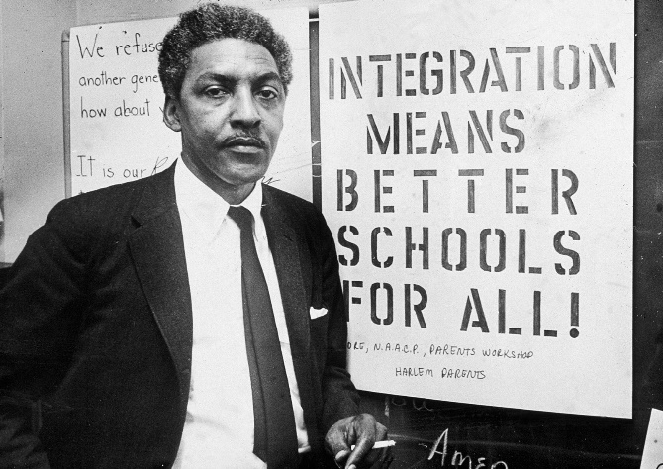
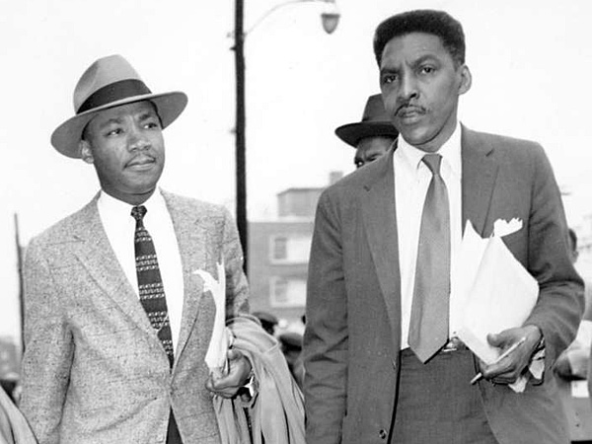
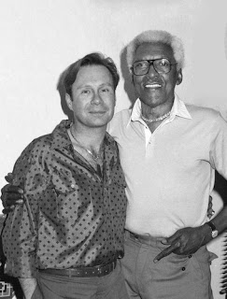
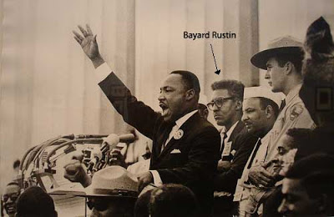
Q9. Who is Bayard Rustin?
A9. Bayard Rustin is a Civil Rights Leader who worked closely with Martin Luther King Jr. and is often known as MLK’s “Right Hand Man”.
He’s credited with teaching MLK that non-violence is an effective strategy and helped develop many of MLK’s most famous speeches.
Rustin was often “in the shadows” of publicity because he was gay.
Rustin also co-founded a A. Philip Randolph Institute (http://www.apri.org/) which brought together the fight of the Civil Rights Movement and the Labor Movement and is still an active AFL-CIO Constituency Group.

Slide 15
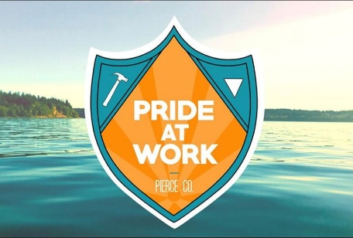
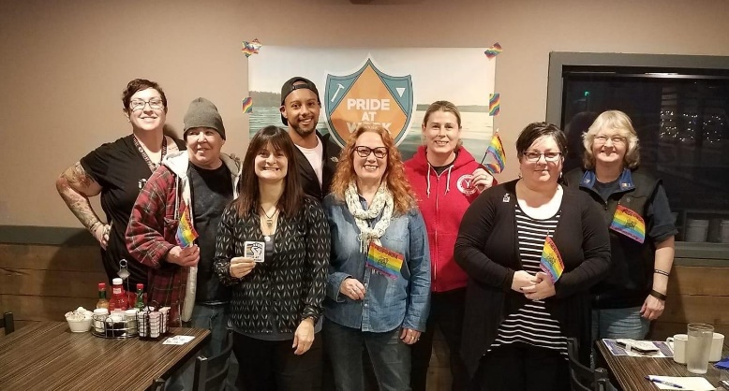
Q10. What other AFL-CIO Constituency Group can you go to for workplace questions or concerns around LGBTQ+ issues?
A10. Pride @ Work!
Pride @ Work is the National Organization that supports the Labor Community when it comes to all Queer issues!
www.prideatwork.org
Bonus:
What’s the LOCAL Chapter of Pride @ Work?
Answer: Pierce County Pride @ Work

Slide 16
Pride in COVID19
Due to the need to keep PRIDE-goers safe, many PRIDE Parades and Festivals are being cancelled, delayed or going to a virtual format.
Two of the bigger PRIDES in this area are making big changes to their festivities and even going VIRTUAL!!
http://tacomapride.org/
https://www.seattlepridefest.org/
Here’s a cool list to all kinds of PRIDE events all over the world!! There is WHOLE LOT OF PRIDE here!
https://metrosource.com/list-of-pride-2020-celebrations-around-the-world/

Slide 17
Local Resources for the LGBTQ+ and Allies
Rainbow Center – Tacoma-based organization that supports the LGBTQ Community and allies
https://www.rainbowcntr.org/
Oasis Center – Tacoma Youth Drop-In &
Resource Center
www.oasisyouthcenter.org

Slide 18
State Resources
WA State Dept. of Enterprise Services
WA State LGBT Legislative Caucus
RAIN - Business Resource Group
WA State LGBT Commission

Slide 19
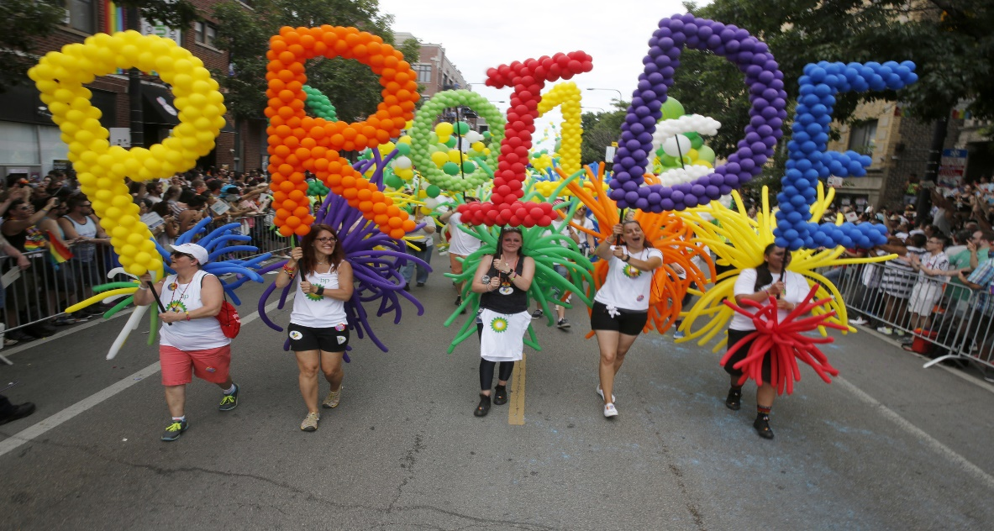
Love is Love.
Happy
2021!
Trey Pearson - Love is Love video

