Slide 1
Apprenticeships – Earn while you Learn!
Apprenticeships are a great way to learn and gain experience at the same time
What are apprenticeships?
Structured training with an employer leading to nationally recognised qualifications
A route into hundreds of different careers, including many in organisations providing NHS healthcare
Can take anything from one to four years to complete – at a variety of levels
Open to anyone from the age of 16 up to retirement!
Learning in work, may include day or block release to a training centre, college or university or may be all done in the workplace.
Working towards a qualification that shows you are competent and able to do the job and have the knowledge that underpins the skill.
Will develop your skills, including English and Maths if not already achieved.
Training is funded and you are paid a wage while learning
The possibility of a permanent job if the Apprenticeship is achieved.
Progression to higher level roles and qualifications – some also apprenticeship qualifications.

Slide 2
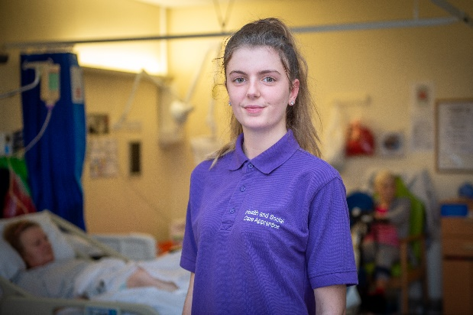
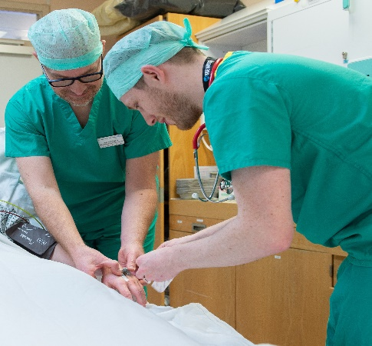
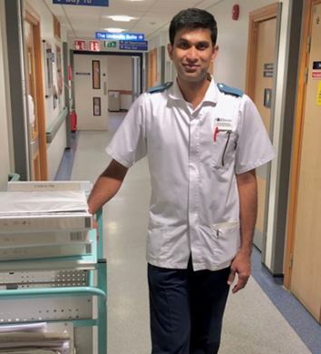
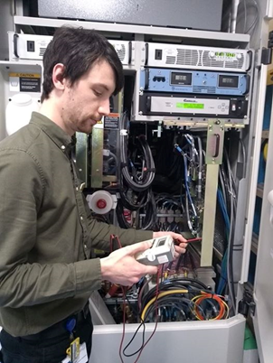
Apprenticeships within SaTH
The NHS is a great place to work
We can provide a
good work environment,
opportunities & support
to develop & flourish
An opportunity for local people of any age from school leavers to retirement.
An apprenticeship
is a stepping stone to a great future.
Yours and ours!
A career option you had
not thought about before?
300+ different
role options, many available through an apprenticeship route
Young people - Fresh ideas, new approaches, different perspectives, energy & optimism
The route is
up to you –
no pressure!
Just the start of a career journey
Supporting people with a variety
of needs and career aspirations
Together we can achieve great things! Why not join us?

Slide 3
Exciting Opportunities.
Many of the traditional academic routes now also have an apprenticeship route:
Registered Nurse, Physiotherapist, Occupational Therapist, Healthcare Scientist, Midwife, Radiographer, Operating Department Practitioner and many others
In the future there will be many more opportunities to follow an apprenticeship route.
Recent apprenticeships offered in SATH have included:
Operating Department Practitioner, IT Technician, Medical Engineering Technician, Radiotherapy Physics Technician, Business Administrator, Diagnostic Radiographer, Pharmacy Technician, Assistant Practitioner – Mammography, Customer Service. With more opportunities being developed all the time!
Following an apprenticeship most students working for SATH are offered a permanent job.
Career pathways can be supported by apprenticeships:
Healthcare Assistant ► Nursing Associate ► Registered Nurse
Radiology Assistant ► Assistant Practitioner ► Diagnostic Radiographer
Once in employment Apprenticeship qualifications also support progression e.g. Leadership and Management qualifications and higher level qualifications.

Slide 4
Applying for a job within the Trust
All our job vacancies are advertised on the following recruitment websites:
www.jobs.sath.nhs.uk (SaTH) and www.jobs.nhs.uk (national)
You can register for an alert for specific roles e.g. Apprentice
All applications are completed and submitted electronically, take time to complete it carefully
* one of the most important areas on the application form – the free text bit!
Read the Person Specification – provide information to cover what is asked for e.g. team working, customer service experience – use the experience from school/college, hobbies, part time jobs.
At interview be well presented and sell yourself.
Values Based Interviews – see our recruitment website for more information under ‘Find a job – applicant guidance’
If unsuccessful – be brave and ask for feedback, it will help you improve for next time!
To investigate the variety of careers within the NHS further go to: www.healthcareers.nhs.uk

