Slide 1
Module 3: Focus on Key Language Uses
Learning Targets:
Explain how the Key Language Uses clarify the purpose for language use when engaging in content learning.
Recognize how language is used for particular purposes, with particular audiences, and in particular sociocultural contexts.
BIG Ideas:
Functional Approach to Language Development
Collaboration among Stakeholders
Notes:
In Module 3 of the WIDA ELD Standards: A Collaborative Approach, the focus is on the four Key Language Uses and how they clarify the purpose for language use when engaging in content learning. One of the Big Ideas is a functional approach to language development. The four Key Language Uses are central to this Big Idea, as they emphasize the ways that language is used for particular purposes, with particular audiences, and in particular sociocultural contexts.

Slide 2
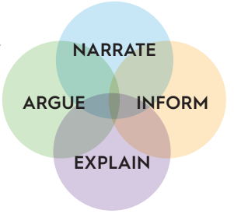
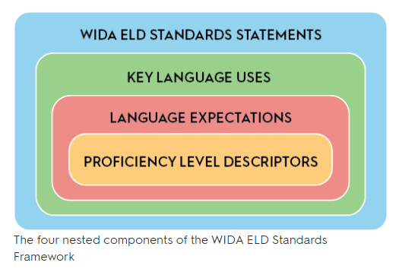
Key Language Uses (KLUs)
Notes:
WIDA has identified four Key Language Uses—Narrate, Inform, Explain, and Argue—that can be used to prioritize and organize the integration of content and language.
The Key Language Uses:
• Bring focus and coherence to the language of schooling
• Help educators make choices to prioritize and coordinate content and language integration
• Serve as an organizing principle for the Language Expectations

Slide 3
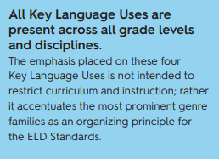
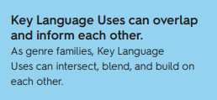
Overview of Key Language Uses
Key Language Uses help both students and educators see that language use is shaped by:
The larger context of schooling
Content area, topic, and purpose for using language
Person(s) with whom one communicates
Students’ identities and social roles
The channel of communication
Notes:
Key Language Uses are present across all grade levels and disciplines and they can overlap and inform each other. For example, as students develop complex explanations, they may also inform (by naming, defining, describing, or comparing and contrasting something), and even narrate (e.g., by including an anecdote) as they work to help their audience accurately understand the how or why of a concept.
Key Language Uses help both students and educators see that language is shaped by the larger context of schooling, by the content area, topic and purpose for using language, as well as by the people with whom they are communicating and the students’ identities and social roles and the channel of communication.

Slide 4
Overview of Key Language Uses
Narrate highlights language to convey real or imaginary experiences through stories and histories. Narratives serve many purposes, including to instruct, entertain, teach, or support argumentation.
NARRATE
Argue highlights language to justify claims using evidence and reasoning. Argue can be used to advance or defend an idea or solution, change the audience’s point of view, bring about action, or accept a position or evaluation of an issue.
ARGUE
Notes:
As a genre family that allows students to create real or imaginary stories and recount histories, the Key Language Use of Narrate relies largely on descriptions and sequencing of events. This way of using language underlies the other Key Language Uses as well. It is typical, for example, for arguments to include a personal story to connect with the audience, or for a science explanation to use a narrative to illustrate a phenomenon. The Key Language Use of Argue is used to advance or defend an idea or solution, change the audience’s point of view, bring about an action or accept a position or evaluation of an issue. The speaker or writer uses argument language to justify claims using evidence and reasoning and is used in many content areas.

Slide 5
Overview of Key Language Uses
Inform highlights language to provide factual information. As students convey information, they define, describe, compare, contrast, organize, categorize, or classify concepts, ideas, or phenomena.
INFORM
Explain highlights language to give an account for how things work or why things happen. As students explain, they substantiate the inner workings of natural, man-made, and social phenomena.
EXPLAIN
Notes:
The Key Language Use of Inform is used primarily to provide factual information. As students convey information, they define, describe, compare and contract, organize, categorize or classify concepts, ideas, or phenomena. The Key Language Use of Explain highlights language used to give an account for how things work or why things happen. This Key Language Use is used primarily in the Science and Math fields to substantiate the inner workings of natural, man-made, and social phenomena and to unpack mathematical thinking.

Slide 6
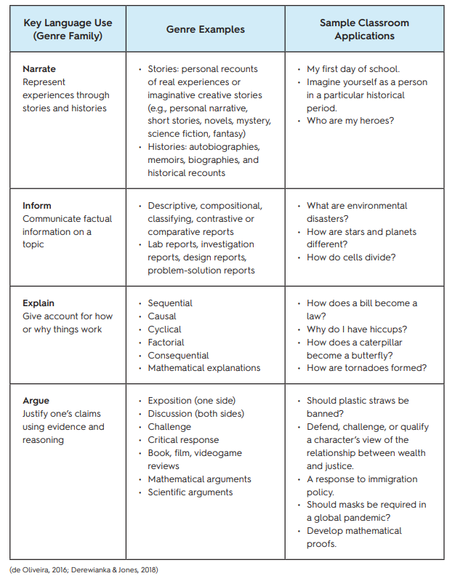
Overview of Key Language Uses
For a deeper dive into the features of each Key Language Use across grades and disciplines, visit Section 4: Resources—Key Language Uses: A Closer Look. (p.219)
Notes:
For a deeper dive into the features of each Key Language Use across grades and disciplines, we are going to look at Section 4: Resources—Key Language Uses: A Closer Look. (on p.219 on the WIDA ELD Standards Framework)
Appendix C also shows K-12 distribution tables of the most prominent Key Language Uses by grade-level cluster and WIDA ELD Standard. (p.290)

Slide 7
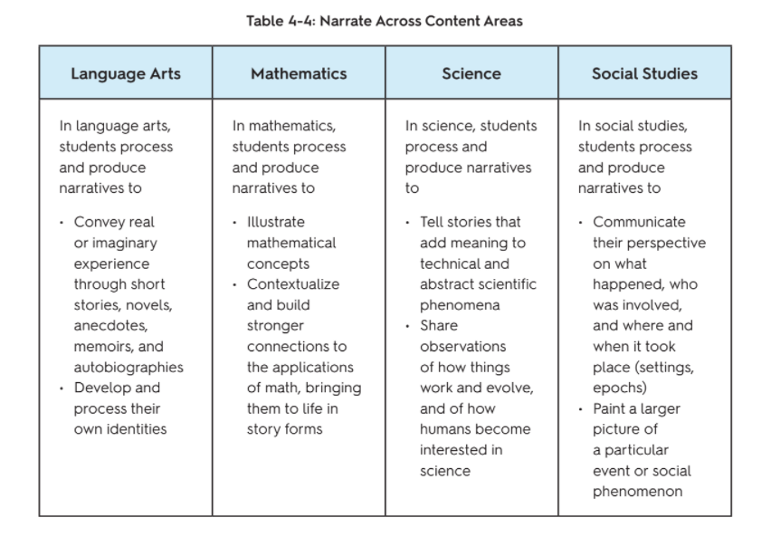
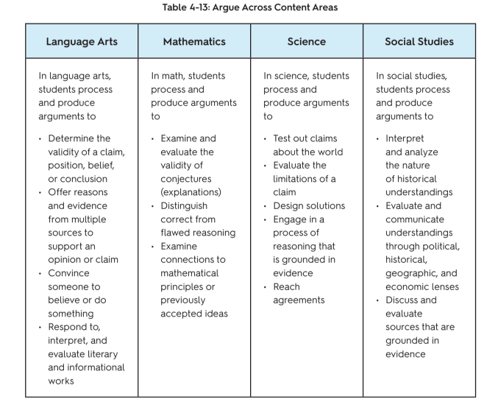
Pg. 233
Pg. 224
Notes:
On pages 224-233 of the WIDA ELD Standards Framework, these tables show more specific examples of how the four Key Language Uses show up in each of the four core academic disciplines.

Slide 8
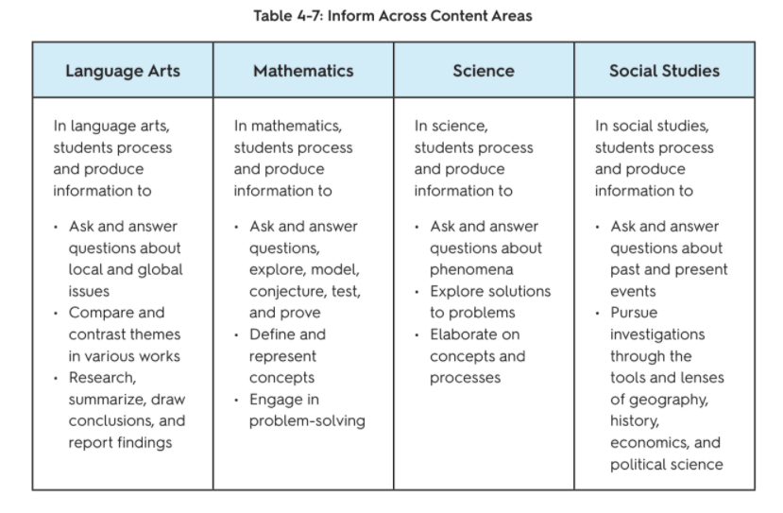
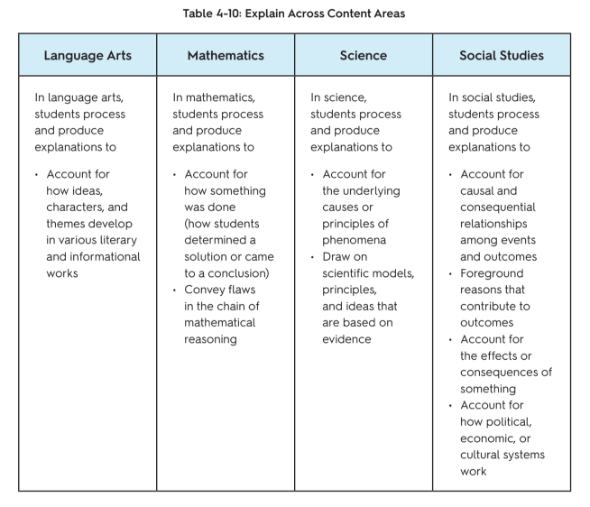
Pg. 230
Pg. 227
Notes:
On pages 224-233 of the WIDA ELD Standards Framework, these tables show more specific examples of how the four Key Language Uses show up in each of the four core academic disciplines.

Slide 9
Breakout Room Discussion
Choose 1 Key Language Use and review the documents for that KLU with your group.
What do you notice about this KLU across content areas?
What language supports or scaffolds might be useful for students for this KLU?
Notes:
Now let’s take 5-10 minutes to review these documents in pairs or groups. Choose one Key Language Use and review the documents for that KLU with your group.
What do you notice about the KLU across content areas?
What language supports or scaffolds might be useful for students for this KLU?

Slide 10
Let’s Practice
Unit Overview: This unit focuses on the idea that sound energy produces vibrations that travel in waves and are transferred through air particles.
Essential Question: How do sound waves produce and transfer energy?
Content Standard: NGSS-4PS3.2 Make observations to provide evidence that energy can be transferred from place to place by sound, light, heat, and electric currents.
Summative Assessment: Students will demonstrate comprehension of these concepts by writing explanations of how a singer breaks a glass with their voice.
4th Grade Science Unit
What is the KEY LANGUAGE USE in this unit?
What are examples of language students will need?
Notes:
Now we are going to practice identifying Key Language Uses in a unit. We will look at two sample units and use the information given to determine what Key Language Use is prominent in the unit that would be a useful focus for language instruction and think about the language that students will need to successfully engage in the unit.
In this first example, we will look at a 4th grade science unit.
(Read overview)

Slide 11
Let’s Practice
Unit Overview: Students read excerpts from two texts (nonfiction and fiction), Rilke’s Letters to a Young Poet and Mitchell’s Black Swan Green. These two texts are juxtaposed, allowing for a study of key ideas and characters across texts.
Essential Question: How is language used to convey central ideas in works of fiction and informational texts?
Content Standard: CCSS.ELA-LITERACY.RI.9-10.3
Analyze how the author unfolds an analysis or series of ideas or events, including the order in which the points are made, how they are introduced and developed, and the connections that are drawn between them.
Summative Assessment: Students write a formal, multi-paragraph response to the following prompt: Identify similar central ideas in Letters to a Young Poet and Black Swan Green. How do Rilke and Mitchell develop these similar ideas?
9th Grade ELA Unit
What is the KEY LANGUAGE USE in this unit?
What are examples of language students will need?
Notes:
In this second example, we look at a 9th grade ELA Unit.
(Read unit overview)

Slide 12
Breakout Room Discussion
Choose a unit example:
How are students being asked to use language in the unit?
What Key Language Uses best reflect how students will interact with language during this unit?
What types of language scaffolds might be useful to support students with this KLU?
Notes:
Now let’s take 5-10 minutes to discuss one of these two units in groups or pairs.
How are students being asked to use language in the unit?
What Key Language Uses best reflect how students will interact with language during this unit?
What types of language scaffolds might be useful to support students with this KLU?

Slide 13
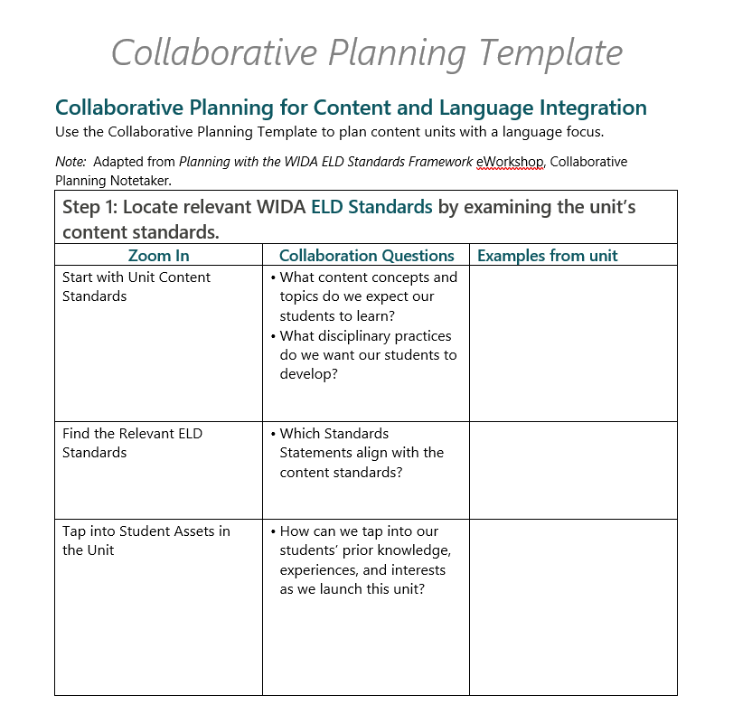
Collaborative Planning
Notes:
WIDA provides a useful Collaborative Planning Template in this e-workshop that can be used to plan for content and language integration when planning content units. Take a look at this template and consider how you might use some of the questions listed to support your unit planning process.

Slide 14
Collaboration Planning
How might your school draw on the Key Language Uses to establish a system that supports collaboration with a focus on language development within curricular units?
Notes:
Now let’s move back into our groups and discuss:
How might your school draw on the Key Language Uses to establish a system that supports collaboration with a focus on language development within curricular units?

