Slide 1
2019 Annual Report to the
IOOC on U.S. IOOS

Slide 2
U.S. IOOS 2019 Annual Report
IOOC Monthly Meeting
January 27, 2020 | Carl Gouldman

Slide 3
Agenda
ICOOS act - “report annually to the Interagency Ocean Observing Committee on the accomplishments, operational needs, and performance of the System to contribute to the annual and long-term plans…”
Approach - FY19 accomplishments - FY20 look ahead and next decade priorities
Portfolio updates and agency highlights
IOOS Program office items
Strategic vision, mission, and goals - linking IOOS Grand Challenges to UN Decade of Ocean Science

Slide 4
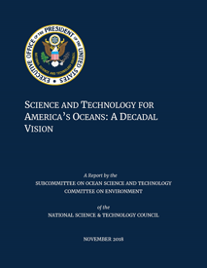
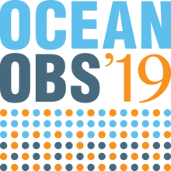
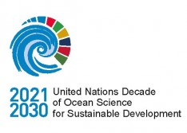
Looking forward
Supporting and implementing OceanObs’19 recommendations
UN Decade of Ocean Science for Sustainable Development
OSTP’s Science and Tech for Oceans: A Decadal Vision
IOOS Grand Challenges
Connecting Global and Coastal observations
Essential Ocean Variables and Communities of Practice development

Slide 5
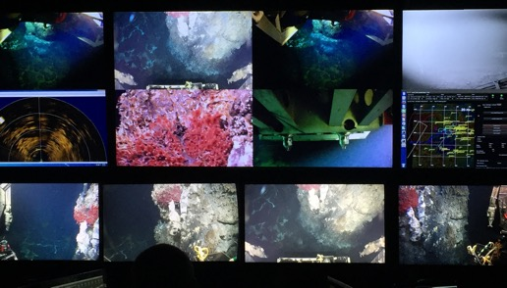
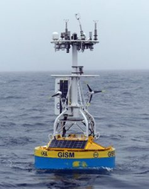
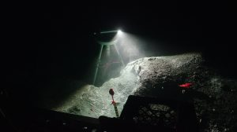
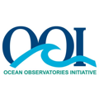
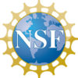
Ocean Observatories Initiative (OOI)
Regional Cabled Array 2019 Expedition
Successful annual maintenance and operations cruise - 44-day expedition (May 30-July 12, 2019) onboard the R/V Atlantis
Irminger Sea Global Surface Mooring Milestone
Sustained mooring in harsh conditions for 1+ year
Returned high quality data
Other Summer 2019 Successes:
Installed new high resolution, self-calibrating pressures sensor at Central Caldera, Axial Seamount
Recovered, repaired & reinstalled COVIS multibeam sonar at ASHES hydrothermal field & installation of thermistor array
Turned on CTD at ASHES hydrothermal field
Recovered ONR-funded uncabled Benthic Observatory Platform (BOP) from Oregon Offshore site & installed BOP at Southern Hydrate Ridge seep site
Recovered, repaired, and reinstalled University of Bremen-Germany-funded cabled overview multibeam sonar at Southern Hydrate Ridge. New 4K video-still camera installed
Notes:
Summer Regional Cabled Array (RCA) 44-day expedition (May 30-July 12, 2019) onboard the R/V Atlantis was highly successful with the completion of all tasks scheduled for this annual maintenance and operations cruise.
Other big success for summer 2019 occurred during nine days of at-sea operations dedicated to turning and installation of cabled and uncabled instrumentation and field work provided to externally-funded researchers. This work included the:
Installation of an NSF-funded new high resolution, self-calibrating pressures sensor at Central Caldera, Axial Seamount (W. Wilcock, University of Washington).
The recovery, repair and reinstallation of the NSF-funded COVIS multibeam sonar for hydrothermal plume imaging at the ASHES hydrothermal field, as well as installation of a thermistor array (K. Bemis, Rutgers University); Bemis also conducted a several hour thermal and video survey of the field.
The turning of an NSF-funded CTD at the ASHES hydrothermal field, Axial Seamount (W. Chadwick, Oregon State University). Note Chadwick received a new NSF award to expand the CTD network to monitor the release of subsurface brines associated with eruptions at Axial as observed during the 2015 eruption (see Xu et al., 2018).
The recovery of an ONR-funded uncabled Benthic Observatory Platform (BOP) from the Oregon Offshore site and installation of another BOP at a seep site at Southern Hydrate Ridge (C. Reimers-Oregon State University and P. Girguis-Harvard University) and associated sediment sampling; and
The recovery, repair, and reinstallation of a University of Bremen-Germany-funded cabled overview multibeam sonar for imaging of all methane plumes at Southern Hydrate Ridge (G. Bohrmann and Y. Marcon -University of Bremen) – the range of this sonar is now extended from 200 m to 700 m. A new 4K video-still camera was also installed near Einsteins’ Grotto.
Picture (Top): From inside the Jason control van, images of the active >270°C hydrothermal edifice “Inferno” showing a beautiful tubeworm bush – the bright red plumes indicate that these worms are “happy and healthy”. UW/NSF-OOI/WHOI: V19.
Picture (Bottom Left): Fig. 1. Irminger-5 surface buoy after deployment in June 2018. Damage to the direct covariance flux sensor (center of tower) is evident.
Picture (Bottom Right): A newly installed 4K camera provided by the University of Bremen, lights up a methane seep site at Southern Hydrate Ridge. The camera sends images of this dynamic habitat hourly back to shore. Seepage of fluids supports white bacterial mats and the pit is home to orange rock fish. Credit: UW/NSF-OOI/WHOI; V19.

Slide 6
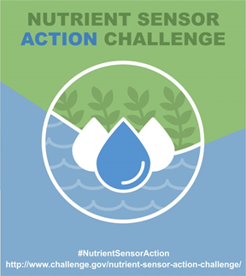
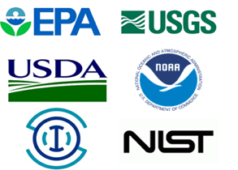
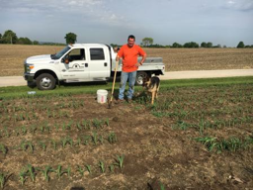
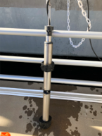
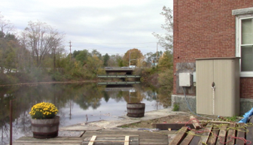
EPA and Nutrient Sensors
Nutrient Sensor Action Challenge
Completed Challenge Stage II and announced winners (Aug 2019):
League of Women Voters of Illinois (Jo Daviess County, Ill.), “Direct Data for Farm Nutrient Management”
South Platte Water Renewal Partners (Englewood, Colo.), “In-Plant Sensors for Nutrient Management”
University of New Hampshire (Durham, N.H.), "Impact of Dam Removals on Nitrate Retention"
More info: https://www.epa.gov/sciencematters/nutrient-sensor-action-challenge-winners-data-and-decisions-manage-excess-nutrients
Notes:
Nutrient Sensor Action Challenge: The Nutrient Sensor Action Challenge is one of a series of challenges focused on nutrient management conducted as part of multi-year collaboration between the EPA, the U.S. Geological Survey (USGS), the U.S. Department of Agriculture (USDA), the National Institute of Standards and Technology (NIST), the National Oceanic and Atmospheric Administration (NOAA), and the U.S. Integrated Ocean Observing System (IOOS). For this challenge, six teams deployed and collected data from two or more nutrient sensors for at least three months and sought to demonstrate how local communities can use the collected data to inform nutrient management.
Challenge winners announced (Aug 2019)
League of Women Voters of Illinois (Jo Daviess County, Ill.), “Direct Data for Farm Nutrient Management” – The team demonstrated how an edge-of-field sensor system could support farmers in reducing nitrogen loss from their fields. The installed sensors provide real-time data to inform management decisions at the farm-scale.
South Platte Water Renewal Partners (Englewood, Colo.), “In-Plant Sensors for Nutrient Management” – This facility is using sensor data to optimize wastewater treatment to meet more stringent nitrogen standards and improve watershed health.
University of New Hampshire (Durham, N.H.), "Impact of Dam Removals on Nitrate Retention" – The team deployed low-cost nutrient sensors to assess amount and timing of nitrate loading associated with dams.
More info: ** Nutrient Sensor Action Challenge Winners: Data and Decisions to Manage Excess Nutrients ** (10/22/2019) https://www.epa.gov/sciencematters/nutrient-sensor-action-challenge-winners-data-and-decisions-manage-excess-nutrients
Picture (Left): The League of Women Voters installed sensors on the farm of Steve Ehrler (pictured) to measure real-time nutrient levels.
Picture (Middle): The low-cost sensor on site at the water resource recovery facility.
Picture (Right): The location of one of the low cost nutrient sensors (in the small shed) at the Sawyer Mill Dam and Reservoir at the mouth of the Bellamy River watershed in Dover, New Hampshire.

Slide 7
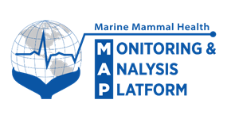
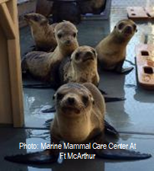
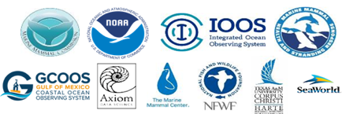
Marine Mammal Health Monitoring and Analysis Platform
Health MAP vision:
For everyone to observe spatial and temporal interactions
among marine mammal health, ocean health, & human activities
CY19 Activities and Accomplishments:
Continued development of a prototype data platform in the Gulf of Mexico (Gulf MAP)
Gulf Environmental Benefit Fund through NFWF
Development and implementation of the standardized, basic and detailed health data fields
Planning for further development of Health MAP capabilities in the Gulf through the CETACEAN* project as part of Restoration under the Open Ocean Trustee Implementation Group
Partners:
*CETACEAN: “Compilation of Environmental, Threats, and Animal data for CEtacean population health ANalyses.”
Updates available: https://www.mmc.gov/priority-topics/marine-mammal-health-and-strandings/

Slide 8
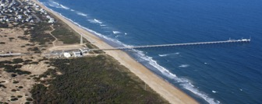
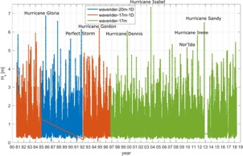
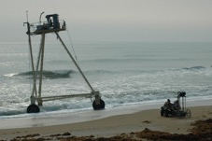
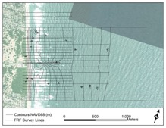
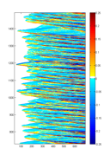
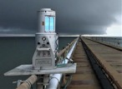
USACE Field Research Facility
Continuous Coastal Monitoring
Located in Duck, NC
Long-term met-ocean data
40 year continuous record
Winds, waves, currents, and more on North Carolina Outer Banks
Wave measurements from shoreline to shelf break
Long-term nearshore morphology data
40 year continuous record
Topo-bathy surveys collected with amphibious vehicles
1 km of shoreline surveyed ~monthly to 12+ m depth
Remote sensing
High-resolution 3D sensing of the surf-zone and beach response using lidar and video
Near-realtime, continuous lidar observations of waves and coastal inundation (wave runup)

Slide 9
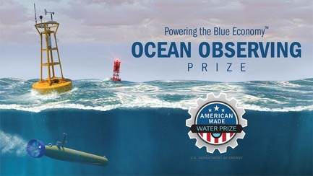
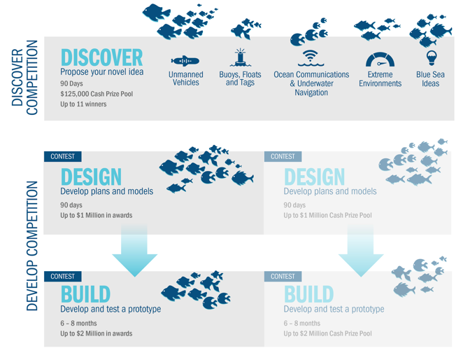
DOE - Powering the Blue Economy: Ocean Observing Prize
https://americanmadechallenges.org/oceanobserving/
$3 million prize competition to generate innovation in marine energy-powered ocean observing platforms.
Announced in September 2019
Important Dates
DISCOVER Stage Open: November 14, 2019
DISCOVER Submission Close: February 12, 2020
Judging and Review Complete: Anticipated March 5, 2020
DISCOVER Stage Winner Notification: Anticipated March 20, 2020
DISCOVER Stage Winner Announcement and Awards: Anticipated March 26, 2020

Slide 10
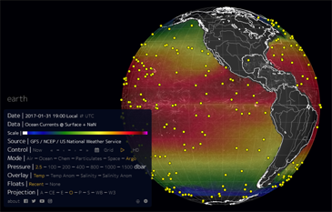
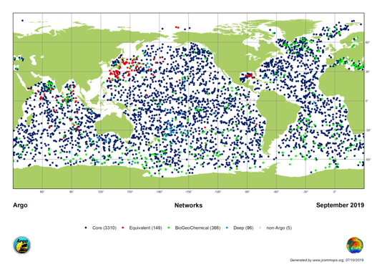
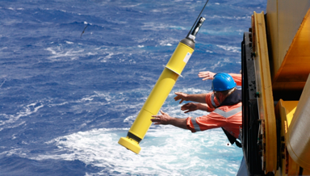
Argo Program
20th Argo Data Management Team Meeting (Villefranche-sur-mer, October 13-18, 2019)
Major focus on data visualization tools
FY19 - $3 Million Awarded for Biogeochemical Argo Float Research
Notes:
Selected projects:
Projects 1 & 2 received a total of $2 million in funding from NOAA and were selected under the 2019 National Ocean Partnership Program in partnership with NASA’s Ocean Biology and Biogeochemistry Program and NOAA’s Climate Variability and Predictability Program, as a contribution to Tropical Pacific Observing System 2020 project. Projects 3 & 4 received a total of $1 million in funding from NOAA Research.
1. “Improvements to Profiling Float Technology in Support of Equatorial Pacific Biogeochemical Studies” PI/Co-PI(s): Stephen C. Riser (UW), Ken Johnson (MBARI), Brendan Carter, (JISAO/UW), Thomas Mitchell (Sea-Bird)
2. “Developing an autonomous biogeochemical profiling float to monitor biological productivity, ocean-atmosphere CO2 fluxes, and hypoxia in the Tropical Pacific Ocean” PI/Co-PI(s): Sarah Purkey, Todd Martz, Lynne Talley, Dean Roemmich, Matthew Mazloff, Daniel Rudnick, Ariane Verdy (SIO-UCSD); Neil Bogue (MRV Systems LLC); Ken Johnson (MBARI)
3. “A Pilot BGC Argo Float Array in the California Current Large Marine Ecosystem” PI/Co-PI(s): Greg Johnson, Richard Feely and Brendan Carter (PMEL), Stephen Riser (UW), Ken Johnson (MBARI), John P. Dunne (GFDL)
4. “Advancing Biogeochemical Argo at the Bermuda Atlantic Time-series Study Site” PI/Co-PI(s): David Nicholson, Susan Wijffels (WHOI).

Slide 11
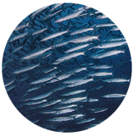
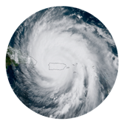
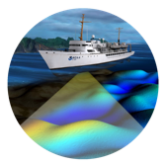
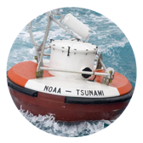
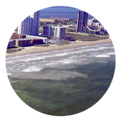
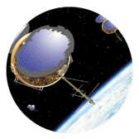
NOAA: Advancing Research Collaboratively
Blue Economy
Weather Research and Forecasting Act of 2017 and 2019
Seafood Production
Triple domestic marine aquaculture production and maximize sustainable commercial fishing by streamlining regulations
Tourism and Recreation
Promote sustainable tourism and recreation in U.S. coastal areas and Great Lakes by strengthening national marine sanctuaries
Ocean Exploration
Expand ocean exploration by making available seafloor maps and data of the entire U.S. exclusive economic zone
Marine Transportation
Strengthen maritime commerce by increasing vessel transit safety and efficiency at major U.S. seaports to reduce costs
Coastal Resilience
Support smarter coastal zone planning and more resilient economies in all U.S. coastal states and territories
Improved Hurricane Forecasting
Improved forecasting tools
Historical tropical cyclone tracking
Tsunami Warning and Education
Coastal Digital Elevation Models
Global Historical Tsunami Events
New Initiatives
Earth Prediction Innovation Center (EPIC)
Strategic collaboration on environmental modeling
4 new strategies
Unmanned Systems
Artificial Intelligence
‘Omics
Cloud Services
Science, Service, and Stewardship
National Oceanic and Atmospheric Administration | U.S. Department of Commerce

Slide 12
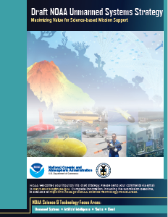
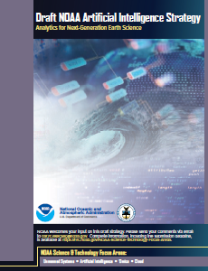
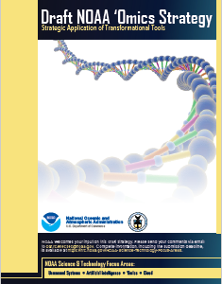
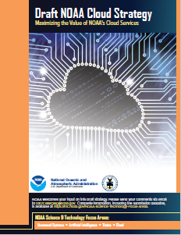
NOAA S&T Focus Areas - Draft Strategies
Four Draft Strategies - intended to expand NOAA’s application of these focus areas:
Unmanned Systems
Artificial Intelligence
‘Omics
Cloud Services
Will guide transformational advances in the quality and efficiency of NOAA's science, products, and services.
https://nrc.noaa.gov/NOAA-Science-Technology-Focus-Areas
Notes:
Unmanned Systems Strategy: In recognition of the opportunities unmanned systems presents for addressing NOAA's mission priorities, the NOAA Unmanned Systems Strategy provides a framework to: (1) efficiently provide requirements-driven, safe, cost-effective, and compliant Unmanned Systems services across the agency; (2) prioritize strategic investments in Unmanned Systems applications and technologies that fuel innovation and strengthen operations, and (3) accelerate and enhance capabilities through partnerships.
Artificial Intelligence Strategy: The overarching goal of the NOAA Artificial Intelligence (AI) Strategy is to utilize AI to advance NOAA’s requirements-driven mission priorities. Through this strategy, NOAA seeks to reduce the cost of data processing, and provide higher quality and more timely scientific products and services for societal benefits.
'Omics Strategy: In recognition of the opportunities and challenges presented by the advent of ‘omics tools, the NOAA ‘Omics Strategy provides a framework to advance the application of ‘omics to address mission priorities. The strategy leverages NOAA’s current organizational structure to more effectively implement ‘omics through improvements in computational and analytical capacities, targeted research, technology transition, workforce proficiency, and partnerships across NOAA’s lines, federal agencies, and extramural research and commercial communities.
Cloud Strategy: NOAA’s robust experience with cloud applications is already beginning to demonstrate significant improvements in performance and skill in areas such as satellite data products and services, numerical weather prediction, ocean models, and big data analysis, storage and dissemination. Cloud services will be further leveraged to expand benefits, such as: (1) accelerated timeline to acquire new computing resources, (2) increased security posture, (3) more accessible and monetizable NOAA data to customers, such as academia and industry, (4) reduced transition time from research to operations, (5) scalable infrastructure that supports scientific and high performance computing requirements, and (6) a more agile and innovative culture.

Slide 13
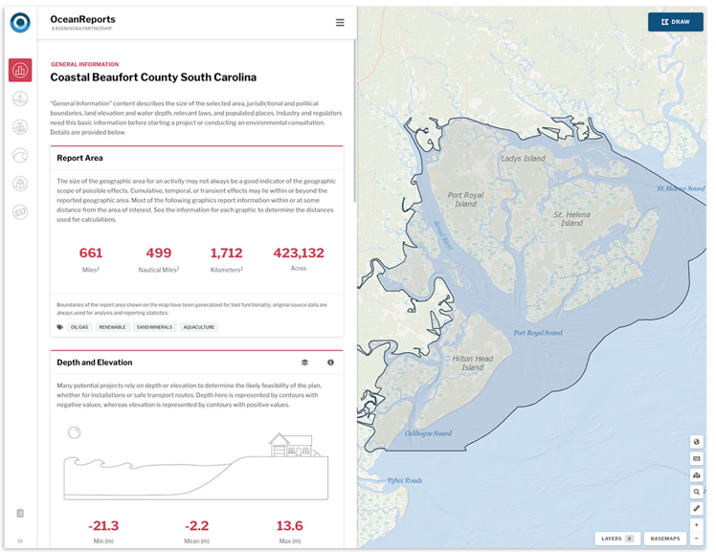
OceanReports Tool
Debuted in April 2019
New web-based interactive tool for ocean mapping and planning
Provides analyses of 'ocean neighborhoods' to support ocean commerce, energy development, and conservation.
https://www.marinecadastre.gov/oceanreports/

Slide 14
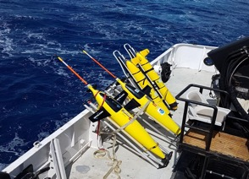
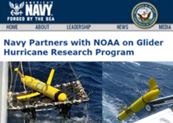
U.S. Glider Network
7,089 Glider Days = 160,000 observations
made available to models!
2019 Accomplishments
Held International “Best Practices” Workshop
Glider - Model comparisons carried out in real-time
Glider DAC Supported New Variables beyond CTD
Navy Partnership Strengthened & Navy glider data made public
Hurricane Glider Partners Expanding!
Looking Ahead
New US Glider Community Coordinator - Bill Lingsch
Model Comparisons for All Gliders
Raw Data Upload Tool
130+ Participants from around the World!
Notes:
2019 Accomplishments
IOOS and UG2 Hosted an International Glider “Best Practices” Workshop in which over 130 participants from around the world came together to discuss and promote glider practices. Input from the community was synthesized. Actions are being taken to implement some of the key community recommendations, including the hiring of a US Glider Community Coordinator.
Oceanographic model comparisons continue to be run and made available in real-time for all gliders involved in the hurricane lider effort. These comparisons are yielding valuable insights into model performance and in some cases glider data impact.
This year the IOOS Glider DAC started accepting data beyond the standard Conductivity, Temperature, and Depth (CTD) Data. It now accepts any variable with a Standard CF Name.
The Partnership with Navy continues to develop and grow. This year the Navy participated in the Hurricane Glider effort and provided close to 10,000 observations in the Caribbean, GoMex, and Mid-Atlantic. The Navy-NOAA MOU is being updated to allow for increased collaboration around unmanned marine systems.
This year saw the biggest increase in partners participating in the hurricane glider effort. Over 33 gliders were deployed as part of the effort with over 13 organizations participating!
Looking Forward
In response to community feedback from the International Workshop, IOOS is hiring a US Glider User Group (UG2) Coordinator. This person will help implement recommendations for the workshop and work to build momentum in the glider community.
The IOOS Glider DAC is working to make model comparisons available for all gliders through the GDAC Map page. Users will be able to click on a glider and see how well a model is performing compared to the real world conditions reported by a glider.
Also, the GDAC will be rolling out a Raw Data Upload tool which reduce the burden on data providers by automatically converting data retrieved from a glider into the IOOS Format.

Slide 15
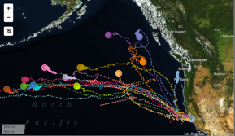
U.S. Animal Telemetry Network (ATN)
FY19 Accomplishments and Funding
$1.46M Total investment from ONR, BOEM, NOAA
Building U.S. telemetry community:
Hosting ATN Data Workshops centered at NMFS Science Centers
7th of 8 planned stakeholder workshops convened; 4 reports completed; common national themes distilled; initial regional telemetry priorities drafted
Live opening of ATN DAC -“A Telemetry Community Resource”
54 Projects/31 Discoverable, 41 PIs/30 Institutions, 27 Species, 504 Deployments, 7 Datasets DOI minted and archived
Proposal drafted w/International Partners to OGC to recognize the “Animal Borne Sensor Network“ (ABSN) as an ‘emerging network for GOOS
Animal Telemetry Baseline Network Support: Two regional acoustic network Data Wranglers (FACT & ACT); Georgia Coastal Acoustic Receiver Array; Argos satellite fees payment program; Develop Next generation animal movement analysis tools; Satellite/Acoustic Telemetry Asset Inventory
https://ioos.noaa.gov/project/atn/
Notes:
$1.46M Total investment from ONR, BOEM, NOAA
7th of 8 planned stakeholder workshops convened; 4 reports completed; common national themes distilled; initial regional telemetry priorities drafted
Live opening of ATN DAC -“A Telemetry Community Resource” that is not only a data repository, but a cyber workspace for researchers to upload, manage, analyze, share and archive their data
54 Projects/31 Discoverable, 41 PIs/30 Institutions, 27 Species, 504 Deployments, 7 Datasets DOI minted and archived
Building U.S. telemetry community: Hosting ATN Data Workshops centered at NMFS Science Centers
Proposal drafted w/International Partners to OGC to recognize the “Animal Borne Sensor Network“ (ABSN) as an ‘emerging network for GOOS
Animal Telemetry Baseline Network Support: Two regional acoustic network Data Wranglers (FACT & ACT); Georgia Coastal Acoustic Receiver Array; Argos satellite fees payment program; Develop Next generation animal movement analysis tools; Satellite/Acoustic Telemetry Asset Inventory

Slide 16
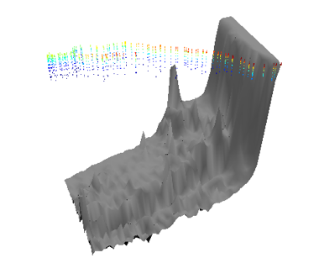
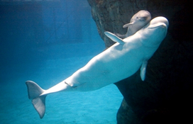
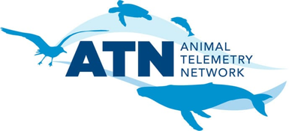
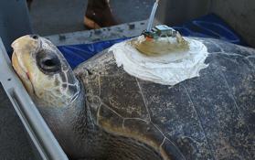
U.S. Animal Telemetry Network (ATN)
FY20 Plans
Continue providing focused workshops/technical assistance
Develop capability in the DAC to QC, apply BUFR code and insert ocean profiles from animal-borne tags onto the GTS in R/T
OCG recognition of ABSN as an emerging network in GOOS
Improve data, analytics, and visualization in DAC and community
Partner with the OTN and the U.S. acoustic telemetry community and assist acoustic PIs with the permanent archival, DOI minting and release of their data.
Maintain strong collaboration with MBON aimed as a sustained IOOS Bio-observing system
Notes:
FY20 Plans and Funding
Shortfall of $400K in funding due to budget reductions at BOEM
Continue providing focused workshops/technical assistance to
ATN PIs submitting their data to the DAC and to the broader
community seeking to make use of datasets in the DAC
Develop capability in the DAC to QC, apply BUFR code and insert
ocean profiles from animal-borne tags onto the GTS in R/T
Achieve formal recognition from OCG of ABSN as an emerging network
Implement technical strategy for multi-sensor and Dtag data access and dissemination through the ATN data portal
Integrate nexgen animal movement analysis tools into the DAC including State Space Modeling and Innovative analytics and visualization tools/products
Partner with the OTN and the U.S. acoustic telemetry community to enable the DAC to serve as a national aggregation point for publically available U.S. acoustic telemetry datasets and assist acoustic PIs with the permanent archival, DOI minting and release of their data.
Maintain strong collaboration with MBON aimed as a sustained IOOS Bio-observing system

Slide 17
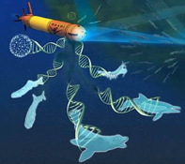
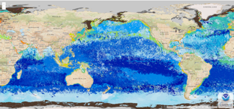
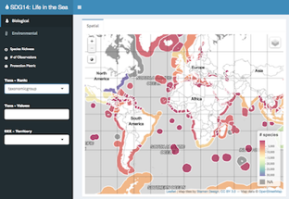
U.S. Marine Biodiversity Observation Network (MBON)
FY19 Plans and Funding
2019 NOAA Science Report included launch of MBON Seascapes products on CoastWatch
Six new interagency-supported MBON projects announced October 2019; ~$2.2M per year from NOAA, NASA, BOEM and ONR
Key features:
Expanded geographic coverage - all of California, Pacific Northwest, Arctic/US Chukchi, Gulf of Maine, and South Florida (including Florida Keys and Gulf of Mexico)
Multidisciplinary - eDNA, satellites, in situ, animal tagging, passive acoustics
MBON special issue in Oceanography anticipated September 2020
Revamped website with US and global information: marinebon.org
FY20 Plans and Funding
MBON All Hands and strategic planning meeting - hosted by NASA May 1, 2020
Continuing strong global engagement including the UN Ocean Decade
Notes:
MBON represents a strong partnership among NOAA, NASA, and BOEM with investments totaling over $2M per year since FY14.
MBON projects have been central in developing best practices for environmental DNA and demonstrating its utility for biological ocean observing; using a single water sample, eDNA can be used to detect organisms ranging from microbes to zooplankton, fish, and whales. This was highlighted at the first US national eDNA conference in November 2018.
In addition to development of the molecular aspects, MBON projects have also advanced the means to collect samples for eDNA analysis using autonomous underwater vehicles. This combination will eventually revolutionize our ability to develop required baselines and time series for life in the sea on regional to global scales.
MBON is also developing a dynamic seascape classification for the global ocean, characterizing the extent to which seascapes are dynamic on temporal and spatial scales. Seascapes are being identified using model and satellite remote sensing data that are updated regularly and time series that provide a historical context for reference against which to measure change; they are available on an operational basis at NOAA CoastWatch.

Slide 18
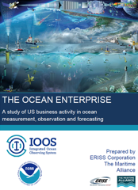
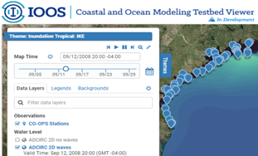
FY2020 IOOS Highlights
Implementing IOOS
CENOTE Act 2018 (Commercial Engagement Through Ocean Technology Act)
Weather Research and Forecasting Innovation Act 2017&19
NOAA Water Initiative
Blue Economy - Ocean Enterprise Study
Research and Development
Coastal and Ocean Modeling Testbed (COMT) - Water Modeling, Forecasting, and Prediction
Ocean Technology Transition - New Project Awards- FY2020
Research and Innovation Workshops

Slide 19
U.S. IOOS Enacted and President’s Budgets FY04-20
NOAA National Ocean Service - Navigation, Observations, and Positioning: ‘National IOOS’ component FY20 Omnibus $6.9M & ‘Regional IOOS Observations’ $39M
‘Request’ = the President’s Budget Request – ‘Enacted’ levels are post rescission totals

Slide 20
IOOS at OceanObs’19
31 Community White Papers published in Frontiers in Marine Science
Hosted 26 lightning talks in the IOOS Exhibit Booth
Celebrated 20 Years of IOOS

Slide 21
Regional Ocean and Great Lakes Data Sharing Network
Initiative to bring together technical staff focused on regional data sharing from regional ocean partnerships, Integrated Ocean Observing System (IOOS) regional associations, and states
Building awareness of Regional Data Sharing efforts
Builds on ongoing regional data sharing funding through NOAA OCM and IOOS
Workshop held in November 2019
Convened regional data sharing technical staff to:
Discuss the status of regional portal activities;
Development of common data products;
Investigate current technology trends to better align systems; and
Discuss a shared vision for future collaboration.
Workshop report published January 7th, 2020

Slide 22
Ocean Technology Transition Program
FY19 ($2.75M)
Four ongoing projects
Lake Erie HABs/Hypoxia (GLOS)
Impact of Observing Systems on Ocean Analysis-Forecast Systems (UCSC/ SCCOOS/CeNCOOS)
MARACOOS/U of Delaware [Data Integration and Web-based Model Validation Tool for NOAA CO-OPS]
U of Notre Dame [Building Coupled Storm Surge and Wave Operational Forecasting Capacity for Western Alaska]
Bio data pilot ‘seed’ projects
MBON - funding to take advantage of funding match to move biological data
into operations
FY20 (~$2.75M)
Two ongoing projects
MARACOOS/U of Del,
U of Notre Dame/Alaska
Three - Five new projects
31 proposals submitted
Review panel meets late March
Decisions in April
Focus areas include:
hardware and software platforms or sensors
sensors - e.g. HAB - sensors / platforms
novel data management tools and platforms
use of cloud-based technologies and platforms
novel autonomous vehicles
eDNA & Biology
High Frequency Radar
https://ioos.noaa.gov/project/ocean-technology-transition/

Slide 23
HF Radar Network Development
FY19
New Restore Act funds ‘Gulf Loop Current Study’ - 7 new sites LA/MS, Mexico, FL straights
5 New sites in 3 IOOS regions
Pacific Islands
Northeast
Caribbean
FY20
New sites TBD
Network management and health
Frequency licenses and wind turbine interference
https://ioos.noaa.gov/project/hf-radar/

Slide 24
National DMAC
FY19 ($1.4M - National DMAC)
DMAC Advancements:
ERDDAP 2.0
IOOS Metadata Profile 1.2
ATN Data Assembly Center (DAC) transitioned from research to operations
OceanObs’19 Community Whitepapers published in Frontiers:
Cloud Computing, Global Data Interoperability, Coastal Moorings, Global Biodiversity Observations, Quality Assurance Vision
Community Building, Training, and Technical Outreach Efforts:
IOOS Code Sprint #1 (held in Ann Arbor, MI October 2019)
https://www.glos.us/code-sprint/
Monthly DMAC Tech Webinars
DMAC Annual Meeting (April 2019):
Over 70 attendees - 15% of attendees from CIOOS (Canada)
Notes:
Picture (top): Figure 1 from “From the Oceans to the Cloud: Opportunities and Challenges for Data, Models, Computation and Workflows”. Data broker architecture diagram for Cloud ingest (source: NOAA BDP). CICS-NC: Cooperative Institute for Climate and Satellites – North Carolina.
Code Sprint Summary:
The IOOS Program Office, in collaboration with the Great Lakes Observing System (GLOS), hosted the inaugural IOOS Code Sprint October 8 - 10 in Ann Arbor, MI (for more information and materials, see: https://www.glos.us/code-sprint/).. The Code Sprint brought together over 45 software developers, data managers, and technical professionals from the IOOS Data Management and Communications (DMAC), the Canadian IOOS (CIOOS), Ocean Observatories, and other communities, to advance capabilities to publish physical, chemical, and biological ocean and lake observations. Most of the work centered on improving open source software libraries hosted on IOOS’ GitHub organization (https://github.com/ioos). Specifically, work was done to standardize the software used for QARTOD implementation, query and plot timeseries datasets hosted on ERDDAP servers on a mobile-friendly app, format and display biological datasets in Darwin Core schema, and leverage emerging commercial cloud technologies like ‘functions-as-a-service’ for data publishing needs. The Sprint combined parallel breakout sprint workgroup time with short lightning talk sessions and a few tutorials on technical topics of interest, including Python code packaging best practices, Docker, and the Python-based Pangeo platform for big data geoscience. The Code Sprint was hosted at a coworking venue in downtown Ann Arbor that provided flexible space for teaming and full-group presentations. A slide deck summarizing the sprint activities described below is available at the Code Sprint website.

Slide 25
A cloud based model development sandbox
Notes:
Developing and running numerical circulation models in the cloud.
Accelerate transition from research to operations by creating a cloud based environment that closely
emulates the operational environment of the National Weather Service supercomputer in terms of access to
initial/boundary conditions and in situ data for assimilation and/or verification.
The cloud infrastructure will be a tool to increase the capability of NOS to transition models from research
to operations and to provide an alternative computational environment to NCEP Central Operations, for
running ocean models and delivering quasi-operational products. As such there is a need for researchers
outside of NOAA to access the system and for NOS model operators (CO-OPS and OCS/CSDL) to access
the system. These two communities have different IT security risk postures and this project will begin to
outline the different requirements for addressing these risks.
Encourage community development of ocean models by enabling software engineering best practices - such
as distributed version control, and continuous integration testing.
Develop tools and best practices to ensure computational costs are allocated to various projects
appropriately and that costs for major system functionality are well understood (e.g. data ingest/egress v.
cycle time).

Slide 26
QARTOD
FY19 QARTOD manuals completed and published to ioos.noaa.gov:
Update to in-situ surface waves manual (Feb 2019)
Update to in-situ currents manual (July 2019)
New pH manual (Aug 2019)
New Frontiers Research Topic: Best Practices in Ocean Observing
Includes 15 articles by 249 authors
Has nearly 40,000 topic views!
Quality Assurance of Oceanographic Observations: Standards and Guidance Adopted by an International Partnership published in Frontiers (Nov 2019)
FY20 QARTOD manuals planned/completed:
Update to in-situ temperature & salinity manual (Jan 2020)
QARTOD - Prospects for Real-Time Quality Control Manuals, How to Create Them, and a Vision for Advanced Implementation, presented at the Ocean Sciences conference (Feb 2020)
Update to water level or data quality control flags (May 2020)
All manuals are included in the Ocean Best Practices repository.
https://ioos.noaa.gov/project/qartod/

Slide 27
Looking forward
Supporting and implementing OceanObs’19 recommendations
UN Decade of Ocean Science for Sustainable Development
OSTP’s Science and Tech for Oceans: A Decadal Vision
IOOS Grand Challenges
Connecting Global and Coastal observations
Essential Ocean Variables and Communities of Practice development

Slide 28
Back up slides

Slide 29
USACE Field Research Facility
Continuous in situ Nearshore Data
Located in Duck, NC
40 year oceanographic and meteorological data record
End of pier winds provide unobstructed high quality wind record
8m Array
High directional resolution wave data from phased array (8m depth)
Cross-shore array of wave measurements from shoreline to shelf break
Nearshore current measurements from 3 – 11 meters depth
Buoys Offshore
ADCP
Met
Altimeter
Pressure sensor (waves)

Slide 30
USACE Field Research Facility
Continuous Long-Term Morphology Data
Four decades of high quality transect topo-bathy surveys collected with amphibious vehicles along 1 km of shoreline
22 transect lines surveyed from dune toe to 8 meter depth.
10 lines surveyed from dune toe to 12+ meters depth.
962 total Surveys 1980-2020
14,677 cross-sections
228 Experiment Surveys
3080 cross-sections
CRAB
LARC
Provides site conditions for researchers and long term nearshore morphology change record.

Slide 31
USACE Field Research Facility
High-Resolution Remote Sensing Data
STATIONARY LIDAR
MOBILE LIDAR
VIDEO IMAGERY
High-resolution synoptic observations of coastal morphodynamics
Hourly 3D beach elevation data along 500-m of coast
Hourly wave runup & sea-surface elevation time-series in-line with FRF wave array
Half-hourly video imagery of surf-zone wave breaking and derived products (bathymetry, shoreline position, sandbar position, currents)
Quarterly 3D beach surveys along 40-km of outer banks shoreline

Slide 32
IOOS Strategic Plan
Vision - Improve lives and livelihoods with ocean,
coastal, and Great Lakes information
Mission - To produce, integrate, and communicate
high quality ocean, coastal and Great Lakes
information that meets the safety, economic, and stewardship needs of the nation.
Five Strategic Goals: Goal 1: Sustain long-term, high-quality observations of ocean, coastal, and Great Lakes
environments to address local, regional and national needs.
Goal 2: Deliver standardized, reliable, and accessible data.
Goal 3: Support model predictions that address a wide range of user requirements.
Goal 4: Provide integrated, user-driven products and tools.
Goal 5: Increase the reach and effectiveness of IOOS through partnerships, stakeholder
engagement, and Enterprise excellence.
32
https://cdn.ioos.noaa.gov/media/2018/02/US-IOOS-Enterprise-Strategic-Plan_v101_secure.pdf
Notes:
Five Strategic Goals:
Goal 1: Sustain long-term, high-quality observations of ocean, coastal, and Great Lakes environments to address local, regional and national needs.
Goal 2: Deliver standardized, reliable, and accessible data.
Goal 3: Support model predictions that address a wide range
of user requirements.
Goal 4: Provide integrated, user-driven products and tools.
Goal 5: Increase the reach and effectiveness of IOOS through partnerships, stakeholder engagement, and Enterprise excellence.

