Slide 1
COVID-19 Vaccine
Guidance for Those Working with Refugee, Immigrant, and Migrant Communities
Notes:
Script:
Thank you for taking the time to learn more about the COVID-19 vaccination process. It is our hope that this presentation will prepare you to share accurate and reassuring vaccine information to refugee, immigrant, and migrant communities.

Slide 2
NRC-RIM
The National Resource Center for Refugees, Immigrants, and Migrants (NRC-RIM) is funded by the U.S. Centers for Disease Control and Prevention and the International Organization for Migration to support state and local health departments working with refugee, immigrant, and migrant (RIM) communities that have been disproportionately affected by COVID -19.
This presentation has been adapted from slides created by the Minnesota Department of Health.
Notes:
Script:
The National Resource Center for Refugees, Immigrants, and Migrants (NRC-RIM) is funded by the U.S. Centers for Disease Control and Prevention and the International Organization for Migration to support state and local health departments working with refugee, immigrant, and migrant (RIM) communities that have been disproportionately affected by COVID -19.
This presentation has been adapted from slides by the Minnesota Department of Health, and we are grateful for their efforts and these materials.

Slide 3
Recognition of Abuse and Discrimination
RIM communities; black, indigenous, people of color; those with disabilities; and the LGBTQ+ communities have endured discrimination and medical abuse.
Among some, this has contributed to an understandable distrust in medicine and public health.
For certain RIM communities, distrust may exist alongside different cultural approaches to medicine and/or limited access to accurate information about the vaccine.
This may result in a hesitancy to be vaccinated.
Notes:
Script:
Refugee, immigrant, and migrant communities; black, indigenous, people of color; those with disabilities; and the LGBTQ+ communities have endured discrimination and medical abuse.
Among some, this has contributed to an understandable distrust in medicine and public health.
For certain RIM communities, distrust may exist alongside different cultural approaches to medicine and/or limited access to accurate information about the vaccin.
This distrust may result in a hesitancy to be vaccinated.

Slide 4
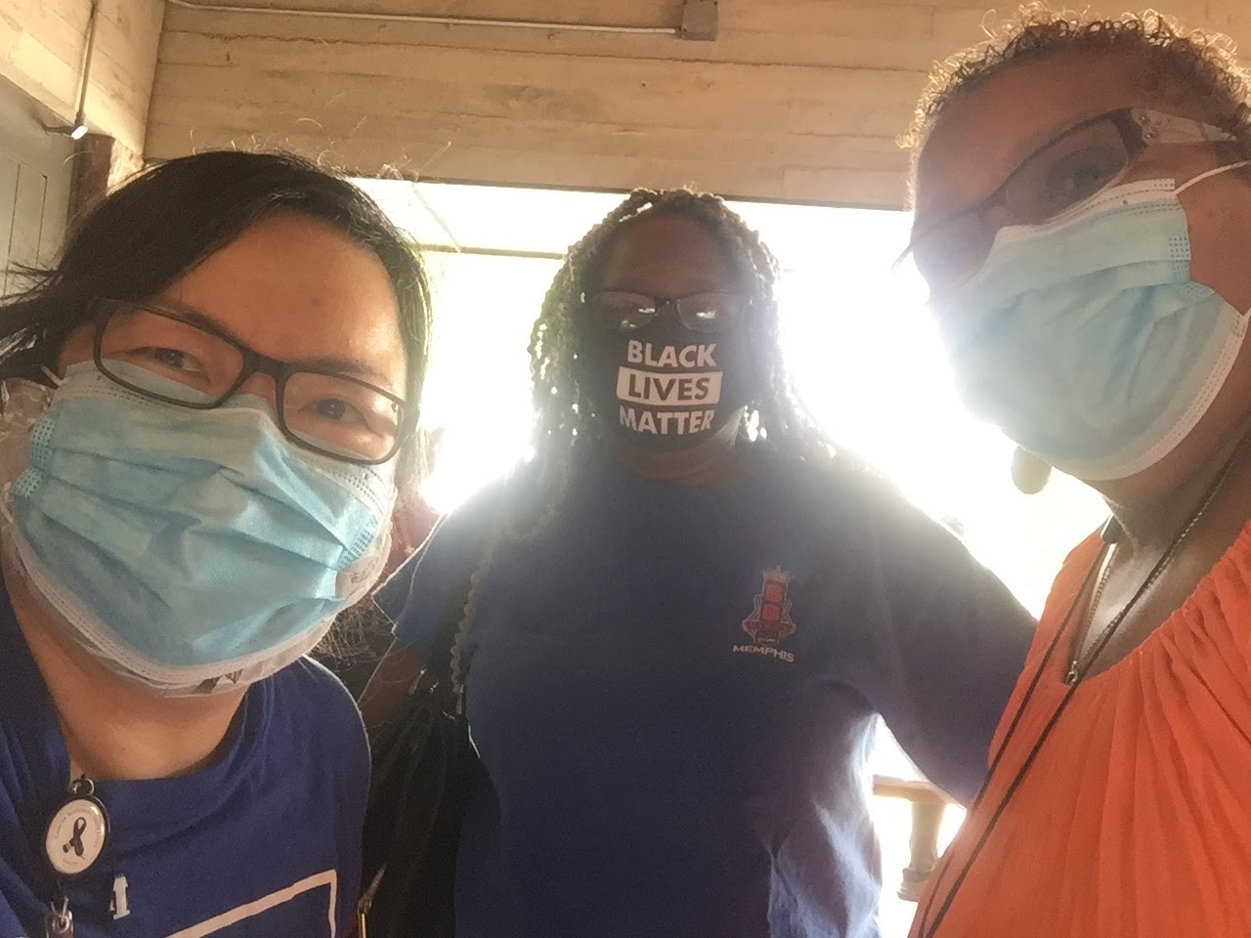
Addressing Distrust Based on Trauma
In addressing distrust based on trauma, providers must:
Recognize the trauma
Show understanding and compassion
Engage in transparent and open communication
Seek community input
Look at the issue from different perspectives
Acknowledge that trust takes time to build
Notes:
Script
Diverse communities are a long way from being healed. It is important to recognize the trauma that has occurred and lean into showing understanding and compassion. To support understanding, providers must engage in transparent and open communication, seeking community input in their work. It is necessary to view vaccine concerns and questions that come up from a perspective that takes into consideration centuries of injustice, and acknowledge that the building of trust takes time.

Slide 5
Purpose of Presentation
This presentation is intended to aid those working with RIM populations in:
Understanding the COVID-19 vaccine and
Effectively communicating knowledge about the COVID-19 vaccine to RIM communities
This presentation is not intended for direct use with RIM populations, but can be modified for such use.
The language used is simplified to support modification.
A shorter, more simplified presentation is available at nrcrim.org
Notes:
Script:
This presentation is intended to aid those working with RIM populations in:
Understanding the COVID-19 vaccine and
Effectively communicating knowledge about the COVID-19 vaccine to RIM communities
This presentation is not intended for direct use with RIM populations, but can be modified for such use.
The language used is simplified to support modification.

Slide 6
1.
Objectives
What will be covered
Notes:
Script:
This presentation will last approximately 30 minutes. Let’s begin by talking about what will be cover.

Slide 7
Objectives
After this presentation, you will be able to:
Describe how a vaccine is made
Explain details of the COVID-19 vaccine and its development
List benefits of the COVID-19 vaccine
Notes:
Script:
After completing this module, you will be able to:
Describe how a vaccine is made
Explain details of the COVID-19 vaccine and its development
List benefits to the COVID-19 vaccine

Slide 8
Objectives, Cont.
Explain how the vaccines will be distributed
Address vaccination concerns
Support refugee, immigrant, and migrant (RIM) communities in accessing the vaccine
Notes:
Script:
You will also be able to:
Explain how the vaccines will be distributed
Address vaccination concerns
Support refugee, immigrant, and migrant, or RIM, communities in accessing the vaccine

Slide 9
2.
Vaccine 101
An overview of vaccinations
Notes:
Script:
Now that we’ve seen the objectives and larger picture, let’s begin with an overview of vaccinations.

Slide 10
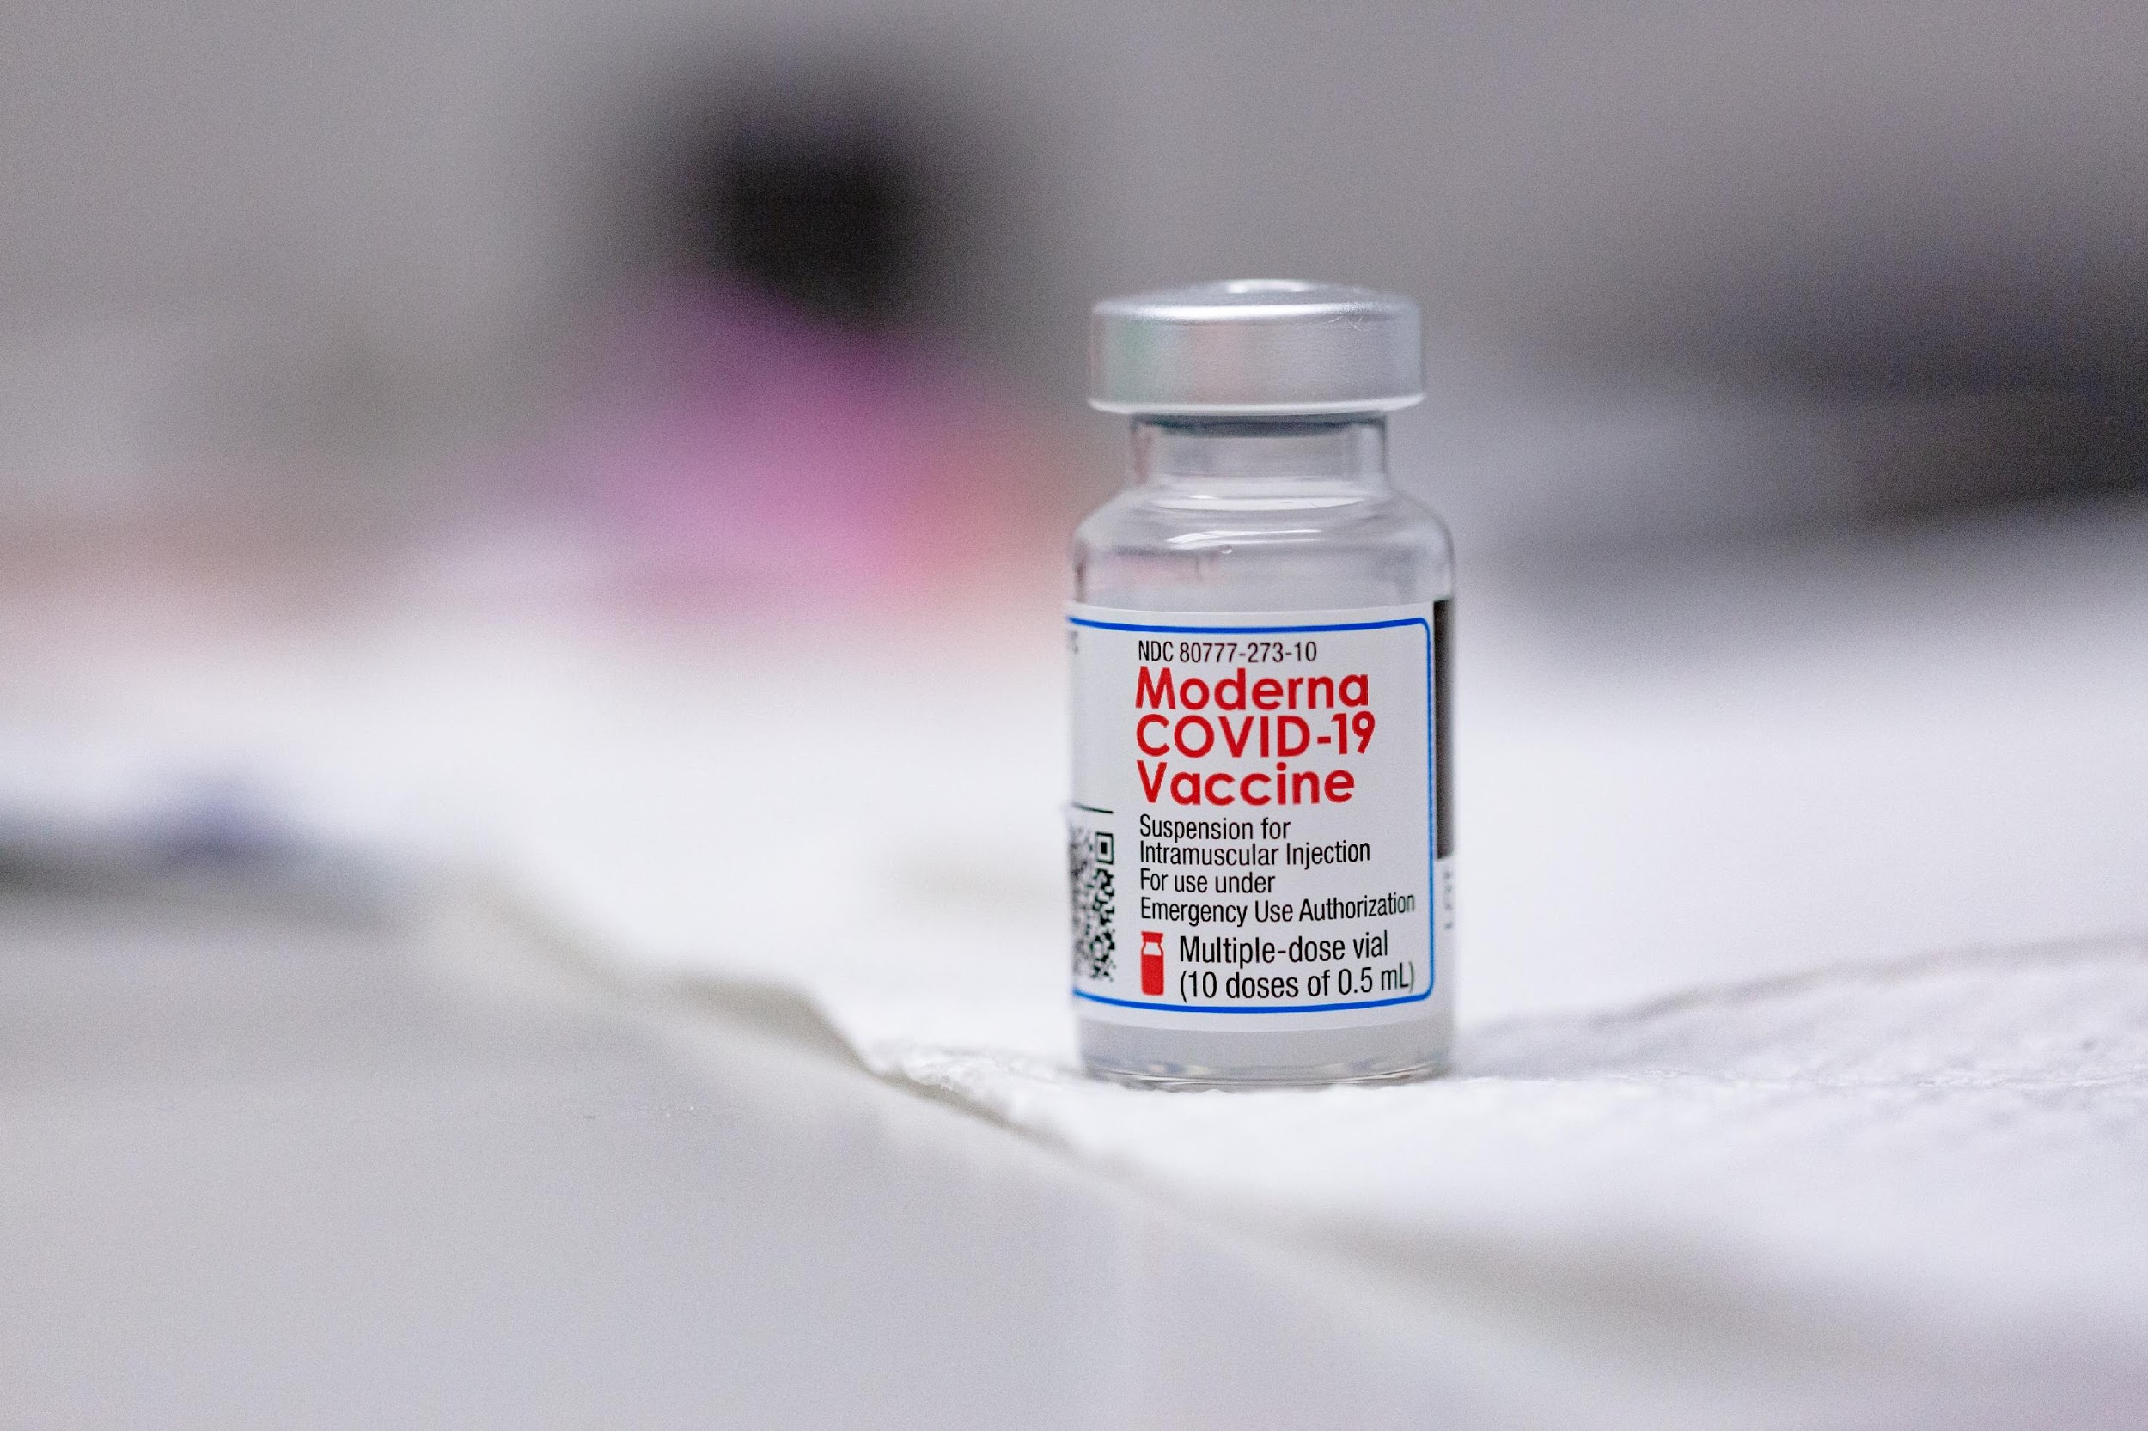
Vaccines
A vaccine is a product designed to help prevent diseases
Vaccines can help individuals from getting diseases such as:
Chickenpox
Influenza (flu)
COVID-19
Notes:
Script:
What is a vaccine? To put it simply, a vaccine is designed to help prevent us from getting sick from “germs”. The vaccine contains ingredients that give a person's body a sample of a germ so the body can learn to fight the disease. Common germs include bacteria and viruses. When a person’s body gets a vaccine with a sample of the virus or bacteria, their body makes antibodies that will guard them in the future. If a person then catches the actual virus or bacteria invader, their antibodies attack and kill the invader before it can make them sick.
Vaccines have helped eliminate worry about many diseases in the United States such as chickenpox. They also help protect people from diseases that still occur every year like influenza. In the short run the new COVID-19 vaccines can protect indivudal people from getting sick. In the long run, it is hoped that we can eliminate the concern for COVID-19 by making it rare, like chickenpox
In some cases, immunity does not last forever, whether you get a vaccine or get the disease.

Slide 11
Vaccines
Vaccines keep communities safe and healthy by:
Supporting herd immunity
Preventing a disease from spreading
Notes:
Script:
One way to help keep people healthy is widespread vaccination. Vaccinating all, or most, of the people in a community can help stop diseases like COVID-19 from spreading from one person to another. This is called herd immunity, when most people in a population or group are immune so that the infection cannot spread from person to person. When most of the people are immune and cannot get the disease, it helps to protect other people who cannot get the vaccine, or who have other conditions that make them vulnerable even if they get the vaccine. So when most the people get the vaccine, it can protect all the people.

Slide 12
COVID-19
A virus is a kind of germ that makes a person sick
COVID-19 is a disease caused by a virus discovered in 2019
Notes:
Script:
Many people call microorganisms that can make you sick, “germs”. A virus is the most common kind of germ that makes people sick. COVID-19 is a disease that is caused by a virus that was first discovered in 2019.

Slide 13
How Vaccines Are Made
A virus can be used to make a vaccine in different ways:
Using a whole virus by using it when it is dead or weakened (like Chickenpox, flu and MMR)
Using a piece of the virus (like tetanus and hepatitis B vaccines are made)
Without using any of the virus itself (how mRNA vaccines are made)
Notes:
Script:
The main three ways to make a vaccine against a virus are.
First, to include a whole virus inside the vaccine. In this case, the virus is weakened or killed, so that it cannot make someone sick with the disease. Many common vaccines are made this way, like chickenpox, influenza and Measles/MMR
A second method is to use just part of the virus. Because it is just a piece of a virus, it does not need to be killed or weakened. A piece of a virus cannot make someone sick. Many vaccines are made this way, probably the best known are tetanus and hepatitis B vaccines.
A third way to make a vaccine is to give the body instructions to make something that looks like a piece of the virus, but not give them any of the real virus. For COVID, this type of vaccine is called an mRNA vaccine. This type of vaccine does not contain any virus at all, and it does not create a virus in your body, so you cannot get the infection from the vaccine
While a person can get side effects from any vaccine since it is triggering your bodies defenses, most vaccines cannot make a person sick with the actual disease.

Slide 14
COVID-19 Vaccines
No COVID-19 vaccine is made using the whole killed or weakened viruses
One vaccine is made with a piece of the COVID virus, and two are mRNA vaccines and made with no virus
None of the vaccines can give a person COVID-19
Notes:
Script:
None of the COVID-19 vaccines contain the whole or weakened viruses, like influenza, chickenpox or MMR. They either use a messenger RNA (mRNA) and we call it an mRNA vaccine (Moderna and Pfizer), or they contain a piece of the covid virus (J&J vaccine). There is no possibility of getting the COVID virus with these types of vaccines.
After getting one of these vaccines, your body prepares for the actual infection by making antibodies which guard your body. If you get COVID, these antibodies work like guards –they recognize the virus and attack and kill the COVID virus before it can make you very sick.

Slide 15
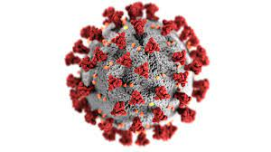
COVID-19 Vaccines
All three COVID-19 vaccines protect people by making their body recognize a piece of the outside of the COVID-19 virus called the “spike protein”.
The red knobs are the
“spike protein”
Notes:
Script:
All three vaccines protect a person by making their body recognize a piece of the outside of the virus called the “spike protein”. This part of the virus is critical to the virus being able to make you sick. If your body can attack these spike proteins when you get the covid, it will kill it before it can make you very sick.

Slide 16
Pfizer and Moderna COVID-19 Vaccines
Use messenger RNA (mRNA)
mRNA is a protein that:
Gives a body instructions to recognize the COVID virus that causes the disease and to kill it before it can make you sick
mRNA is not DNA, and does not interact or change an individual’s DNA in any way
Notes:
Script:
The mRNA vaccines, Pfizer and Moderna vaccines do not contain any live viruses (or germs). When someone gets one of these vaccines, it gives their body instructions to make something that looks just like the "spike protein”. When their body sees this fake spike protein their body responds by making antibody protectors against these spike proteins. These antibody protectors then stand by and are on-guard. If you catch COVID, these antibody protectors immediately attack the real COVID spike proteins, killing the COVID before it can make you sick.
Some people hear mRNA and confuse it with DNA. mRNA is very different than DNA. There is no DNA in the vaccine, and these vaccines to not affect someone's DNA.

Slide 17
Johnson & Johnson COVID-19 Vaccine
Attaches a piece of the COVID virus (the spike protein) to a harmless, killed virus (adenovirus)
After vaccination, like with the mRNA vaccine, if a person catches COVID their body kills the virus before it can make them sick.
Notes:
Script:
The J&J vaccine is not an mRNA vaccine. Instead, the J&J vaccine uses another virus, called an adenovirus (a virus that causes the common cold). The adenovirus is killed and then a fake spike protein is attached. After someone gets the vaccine, their body prepares their antibody protectors against the spike protein, like the mRNA vaccines. If the person catches the COVID, their antibody protectors recognize the spike protein and attack and kill the covid before it can make them sick.

Slide 18
Vaccine Ingredients
Do not include:
Eggs
Pork products
Gelatin
Latex
Preservatives
Microchips
Notes:
Script:
Some people have concerns about what is in vaccines. The COVID-19 vaccines available do NOT contain eggs, pork products, gelatin, latex, preservatives or microchips.

Slide 19
3.
COVID-19 Vaccine
Development and Efficacy
An overview of the vaccination development process and the COVID-19 clinical studies
Notes:
Now let’s move onto the vaccination development process and the results of the COVID-19 vaccine clinical studies.

Slide 20
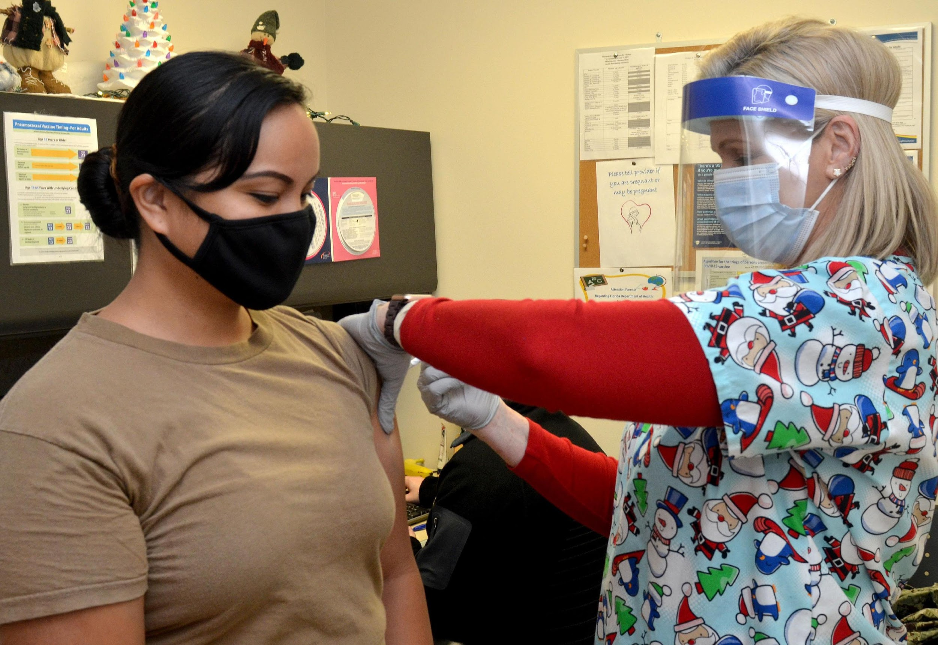
Vaccine Development Goals
Safe
Effective
Notes:
Script:
The two goals of any vaccine development are that the vaccine is safe and effective.

Slide 21
Vaccination Development
Notes:
Script:
The first COVID-19 vaccines have come out within a year of the COVID-19 virus being discovered, which is incredibly fast. Many people have questions about how a vaccine could be created so quickly.
This picture shows all the steps used to make, test, and approve any vaccine in the US. All three vaccines went through all these steps--no steps were skipped.
The reason this could occur so fast were: first, the technology used to make these types of vaccines already existed, and have more than 10 years research behind them, so they just needed to adjust them to the COVID virus. Second, money from the federal government and partnerships helped the process go much faster than usual. Third, usually each step is completed before the next step starts. To speed up the process, when possible, these steps overlapped and were done at the same time.
After the vaccine was developed, like every other vaccine in the US, the Food and Drug Administration (FDA) did a very thorough review of all the data to make sure it was safe and that it worked.
Every vaccine, COVID or other vaccine, must go through all these steps before it can be used outside research.

Slide 22
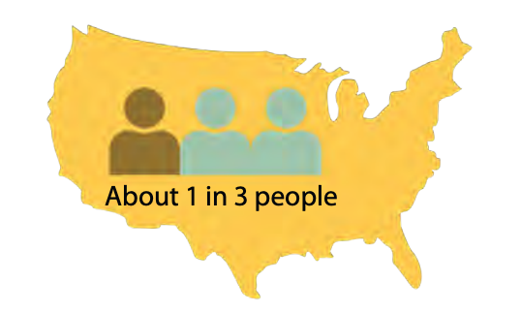
Clinical Studies
Pfizer Vaccine
44,392 participants
Race
26% Latinx
10% Black
5% Asian
0.5% American Indian/Alaska Native
Graphic Credit: Diversity in COVID-19 Vaccine Studies, Multnomah County Health Department
Notes:
Script:
Public health officials wanted to ensure the vaccine worked in all our various populations in the U.S. As a result, vaccine manufacturers worked to include study participants that reflect the diversity of the population, including race, ethnicity, and various ages and health conditions. In the Pfizer study, about 1 in 3 participants were people of color.

Slide 23
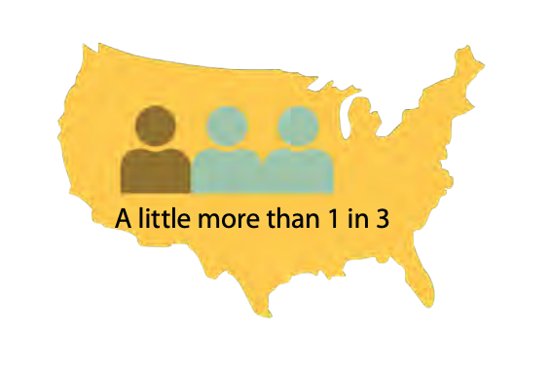
Clinical Studies
Moderna Vaccine
30,000 participants
Race
20% Latinx
10% Black
4% Asian
0.7% American Indian/Alaska Native
Graphic Credit: Diversity in COVID-19 Vaccine Studies, Multnomah County Health Department
Notes:
Script:
In the Moderna study, a little more than 1 in 3 participants were people of color.

Slide 24
Clinical Studies
Johnson and Johnson Vaccine
44,325 participants
Race
45% Latinx or Hispanic
13% Black
6% Asian
1% American Indian/Alaska Native
Notes:
Script: The J&J vaccine trial population in the study was “diverse and broad”. 44% were from the US with the other main countries where it was studied in Central and South America (41%) and South Africa (15%).

Slide 25
Clinical Studies
Pfizer Vaccine
Efficacy rate of 95%
Moderna Vaccine
Efficacy rate of 94%
Johnson & Johnson Vaccine
Efficacy rate of 72% in US trials
Notes:
Script:
Both the Pfizer and Moderna vaccines are over 94% effective, meaning they totally prevented COVID-19 disease in more than 9 out of 10 people. The Johnson & Johnson totally protected about 7 in every 10. However, all three vaccines prevented everyone who got them from very severe disease or from dying.

Slide 26
What Is Known About the Vaccines
Helps most not to get sick at all
Helps some get less sick
Works in all different groups:
Different ages
Different racial and ethnic groups
Different health conditions
Works even for new COVID-19 variants
Notes:
Script:
The high efficacy rates mean that the vaccine helps most people not to get sick. The few people who do get sick after the vaccine get less sick, and don’t die from the infection.
Because participants in the vaccine studies included people of different races, ethnicities, ages, and health conditions, we know that the vaccine works equally in everyone.
There may be questions about how well the COVID-19 vaccine works on new COVID-19 variants. Current research shows that the COVID-19 vaccine still protects against these new variants.

Slide 27
What Is Known About the Vaccines
Pfizer vaccine requires two doses
Moderna vaccine requires two doses
Johnson & Johnson vaccine requires one dose
All take a couple weeks to give any protection
A person is not fully protected until at least two weeks from final dose
Notes:
Script:
The Pfizer and Moderna vaccines require two doses about 1 month apart. The Johnson & Johnson vaccine requires only one dose. All vaccines take a couple of weeks to give any protection. After the final dose of any of these vaccines, it takes about two weeks for the body to build up full protection.

Slide 28
What Is Still Being Learned
When herd immunity will be reached
If the virus can be passed by those vaccinated
How long vaccine protection will last
When everyone will get vaccinated
Notes:
Script:
There are some things we don’t know about COVID-19 vaccines yet.
We know these vaccines are good at preventing people from getting sick, but we don’t have enough data yet to say if someone who was vaccinated may still spread the disease to others if they get infected with COVID-19.
At this time, we do not know if this will be a vaccine that people need to get again, like needing a flu vaccine every year, or the tetanus shot every 10 years.
At this point, we do not know when there will be enough vaccine for everyone who wants it. We also don’t know when we will have enough people vaccinated in order to put an end to this terrible pandemic.

Slide 29
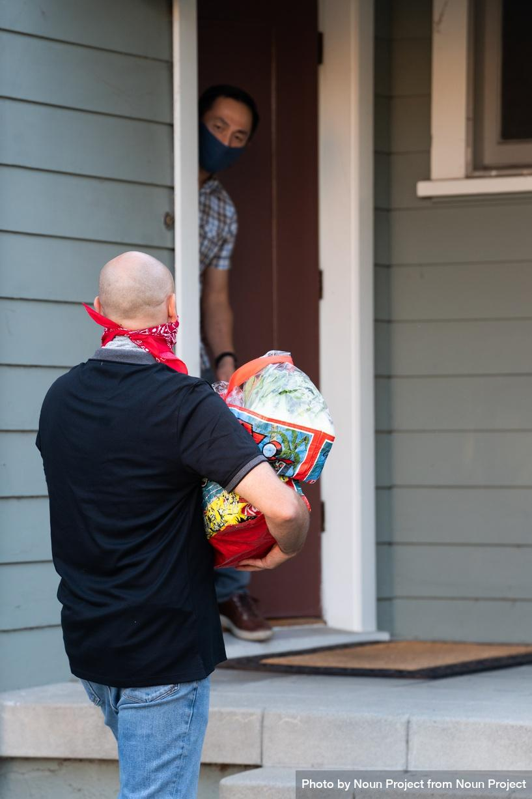
What This Means
The public should continue to follow public health recommendations:
Wear a mask
Frequently wash hands
Stay 6 feet from others
Stay home as much as possible
Notes:
Script:
Because there is still so much that is unknown, it is important that we continue to follow public health recommendations and wear masks, wash our hands frequently, maintain social distance, and stay at home as much as possible.

Slide 30
4.
Supply and Distribution
An overview of supply, distribution, and side effects
Notes:
Script:
Now that we know we have safe vaccines that work, how is it getting out to people and what side effects, if any, are people experiencing?

Slide 31
Vaccine Allocation
Not enough for all to be vaccinated at once
Vaccine priorities vary from state to state
Each state is considering:
Vaccine availability
Who is most likely to be exposed to COVID-19
Who is most likely get very sick from COVID-19
Notes:
Script:
There is not enough vaccine available to give it to everyone at the same time. More vaccine is becoming available every day.
Because there is not enough vaccine for everyone right away, difficult decisions have to be made about who gets the vaccine first and how to get the vaccine out to people.
There are many, many people that need the vaccine. The goal for the first, limited doses of COVID-19 vaccine is to give vaccine to those at highest risk of getting COVID-19 and those most at risk of severe disease and complications if they get COVID-19.
Each state does not control how much vaccine is received from the federal government, but each state can make sure that the vaccine they get, gets out to people that need it quickly and safely. Decision makers are responsible for making sure that the vaccine efforts are equitable--meaning that we need to make sure those in charge are making the vaccine available to all people fairly regardless of where they live, the color of their skin or how much money they have.

Slide 32
Free Vaccines for Everyone
Vaccines are free for everyone
There may be an administration fee billed to insurance
No one can be denied a vaccine if there are unable to pay an administration fee
Anyone can be vaccinated regardless of immigration status
Notes:
Script:
COVID-19 vaccine will be provided free of charge. A person might be asked for their insurance information because health care providers can charge an administration fee for giving the vaccine to someone. However, anyone can still get the COVID-19 vaccine if they do not have insurance and/or cannot pay the administration fee. No one should receive a bill for the vaccine or administration fee. If you get a bill, call your clinic and let them know you should not have to pay.
The vaccine will be available to all -- no one will be asked about their immigration or citizenship status.

Slide 33
Free Vaccines for Everyone
It is recommended for all adults, including those who already had COVID-19
Individual choice as to whether or not to vaccinate
Age of availability depends on vaccine type
Pfizer vaccine is for those 16 and above
Moderna vaccine is for those 18 and above
Johnson & Johnson vaccine is for those 18 years and above
Notes:
Script:
Everyone is recommended to get the COVID-19 vaccine when it is available to them, even if they have had COVID-19 disease before. However, it is an individual’s choice as to whether or not they receive the vaccine.
The age of availability depends on vaccine type: The Pfizer vaccines is for those 16 and older, while the Moderna and Johnson & Johnson vaccines are for those 18 and older.

Slide 34
Fertility and Pregnant Women
No evidence the vaccine causes fertility problems
Pregnant women should talk to their doctor about whether they should get vaccinated
Notes:
Script:
While there is no evidence the vaccine causes fertility problems, pregnant women should talk to their doctor about whether they should get vaccinated

Slide 35
Beware of Scams
Health care providers will never contact an individual to request personal information or credit card information in order for them to receive the COVID-19 vaccine
Offers to sell or ship vaccine are scams
Notes:
Script:
There are scams related to the COVID-19 vaccine. Note that health care providers will never contact an individual and ask for their personal information or credit card information in order for them to receive the vaccine. Offers to sell or ship vaccine are also scams. If a suspicious call is received, it should be ignored.

Slide 36
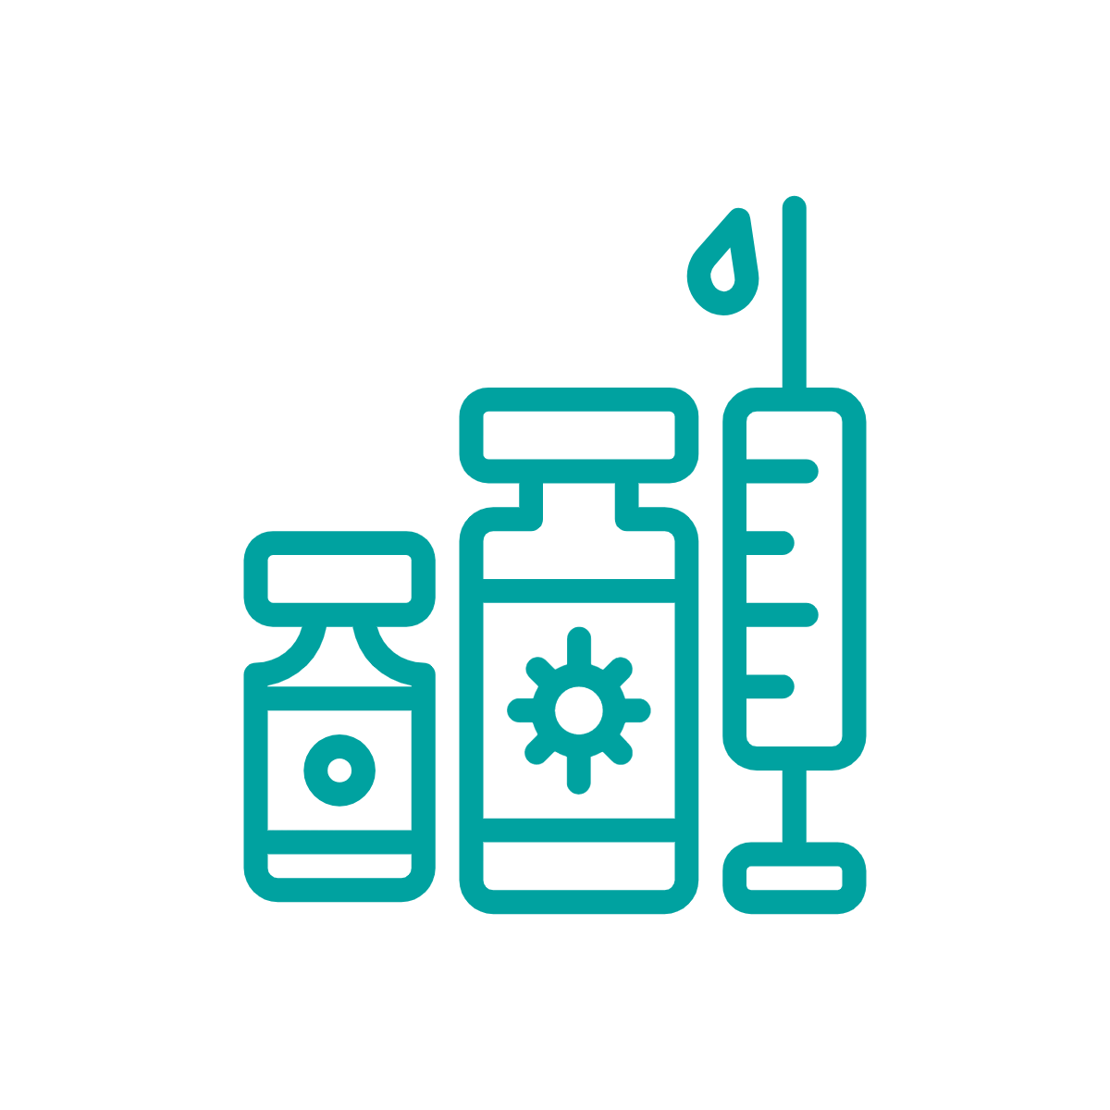
Language Access
If a person has limited English proficiency, they should be offered (or request) professional interpreter services
Handouts should be in the patient’s language
Consent must be obtained in the patient’s primary/preferred language.
Notes:
Script:
At the clinic, a person who has limited English proficiency should be offered (or request) a professional interpreter services to make sure their questions are answered. The ACA requires language services as a matter of law. They should also be given a fact sheet, called the emergency use authorization (EUA) fact sheet, from the federal government. Ideally, this should be given in the primary/preferred language. Consent must be obtained in the patient’s primary/preferred language.
Individuals have the right to refuse or accept the COVID-19 vaccine.

Slide 37
Side Effects
Are normal
Mean the body is developing immunity
Are signs that the vaccine is teaching a person’s body how to fight COVID-19
Do not mean that a person has COVID-19
Notes:
Script:
Some side effects are common when someone gets their COVID-19 vaccination such as a sore arm, fever, headache, body aches and fatigue. Side effects mean the body is developing immunity and are signs that the vaccine is teaching a person’s body how to fight COVID-19. A sore arm may last for a few days but most side effects go away in a day or two.
Side effects do not mean that a person has COVID-19.
The vaccine cannot give someone COVID-19.

Slide 38
Side Effects, Cont.
Usually start within 24 to 36 hours
Go away after 24 to 48 hours
More common after final dose
More common in younger adults
Serious adverse effects are rare
Notes:
Script:
Side effects usually start in 12-24 hours and go away within 1-2 days. They are more common after the second dose for Pfizer and Moderna vaccines. They are also more common in younger adults. They usually don’t prevent someone from doing their daily activities.
You might have heard about serious adverse events with COVID-19 vaccines. A serious “adverse event” is different than a “side effect” and is more serious, and could be life-threatening. These events are extremely rare. They may happen with severe allergic reactions to the COVID-19 vaccine. These occur within minutes after the vaccination. Health departments are aware of this and have talked to vaccinators and clinics about it. Clinics are prepared to respond quickly with the right medicine. The person getting the COVID-19 vaccine will be asked to wait 15-30 minutes after they have been vaccinated to make sure they do not have this reaction.

Slide 39
Side Effects, Cont.
Sore arm
Muscle aches
Headache
Fatigue
Fever, although less common
Notes:
Script:
After getting the COVID-19 vaccination, many people have a sore arm. Some people (about 15%) will have muscle aches, tiredness, headache, or maybe a fever, although a fever is less common.

Slide 40
Looking Ahead
Other vaccines are in production
Will have enough vaccine for widespread use sometime by summer of 2021
Notes:
Script:
Looking ahead, other vaccines are in production. Some have been approved to be used in other parts of the world. It is expected that there will be enough vaccine for everyone who wants to be vaccinated by summer of 2021.

Slide 41
6.
Considerations for RIM Communities
Who RIM communities are and how they can be supported in accessing the vaccine
Notes:
Let’s now turn our attention to RIM communities and how they can be supported in accessing the vaccine.

Slide 42
RIM Communities
Refers to refugees, immigrants, and migrants currently in the U.S. who were born in other countries
Notes:
Script:
”RIM communities” refers to refugees, immigrants, and migrants — people currently in the U.S. but who were born in other countries.

Slide 43
RIM Communities
There are neighbors and friends, business owners and entrepreneurs, parents and grandparents, artists and musicians.They care for the sick and the elderly, bring food to stores, educate children, and pursue their own education. They lead policy change at the state level, conduct health equity research, and run clinics.
Notes:
Script:
There are neighbors and friends, business owners and entrepreneurs, parents and grandparents, artists and musicians.They care for the sick and the elderly, bring food to stores, educate children, and pursue their own education. They lead policy change at the state level, conduct health equity research, and run clinics.

Slide 44
A Disproportionate Effect
There is growing evidence that COVID-19 disproportionately affects some populations, including certain RIM communities
Learn more about this through the NRC-RIM Module, Working with Refugees, Immigrants, and Migrants in COVID-19
Certain RIM communities may be hesitant to obtain the vaccine
This is due, in part, to social and structural determinants of health
Notes:
Script:
There is growing evidence that COVID-19 disproportionately affects some populations, including certain RIM communities
Learn more about this through the NRC-RIM Module, Working with Refugees, Immigrants, and Migrants in COVID-19
Certain RIM communities may be hesitant to obtain the vaccine
This is due, in part, to social and structural determinants of health

Slide 45
Social and Structural Determinants of Health
Social determinants of health - conditions in society that affect who gets sick and who doesn’t.
Examples: language barriers, transportation, working conditions, community strength, healthcare access
Structural determinants of health - larger social forces that impact on the way in which people live their lives.
Examples: racism, xenophobia, patriarchy, racial capitalism
Notes:
Script:
Social determinants of health are conditions in society that affect who gets sick and who doesn’t.
Examples of social determinants include language barriers, transportation, working conditions, community strength, healthcare access
Structural determinants of health are larger social forces that impact on the way in which people live their lives.
Examples of structural determinants of health include racism, xenophobia, patriarchy, racial capitalism

Slide 46
Community Diversity
There is great diversity within RIM communities:
Country of origin and ethnicity
Age
English proficiency
Educational background
Socioeconomic background
Culture
Notes:
Script:
RIM communities are not monolithic. Within RIM communities there is great diversity.

Slide 47
Community Diversity
Some are eagerly awaiting vaccinations
Others may be more hesitant
Newer arrivals (< 1 year) tend to be more open to vaccination
Possible that some may have been vaccinated before travel to the US
Notes:
Script:
As we discussed at the beginning of this presentation, some communities may be hesitant to receive the COVID-19 vaccine.
General data suggests that refugees, immigrants, or migrants who are newer arrivals to the US tend to be more open to the vaccine.
It is also possible that in the future, some refugees, immigrants, or migrants may be vaccinated before travel to the US.

Slide 48
Communicating with RIM Communities Regarding the Vaccine
Consider:
Individual readiness
English language proficiency
Use simplified language
Translate written materials
Ensure interpretation is available
Notes:
Script:
It’s important to be aware of and consider the diversity of responses to the COVID-19 vaccine. Providers should assess an individual’s readiness to receive the COVID-19 vaccine based on personalized conversation, and then tailor communications about the vaccine based on this.
If an individual has limited English proficiency, it’s important to ensure that written materials use simplified language, translated into the languages of community members. For verbal communication, information should be conveyed in the individual’s primary language. If the information is being communicated in English, interpretation should be provided by a trained interpreter.

Slide 49
Primary Message: Tagline
An example of an effective, primary message tagline for use with RIM communities is:
Protect yourself. Protect your community. Get vaccinated.
SAFE. EFFECTIVE.
Notes:
Script:
An example of an effective, primary message tagline for use with RIM communities is: Protect yourself. Protect your community. Get vaccinated. Followed by the words: SAFE. EFFECTIVE.

Slide 50
Primary Messages: Calls to Action
Effective calls to action will depend on the message tactic:
For use on digital and print materials promoting vaccinations: Get vaccinated.
For use in social media posts to counteract misconceptions and falsehoods related to COVID-19 vaccines: Get the facts.
Notes:
Script:
Effective calls to action will depend on the message tactic:
For use on digital and print materials promoting vaccinations, an effective message is: Get vaccinated.
For use in social media posts to counteract misconceptions and falsehoods related to COVID-19 vaccines, an effective message is: Get the facts.
It is recommended that you not refer to “misconceptions and falsehoods related to COVID-19 vaccines as “myths”.

Slide 51
Other Considerations and Solutions
Limited familiarity with US health systems
Identify vaccination sites
Support registration
Concerns about immigration status
Consider location of vaccination site
Reiterate that vaccinations are encouraged for all
Notes:
Script:
RIM communities may be less familiar with the US healthcare systems, so it’s vitally important to help RIM communities identify vaccination sites and support registration through clear and relevant communications.
Some within RIM communities may have concern about receiving the vaccine due to their immigrant status – so it’s important to consider the location of vaccination sites. for example, is law enforcement nearby? Might this support or hinder access? People supporting RIM communities should also reiterate that vaccines are available for, and encouraged for, all people, regardless of immigrant status.

Slide 52
Other Considerations and Solutions
Limited access to transportation
Identify site nearest individual
Provide clear directions
Organize a vaccination drive in a RIM community
Notes:
Script:
Limited access to transportation may also serve as a barrier to vaccination. Potential solutions may be to identify a vaccination site nearest to the individual, providing clear directions to the location of the site, or to organize a vaccination drive in a RIM community.

Slide 53
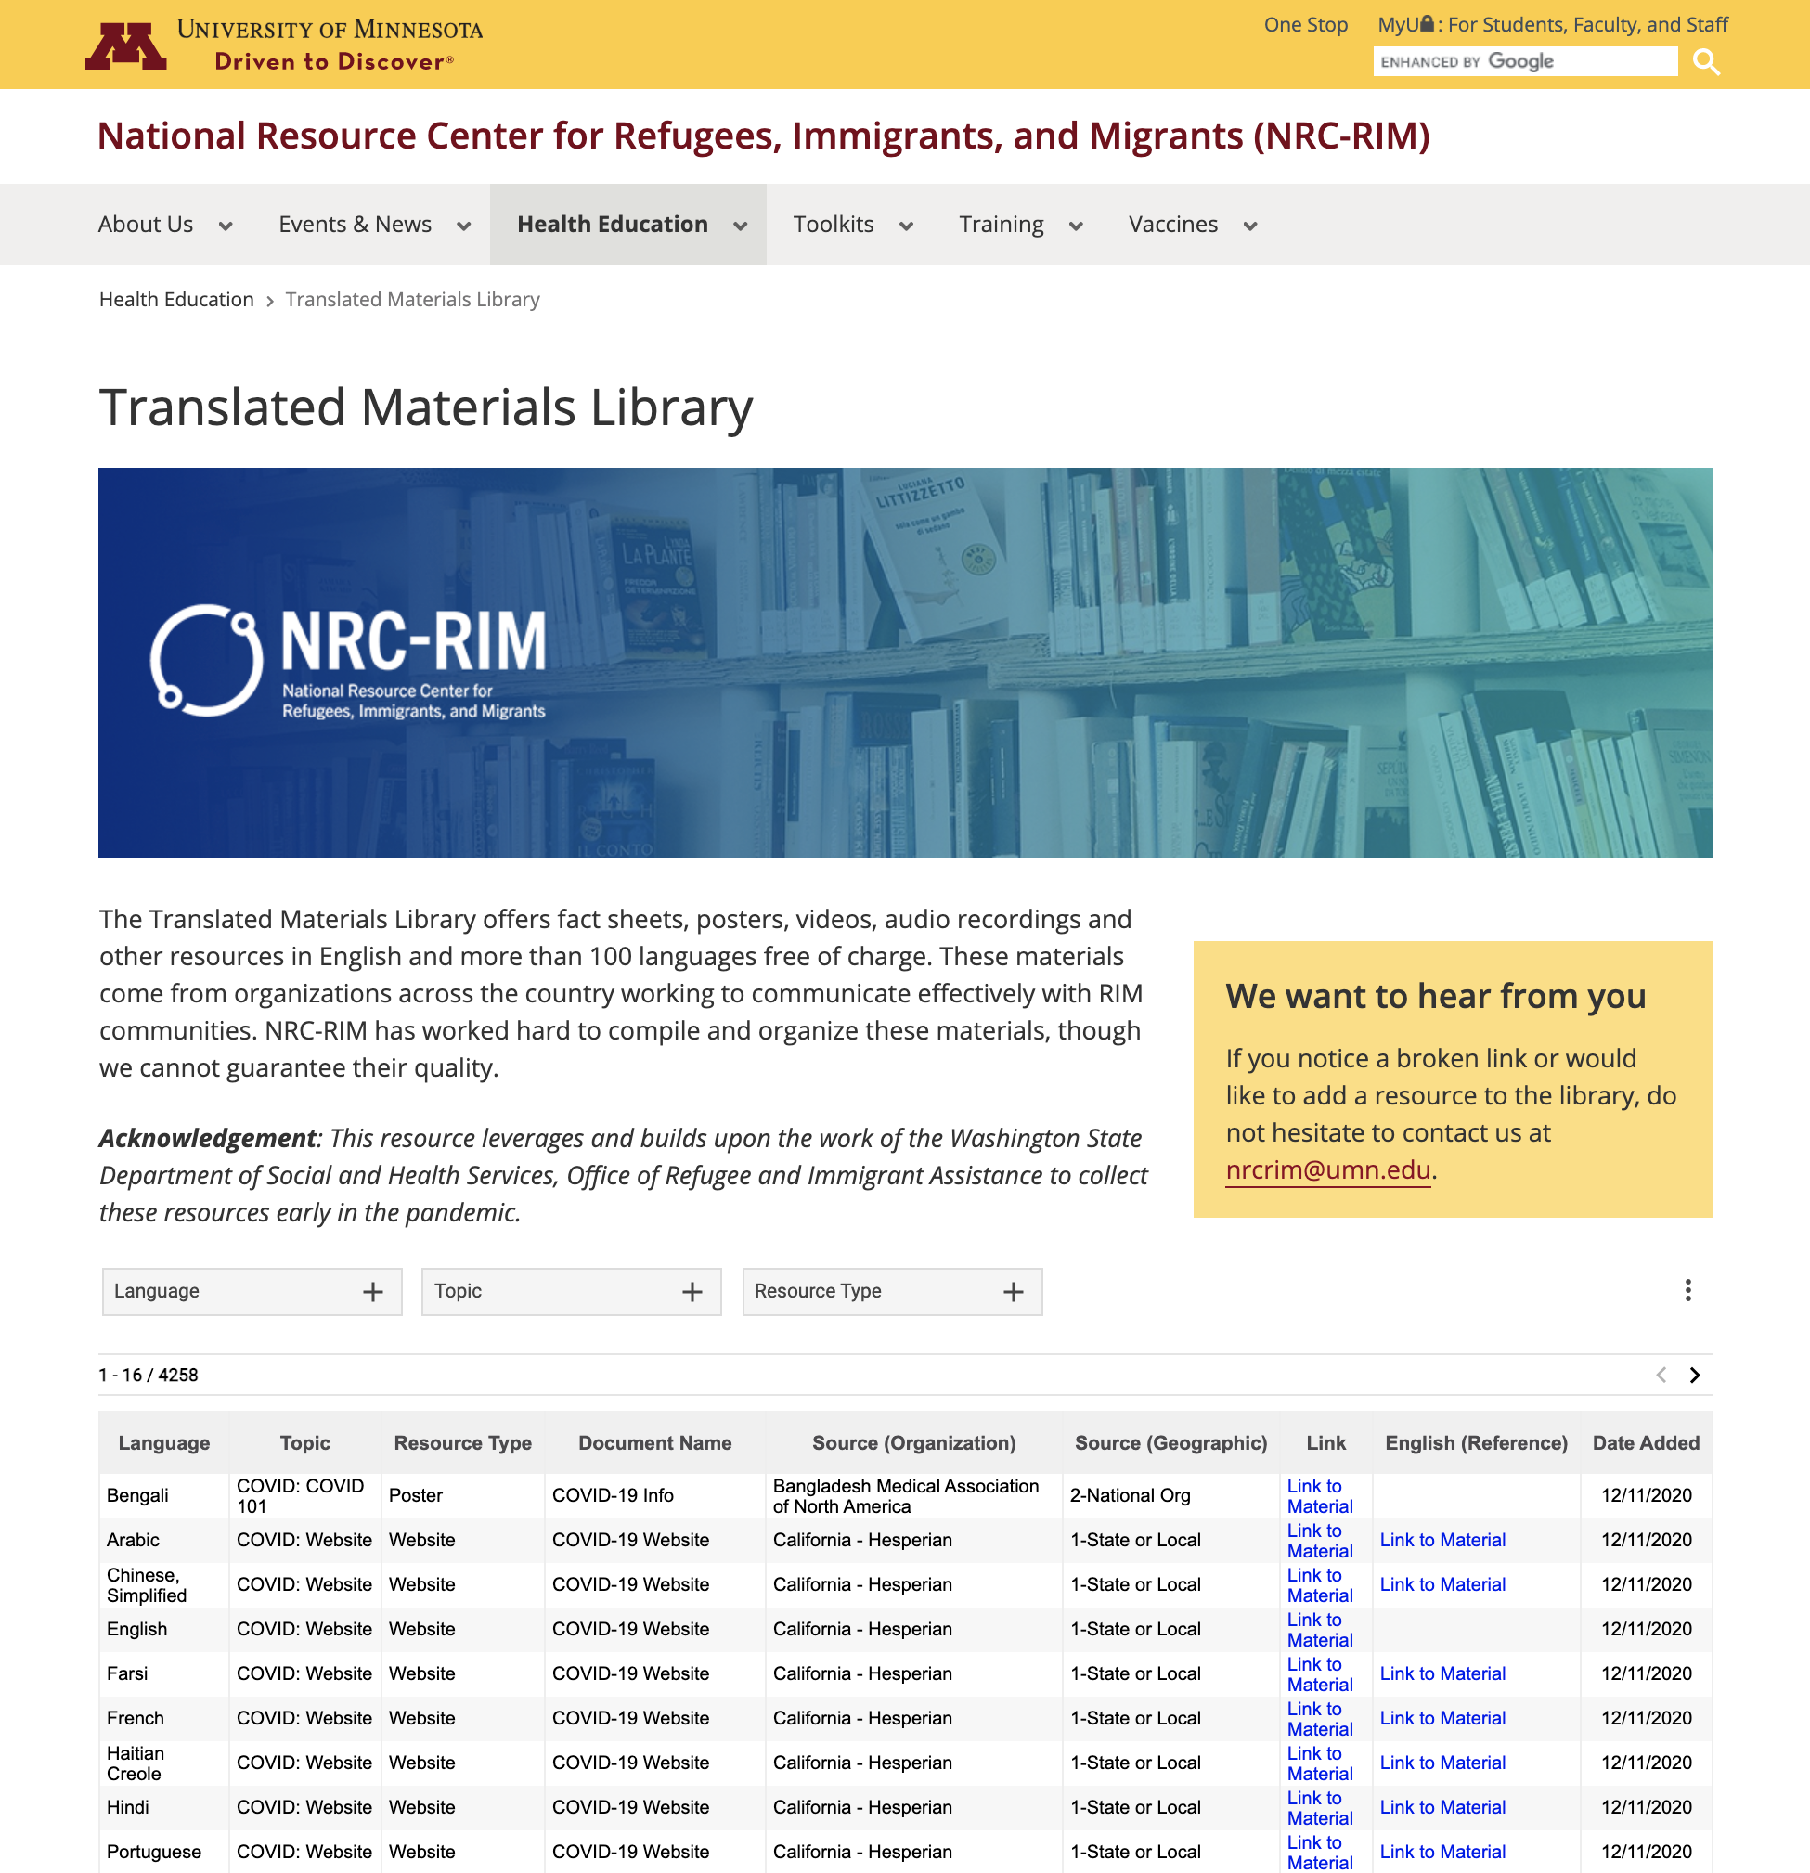
Resources
NRC-RIM translated materials library
nrcrim.org/health-education/translated-materials-library
Notes:
Script:
Additional resources can be found on our project’s website nrcrim.umn.edu. Here you can find posters, handouts, and other materials translated into a variety of languages.

Slide 54
6.
Summary
Let’s summarize what we’ve learned
Notes:
To finish, let’s summarize what we’ve learned.

Slide 55
Summary
The vaccine is safe.
The vaccine is effective.
The vaccine will not make one sick with COVID-19.
Notes:
Script:
As we come to the end of our vaccine discussion today, this slide highlights key takeaway points to remember about the vaccines.
The vaccine is safe – proper safety and testing procedures were followed.
The vaccine is effective. The high efficacy rates mean that the vaccine helps most people not to get sick. It also helps some people get less sick.
The vaccine works and will not make one sick with COVID-19.

Slide 56
Summary
The vaccine will be given in phases.
Getting the vaccine is free.
There may be an administration fee billed to insurance
No one can be denied a vaccine if they are unable to pay an administration fee
Notes:
Script:
The vaccine will be given in phases.
Getting the vaccine is free.
There may be an administration fee billed to insurance
No one can be denied a vaccine if there are unable to pay an administration fee

Slide 57
Summary
Certain RIM communities have been disproportionately impacted by COVID-19
Some may be hesitant to receive the vaccine.
They can be supported through:
Recognition of past trauma
Access to accurate, translated information
Other social supports
Notes:
Script:
Certain RIM communities have been disproportionately impacted by COVID-19
Some may be hesitant to receive the vaccine.
They can be supported through:
Recognition of past trauma
Access to accurate, translated information
Other social supports

Slide 58
Thank you
For additional resources, visit nrcrim.org

