Slide 1
U.S. Department of Education
How to be considered as a peer reviewer for programs administered by the Department

Slide 2
Contents
Benefits of being a Peer Reviewer
Selection and Requirements
Process to become a Peer Reviewer
Helpful Hints & Reminders

Slide 3
Benefits of Being a Peer Reviewer

Slide 4
Benefits of Being a Peer Reviewer
Serve the education community by providing your unique expertise
Be exposed to new innovative ideas to expand and enhance education
Service
Innovation
Network with and learn from other noted education colleagues
Make recommendations to the Department on which projects to fund
2
3
Development
Influence
1
4
Peer Reviewer Benefits

Slide 5
Selection & Requirements

Slide 6
Peer Reviewer Selection
The Department is organized by program offices, which oversee specific programs (grant competitions)
Example
Program Office
Program
(Grant Competitions)
Office of Postsecondary Education
Education Innovation & Research
(EIR)
Office of Elementary & Secondary Education
Office of Special Education and Rehabilitative Services
Magnet Schools
Assistance Program
(MSAP)
Note: This is illustrative, not exhaustive of all Program offices or Programs
Each Department program selects its own reviewers based on the expertise needed specific to a grant competition
In the above example, EIR and MSAP would be the specific programs selecting reviewers
If a reviewer is interested in a specific program, then he or she should look for that specific program’s call for reviewers
Note: the Department put a notice in the Federal Register in FY2024 here

Slide 7
Peer Reviewer Requirements
1
2
3
4
5
6
Department program specific expertise
Possess high-standards of analysis and evaluative writing
Objectivity when assessing grant applications
Must be able to put in the necessary time for reviewer training and review period
Ability to work independently and as a member of a team
Access to a phone, email, computer, the Internet, and the G5 grants management system

Slide 8
Process to become a Peer Reviewer
4-Step Registration process to be considered as a potential Department peer reviewer

Slide 9
4 – Step Registration Process
1
Register
in G5
2
Activate Your Account
3
Log into G5
(Two Factor Authentication)
4
Edit Your Reviewer Profile

Slide 10
Step 1: Registering with G5
Go to www.g5.gov
Click the Sign-up link
You will then be moved to the registration screen
Registration* screen
Enter the fields marked by a red asterisk (do not include dashes in phone numbers, do include your area code)
Enter a valid email address
Click the Continue button
Terms and Conditions Screen
If you agree to the terms listed, select the Agree radio button and click the Submit button.
Activation Link
An account activation email will be sent to the email address you provided
Click on the link provided. You will then be taken to G5 to activate your account
*If you have previously registered in G5 you do not need to register again. Once you register, G5 retains your information for consideration in future years, and you may go into and update your reviewer profile. Should you need assistance, contact the G5 Helpdesk at (888) 336-8930.

Slide 11
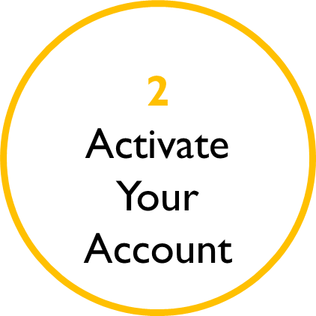
Step 2: Activating Your Account
Please read the user agreement, click the Agree radio button to acknowledge your compliance, and click the Submit button
Read the G5 User ID and Password Memorandum and click the Continue button
Enter the required fields and click the Continue button to finalize your activation
Click the Activate button to confirm the information you have entered and activate your account
Should you need assistance, contact the G5 Helpdesk at (888) 336-8930.

Slide 12
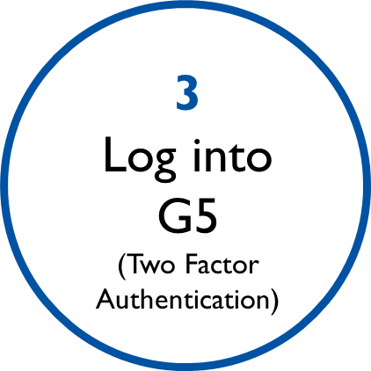
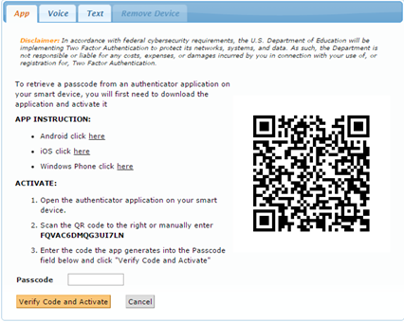
Step 3: Logging into G5
Go to www.g5.gov
After entering your Email ID and Password, you must check the box indicating that you accept the Department’s terms for using G5
Then click the Login to G5 button
You will have to check the Yes, I Accept the Terms checkbox each time you log into G5
Two Factor Authorization
You will have one of three ways to retrieve the unique code needed to complete the G5 log-in process:
App: Use an authenticator application on your smart device (click on the hyperlink for your specific mobile device to get instructions)
Voice: Receive Voice Call-Back
Text: Receive SMS Text
Use only one of the three options to retrieve the unique code necessary to log into G5
You will need to enter the 6-digit code generated into the Passcode field in G5
The authentication code is only valid for 30 – 60 seconds. If you do not enter the code in time, you will need to enter the next code that appears
Should you need assistance, contact the G5 Helpdesk at (888) 336-8930.

Slide 13
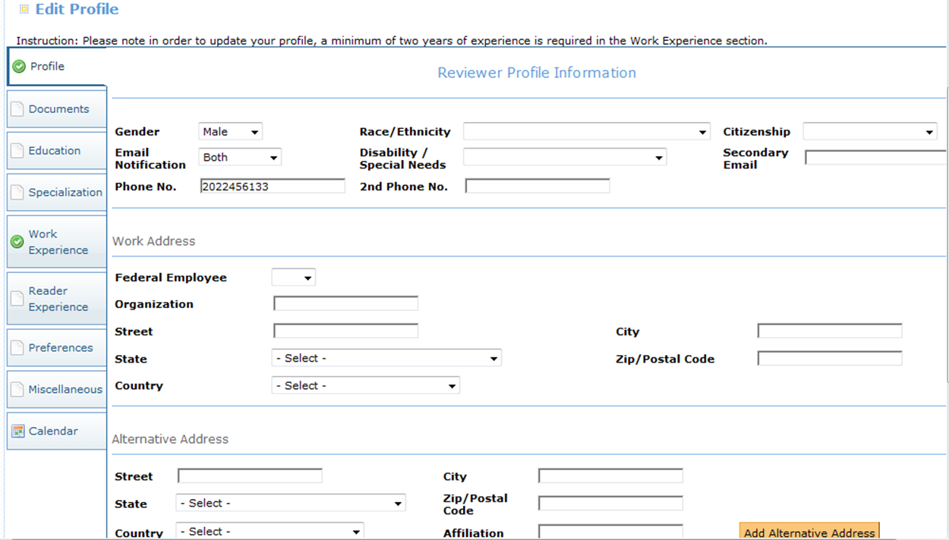
Step 4: Editing Your Reviewer Profile (1/2)
Once you have completed the Two Factor Authorization Log-in process, you will be directed to My Profile where you will need to select an available type of access
In this case you will select Reviewer and click the Continue button
Should you need assistance, contact the G5 Helpdesk at (888) 336-8930.

Slide 14
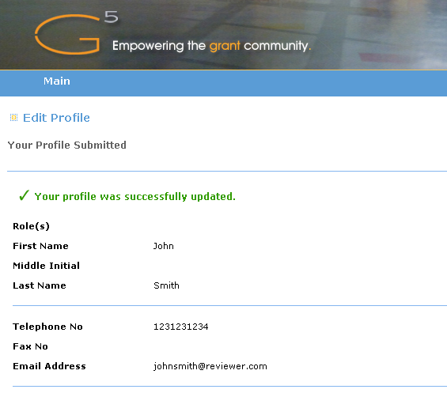
Step 4: Editing Your Reviewer Profile (2/2)
You must upload a resume on the Documents tab
All uploaded documents must be in a PDF format
You must also enter a minimum of two years of experience on the Work Experience tab
All other fields are optional
However, it is encouraged that you include the following in your profile: Specialization, Reader Experience, and Preferences*
After review, click the Submit button to request reviewer access
You will receive a confirmation message, like the one to the right, indicating your profile was successfully updated
The resume is now available to ED program staff to consider for a competition
You will need to log out and allow some time for your request to be processed
*For what Department grant competitions the reviewer wants to serve

Slide 15
Helpful Hints & Reminders

Slide 16
Helpful Resume Hints
Cite prior grant experience, i.e. writing, administering, evaluating, or reviewing
Be sure resume is complete, spell out abbreviations, and include dates
Keep it concise – suggest 2 pages, no longer than 5 pages
Highlight professional accomplishments and specific experiences

Slide 17
Final Reminders and Useful Links
Each Department program selects its own peer reviewers based on expertise needed specific to a grant competition
Neither submission of your resume or registering in G5 guarantees that you will be selected to be a peer reviewer
Individuals selected to be a peer reviewer will be contacted by the program office
If you have peers you would like to recommend that may be interested in being Department reviewers, please provide them this resource toolkit!
Relevant pages where new potential reviewers should go are below:
www.g5.gov
ED.gov
Federal Register
Grants.gov

